Slide 1
Διάλεξη 2
Εκτίμηση Σκηνής και Πρωτοβάθμια Εκτίμηση
Notes:
Instructor Notes
Welcome to Lesson 2: Scene Management and Patient Assessment.

Slide 2
Εκπαιδευτικά Αντικείμενα
  Η αναγνώριση κινδύνων που βρίσκονται στην «σκηνή του συμβάντος» και εκθέτουν σε κίνδυνο τους διασώστες, τους τραυματίες και τους παρευρισκόμενους.
  Η ανάπτυξη ενός πλάνου διαχείρισης χρησιμοποιώντας σημαντικές πληροφορίες που συγκεντρώθηκαν κατά την Πρωτοβάθμια Εκτίμηση.
  Η περιγραφή της αλληλεπίδρασης μεταξύ εκτίμησης και αντιμετώπισης κατά την Πρωτοβάθμια Εκτίμηση.
  Η αξιολόγηση της κατάστασης στο σημείο συμβάντος και η περιγραφή των αρχών της διαλογής σε καταστάσεις ΜΑΥ.
Notes:
Instructor Notes
At the completion of this lesson, the participant should be able to:
Identify the scene safety threats that pose a hazard to personnel, patients, and bystanders.
Recognize indications of intimate partner violence.
Evaluate emergency situations and apply the principles of triage to determine the most appropriate course of action
Apply an MUCC-compliant triage method to manage multiple-casualty incidents.

Slide 3
Πρώτη εντύπωση και εκτίμηση σκηνής
Εκτίμηση σκηνής :
  Γενική εντύπωση της σκηνής του συμβάντος
    Εμφανή στοιχεία
    Δυσδιάκριτα στοιχεία
  Σκεφτείτε πιθανούς κινδύνους και διαθέσιμα μέσα για ειδικές συνθήκες.
    Συνθήκες Ασφαλείας
    Ανταλλαγή πυρών
    Σκηνή εγκλήματος
    Όπλα μαζικών απωλειών υγείας
    Haz – Mat
    Οικογενειακή βία
  Σκεφτείτε επιπρόσθετα μέσα σύμφωνα με τις ανάγκες σας
Γενική εντύπωση της κατάστασης του τραυματία :
  Γρήγορη εκτίμηση της γενικής εικόνας του τραυματία.
Notes:
Instructor Notes
Expand on the following points.
Briefly review how to perform a scene size-up.
Scene Size-Up
Consider the possible safety hazards
General Impression - Obvious
Dispatch information – if available
MOI
Number of patients
Weather/Light
Location
General Impression – Subtle
Odors
Signs of domestic violence
Signs of gang activity
Smoke
Liquids around the scene
Consider the resources available.
EMS
Police
Fire
Electric company
HazMat team
More units
Light/Heavy rescue

Slide 4
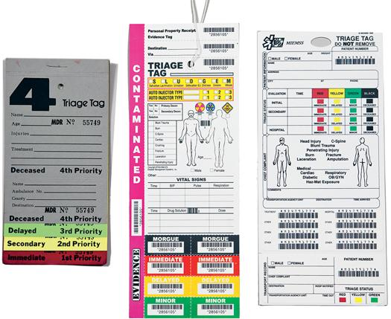
Διαλογή μαζικών απωλειών υγείας
Υπάρχουν πολλά συστήματα διαλογής.
Δεν υπάρχουν ικανοποιητικά δεδομένα για την επιλογή κάποιου. συστήματος
Οι διασώστες πρέπει να εξοικειωθούν με αυτό που χρησιμοποιείται στη χώρα τους.
AHDR : All Hazard Disaster Response – Triage
© File of Life Foundation, Inc.
Notes:
Instructor Notes
Expand on the following key points.
Discuss the local EMS mass-casualty triage system.
A model uniform core criteria (MUCC)-compliant triage method will effectively manage the scene and primary survey of multiple casualty incidents.
Ensure that participants understand the system may change depending on the location.
Ask participants for examples of other triage systems.
Discuss SALT versus START
Discuss how the general impression and primary survey are inappropriate for a mass-casualty incident.

Slide 5
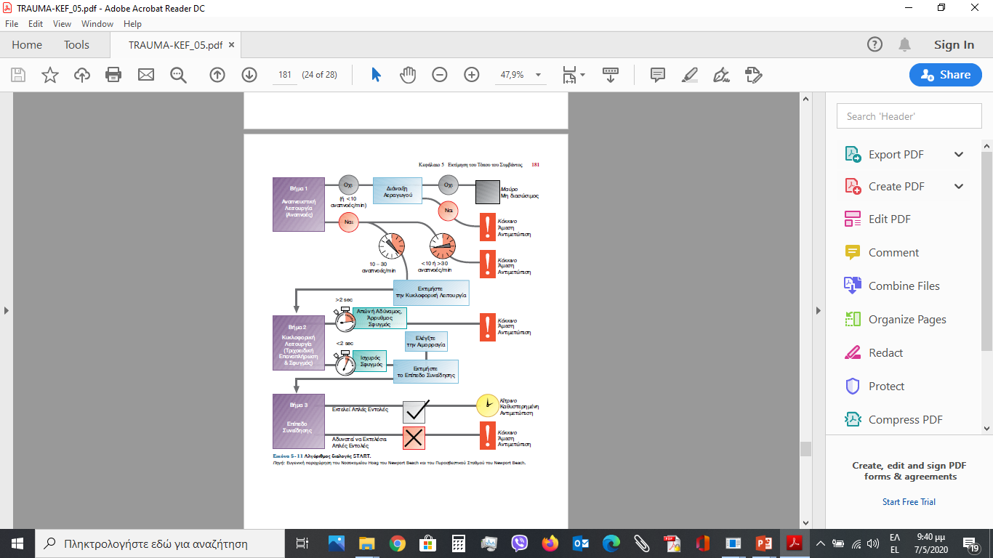
Αλγόριθμος Διαλογής
START:
30 – 2 – Can Do

Slide 6
Πρωτοβάθμια εκτίμηση
  X — Αναγνωρίστε μεγάλη εξωτερική αιμορραγία.
  A — Ελέγξτε για προβλήματα αεραγωγού.
  B — Αναγνωρίστε τα προβλήματα αερισμού.
  C — Βρείτε σημεία υποάρδευσης και ελέγξτε τις υπόλοιπες αιμορραγίες.
  D — Ελέγξτε τη νευρολογική κατάσταση.
  E — Ελέγξτε για άλλες κακώσεις/ προστατέψτε από υποθερμία.
Notes:
Instructor Notes
Expand on the following points.
Briefly review how to perform a scene size-up and primary survey for a trauma patient.
Primary Survey
X (eXsanguinating hemorrhage)—Identify severe external bleeding.
A (Airway management and cervical spine stabilization)—Identify airway compromise or potential for this to develop.
B (Breathing)—Identify breathing inadequacy or potential for this to develop.
C (Circulation)—Identify hypoperfusion; control mild to moderate bleeding.
D (Disability)—Identify neurologic dysfunction.
E (Expose/environment)—Identify significant injuries.

Slide 7
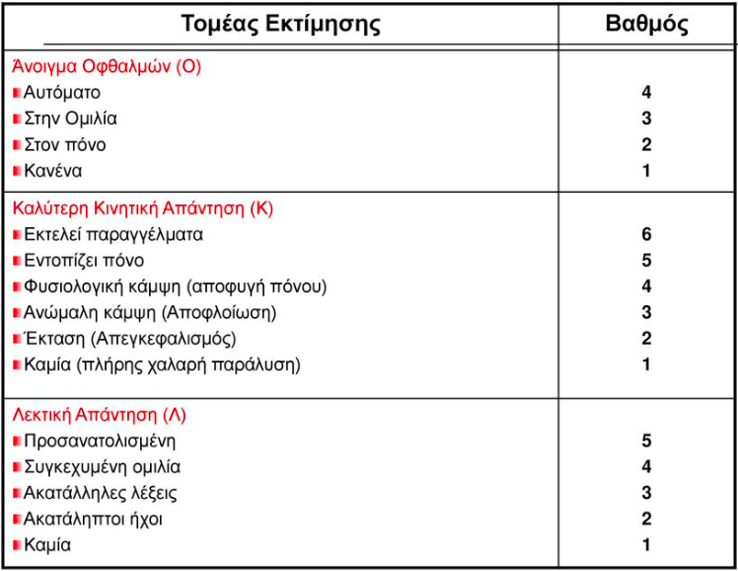
D : Επίπεδο Συνείδησης
Εναλλακτικά :
A – Ξυ
V – Λ
P – Ε
U – Δ
© Jones & Bartlett Learning.
Notes:
Instructor Notes
Expand on the following points.
The table lists the scoring in the Glasgow Coma Scale.
Review with participants as needed.

Slide 8
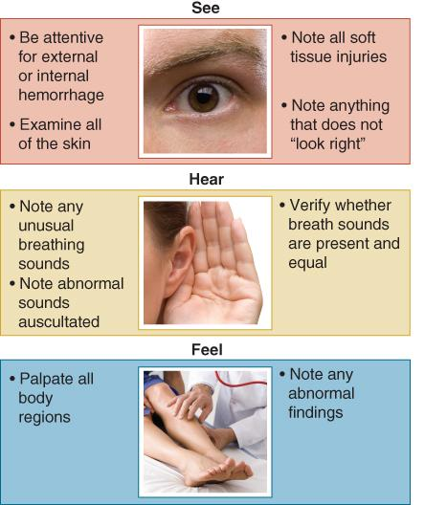
Δευτεροβάθμια Εκτίμηση
Ζωτικά Σημεία
SAMPLE
“Βλέπω – Ακούω – Αισθάνομαι”
Notes:
Instructor Notes
Continue to present the case to the participants:
•Secondary survey
•It is important to identify and treat all immediate life-threatening injuries, initiate resuscitation, and quickly package this patient for EMS transport to the appropriate trauma center.
•Typically, the secondary survey is completed during EMS transport and is intended to identify injuries or problems not identified during primary survey.
•Can you name a few interventions you have to perform on scene for this patient?
•Critical trauma patients shall be transported as soon as possible upon completion of primary survey and not retained for a secondary survey.
•What is the importance of vital signs during the secondary survey?
•To obtain a quantitative evaluation of the patient’s status
•A complete set of vital signs includes:
•Blood pressure (manual)
•Pulse rate and quality
•Ventilatory rate and depth
•Oxygen saturation
•Skin color and temperature
•SAMPLE history
Review each letter of the mnemonic SAMPLE.
•Signs and symptoms
•Allergies
•Medications
•Past medical history
•Last meal
•Events leading up to trauma
•What is the importance of the SAMPLE history during the secondary survey? Can you name some findings that would be discovered during the SAMPLE history?
•This is a mnemonic that serves as a good reminder for the information that should be documented for the patient care report and passed on to the responding emergency personnel or medical staff at the receiving hospital.
•“See, hear, feel”
•See:
•Be attentive for external or internal hemorrhage.
•Examine all of the skin.
•Note all soft-tissue injuries.
•Note anything that does not “look right.”
•Hear:
•Note any unusual breathing sounds.
•Note any abnormal sounds.
•Verify whether breath sounds are present and equal.
•Feel:
•Palpate all body regions.
•Note any abnormal findings.
•How would you use “see, hear, feel” to complete the secondary survey?
•“See, hear, feel” allows the prehospital care provider to “search” the body for injuries.

Slide 9
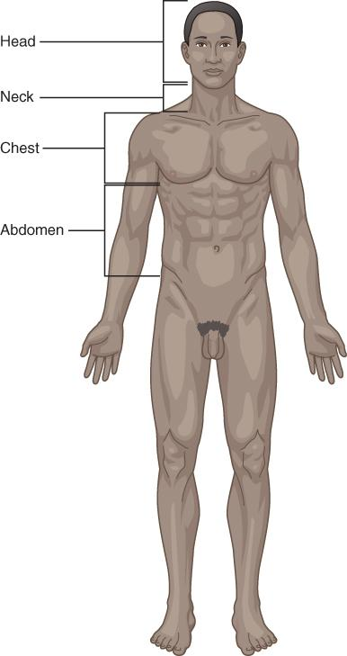
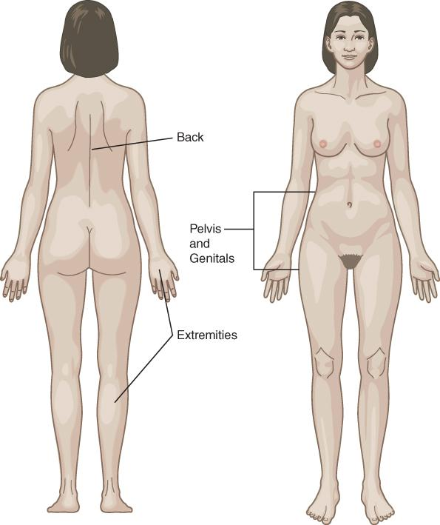
Ανατομικής Περιοχές του ανθρωπίνου σώματος
Κεφάλι
Τράχηλος
Θώρακας
Κοιλιά
Πύελος
Περιοχή γεννητικών οργάνων
Οπίσθια περιοχή του κορμού
Άκρα
© Jones & Bartlett Learning.
© Jones & Bartlett Learning.
Notes:
Instructor Notes
Expand on the following points:
•Anatomic regions of the body
•Head
•Neck
•Chest
•Abdomen
•Pelvis
•Genitals
•Back
•Extremities
Participant engagement
•Review the anatomic regions of body as they pertain to the secondary survey for first responders. Discuss each anatomic region briefly and what you might “see,” “feel,” or “hear.”
•What do you want to look for on the patient’s head?
•Look for any contusions, abrasions, lacerations, deformities, and hemorrhage of both the face and skull.
•Check pupil size and reactivity.
•This patient has equal and reactive pupils with no other injuries found.
•What should you look for on the patient’s neck?
•Assessment of the neck should be done prior to the application of a cervical collar.
•Try to look for the location of the trachea, any contusions, abrasions, lacerations, and hematomas.
•If there is clinical concern, the patient should be examined with inline stabilization to assess for potential injury.
•This patient’s trachea is mid-line with no other issues noted.
•What would you look for on the patient’s chest that would indicate injury?
•Deformities, paradoxical movement, contusions, and abrasions
•There should be equal chest expansion equally bilaterally with no trauma noted.
•It can often be challenging to auscultate for a pneumothorax in the prehospital environment.
•What are you looking for when you assess the patient’s abdomen?
•Look for any abrasions, ecchymosis, and distension.
•Remind participants that abdominal trauma may not show immediate signs of bleeding and that frequent reassessment of the abdomen should be performed.
•What are you feeling/looking for when you assess the patient’s pelvis?
•Look for signs of trauma, such as abrasions or bruising.
•Palpation of the pelvis for stability (gently palpate, as excessive pressure will cause pain for the patient)
•What are you looking for when you assess the patient’s genitalia?
•Look for bleeding or signs of trauma, such as abrasions or other wounds.
•What are you looking for when you assess the patient’s back?
•Look for signs of trauma, such as bleeding, bruising, or wounds.
•Remind participants that injuries can be missed if the patient’s back is not assessed, which can result in poor patient outcome.
•What are you feeling/looking for when you assess the patient’s extremities?
•Look for signs of trauma, such as bleeding, bruising, or wounds.
•Palpate each extremity and check for pulse, movement, and sensation.

Slide 10
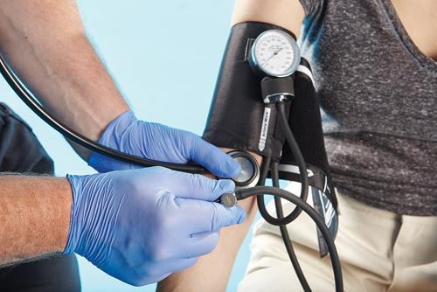
Ζωτικά Σημεία
Αρτηριακή Πίεση
Σφυγμός
Αναπνοή
Θερμοκρασία σώματος
ΕΠΙΚΟΥΡΙΚΑ
Οξυμετρία : SpO₂
Σάκχαρο Αίματος
© Jones & Bartlett Learning.
Notes:
Instructor Notes
Expand on the following key points.
•Manual blood pressure
•Explain that it is important to take a manual blood pressure initially so that a known baseline is established.
•Automatic blood pressure cuffs do not evaluate a blood pressure appropriately in the hypotensive patient.
•Discuss what hypertension and hypotension could mean in the trauma patient.
•Explain that both hypertension and hypotension can be deadly in the trauma patient.
•Hypertension can be a sign of a traumatic brain injury, and hypotension shows that the end-cell oxygenation is not great enough to sustain life, which could be due to a neurologic issue or hypovolemia.
•Pulse rate and quality
•Discuss why you need to obtain a pulse rate, exact numbers, and the quality of the pulse during the secondary survey of the trauma patient.
•Discuss what types of pulse rates and qualities could be detrimental to the trauma patient.
•Explain that a thready or absent radial pulse could be a sign of hypovolemia.
•Explain that a rapid pulse could be an early indicator of shock.
•A slow heart rate is just as concerning, but is this a true bradycardia or is the bradycardia masking injuries because this patient is on a beta blocker?
•Ventilatory rate and quality (including breath sounds)
Discuss why, when measuring the patient’s ventilatory rate, exact numbers are important.
What does it mean if a patient is breathing too fast? Too slow? Irregularly?
What breath sounds would lead you to suspect an underlying injury that you would not see during the primary survey?
Explain that irregular breathing patterns can lead you to suspect a head injury.
Explain that absent breath sounds on one side combined with signs of shock or severe difficulty breathing should make you suspicious of a pneumothorax.
Oxygen saturation (SpO2)
Discuss what an oxygen saturation means to the prehospital care provider.
How reliable is this number? (Discuss how hypotension and vasoconstriction can affect (SpO2) readings.)
Blood glucose
Discuss why a glucose level is important to the trauma patient.
Participant engagement
Discuss the equipment utilized to assess vital signs in your agency.

Slide 11
Ιστορικό SAMPLE
S — Symptoms : Συμπτώματα
A — Allergies : Αλλεργίες
M — Medications : Φάρμακα
P — Past medical and surgical history : Ιατρικό Ιστορικό
L — Last meal : Τελευταίο γεύμα
E — Events : Γεγονότα
Notes:
Instructor Notes
Continue presenting the case to participants.
SAMPLE History
S — Symptoms
A — Allergies
M — Medications
P — Past medical and surgical history
L — Last meal
E — Events
Participant engagement
Ask participants to give you examples of questions to ask the case study patient in order to determine the SAMPLE history.
The secondary survey was completed while waiting on medical helicopter.
•The case study patient has the following history:
S — Right leg pain
A — None
M — Fexofenadine
P — Hay fever
L — Breakfast: bacon, lettuce, and tomato sandwich
• E — While performing maintenance on an industrial machine, it was powered on by accident.
•The patient’s vital signs:
•BP: 90/50 mm Hg
•Heart rate and quality: 130 beats/min, regular and weak at the radial pulse
•Ventilation rate: 20 breaths/min, deep with adequate chest rise
•SpO₂: 94% on room air
•Glucose: 106 mg/dL (6.9 mmol/L)
•Skin condition and temperature: pink, warm, and dry
•Temperature: 97°F (36°C)
•Pain: 8/10 to right leg (10/10 on movement and palpation)

Slide 12
Παρουσίαση περιστατικού:
Σας καλούν σε βιομηχανικό χώρο για εγκλωβισμό εργάτη σε μηχανή.
  34 ετών άνδρας με εγκλωβισμό κάτω άκρου σε βιομηχανική μηχανή.
  Ανταποκρίνεται και διασωστικό όχημα πυροσβεστικής.
  Προβλεπόμενος χρόνος άφιξης ασθενοφόρου 10 λεπτά.
  Μικρό νοσοκομείο σε 15 λεπτά απόσταση.
  Μεγάλο νοσοκομείο (Κέντρο Τραύματος) 45 λεπτά απόσταση.
Notes:
Instructor Notes
Present the case to the participants.
A 34-year-old male was working in an industrial plant when his right leg got caught in a machine.

Slide 13
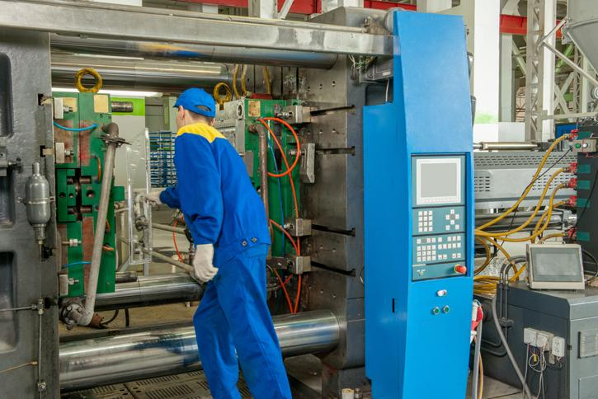
Εκτίμηση σκηνής
Ποιοι είναι οι πιθανοί κίνδυνοι σε αυτή την σκηνή ;
© Albert Karimov/Shutterstock
Notes:
Instructor Notes
Continue to present the case to the participants.
Canvass the group to identify possible safety issues.
Is the machinery still operating or operational?
Are there nearby machines or equipment that is still operating that could risk personnel safety?
Is there an associated spillage of hazardous material (i.e., toxic, slip hazard, flammable, etc.)?
Is the environment safe (i.e., fumes, noise, level surfaces, trip hazards, confined space, fire/explosion risk)?
Is the machinery stable and safe to approach?
How many workers have been injured? Are all other workers accounted for?
Do you have sufficient resources to respond to this incident to address scene safety issues?

Slide 14
Εξέλιξη περιστατικού
Οι πυροσβέστες φθάνουν πριν από εμάς.
Έχουν απεγκλωβίσει το θύμα που τώρα κάθεται με πλάτη στον τοίχο.
Σας αναφέρουν πώς το πόδι ήταν εγκλωβισμένο μέχρι το γόνατο.
Δεν υπήρξε πτώση ή άλλη κάκωση.
Notes:
Instructor Notes
Continue to present the case to the participants. Begin a discussion with participants by asking the following questions.
The patient is in a large, well-lit room at a safe distance from the stopped and partially disassembled machine.
Is the scene safe enough to approach the patient?
Are more resources needed to manage the scene?

Slide 15
Γενική εντύπωση
Ο ασθενής είναι ξύπνιος αλλά ωχρός.
Το δεξί πόδι είναι τυλιγμένο με ματωμένες γάζες που στάζουν αίμα.
Λεκές αίματος από το σημείο της μηχανής μέχρι τον ασθενή.
Notes:
Instructor Notes
Continue to present the case to the participants.
The patient’s right pant’s leg is torn and the dressings are not controlling the bleeding.
There is a large amount of blood staining the patient’s pants and shirt.
Estimated blood loss on scene is 1.5 liters.

Slide 16
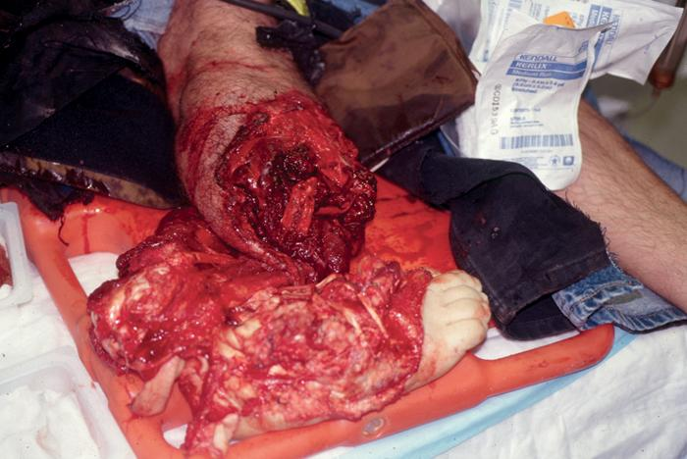
Γενική εντύπωση
Ποιος είναι ο μηχανισμός κάκωσης ;
Ακινητοποιούμε αυχένα ;
Τα μέσα μας αρκούν για τη φροντίδα του ασθενή ;
Courtesy of Peter T. Pons, MD, FACEP.
Notes:
Instructor Notes
Continue to present the case to the participants.
Ask participants to provide the mechanism of injury (MOI).
Can participants visualize what happened without “filling in the gaps” with assumptions?
What protective equipment was used (i.e., helmet, gloves, etc.)?
How was the leg pulled into the machine (i.e., did he fall into the machine, associated joint or muscle injuries, etc.)?
How was the leg removed (i.e., pulled out, or was the machine removed from around the leg)?
How much blood has been lost (i.e., was the bleeding severe while trapped or was it tamponaded or tourniqueted by the machine, etc.)?
How severe was the bleeding prior to bandaging (i.e., free flow or pulsatile flow, etc.)?
Is cervical spine motion restriction indicated?
MOI does not suggest the need for cervical spine motion restriction.
Do you have enough resources to manage this patient?
Is there an indication for launching a helicopter to assist with transport?

Slide 17
Πρωτοβάθμια Εκτίμηση
X — Μεγάλη αιμορραγία στο δεξί πόδι
A — Ανοικτός αεραγωγός.
B — Γρήγορες αναπνοές
C — Δέρμα ωχρό και υγρό, γρήγορος κερκιδικός σφυγμός.
D — GCS : 15.
E — Δεν αισθάνεται, δεν κινεί το πόδι, δεν έχει σφυγμό περιφερικά της κάκωσης.
Notes:
Instructor Notes
Walk participants through the results of the primary survey.
X—Control severe external bleeding with direct pressure on the dressings while a tourniquet is applied.
A—Airway is patent.
B—Encourage the patient to continue deep breathing. Provide supplemental oxygen as needed to maintain an SpO₂ of 94% or greater.
C—Reassessment of skin condition and pulses necessary to continue to monitor for hemorrhagic shock.
D—Reassessment of mental status is key to determining the progression of shock; get the baseline.
Pupil assessment is not required if GCS = 15.
E—Right leg is avulsed from the knee to the toes; open fracture of the tibia and fibula – however, this information is unknown at this time because the dressings should not be removed in this scenario. Make sure students understand that in this scenario – obvious signs of shock and blood dripping from the dressing – there is no indication to remove the bandage from the leg and that placement of a tourniquet at the mid thigh immediately is indicated as a life-saving maneuver. The dressing may be reinforced as needed, but the goal is to stop exsanguinating hemorrhage and minimize scene time. Care on scene should be limited to: apply a proximal tourniquet, administer oxygen, reinforce the dressing, cover with a blanket and transport – with IV en route.

Slide 18
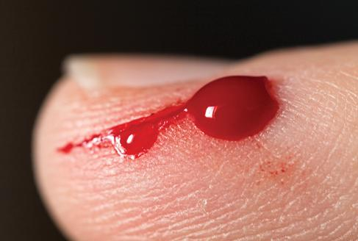
Συζήτηση
Τριχοειδική αιμορραγία
  Προκαλείται από επιφανειακή σχάση του δέρματος.
  Αντιμετωπίζεται με απλή πίεση.
© Sasha Radosavljevic/iStock/Getty Images.
Notes:
Instructor Notes
Begin a discussion with participants on how to best recognize the type of bleeding/hemorrhage the patient has. Also discuss the best initial treatments.
Capillary bleeding
Caused by abrasions that have scraped open the tiny capillaries beneath the skin
Occurs with all wounds, is slight, and easily controlled with direct pressure

Slide 19
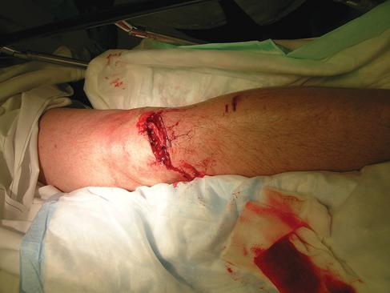
Συζήτηση
Φλεβική αιμορραγία
  Κάκωση φλεβών
  Από βαθύτερη σχάση ιστών.
  Συνήθως ελέγχεται με άμεση πίεση.
© E.M. Singletary, M.D. Used with permission.
Notes:
Instructor Notes
Begin a discussion with participants on how to best recognize the type of bleeding/hemorrhage the patient has. Also discuss the best initial treatments.
Venous bleeding
Originates from deeper in the tissue
Not under direct pressure from the pumping heart, so blood flows evenly
Veins carry the same volume of blood as the arteries, but bleeding can be controlled with direct pressure.

Slide 20
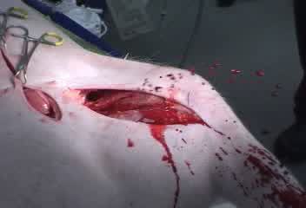
Συζήτηση
Αρτηριακή αιμορραγία
  Κάκωση αρτηρίας.
  Ελέγχεται δύσκολα.
  Το αίμα εκτινάσσεται κατά ώσεις (σφυγμικό).
  Μπορεί να προκαλέσει σοβαρή υπογκαιμία απειλητική για την ζωή.
Notes:
Instructor Notes
Begin a discussion with participants on how to best recognize the type of bleeding/hemorrhage the patient has. Also discuss the best initial treatments.
Arterial bleeding
Under direct pressure from the pumping heart, so blood will spurt with each heartbeat
Because this bleeding is under pressure, blood loss can be severe in a short amount of time and bleeding control can be more challenging.
It is characterized by spurting red blood and can quickly result in life-threatening hypovolemia.

Slide 21
Άμεσες ενέργειες απειλητικών κακώσεων
Ποιες είναι οι απειλητικές κακώσεις ;
Τι ενέργειες απαιτούνται ;
Courtesy of Peter T. Pons, MD, FACEP.
Notes:
Instructor Notes
Continue discussing the patient’s case with participants.
Ask participants to name the potential life threats.
Exsanguinating hemorrhage
Ask what treatment technique is indicated for the patient in this case.
External hemorrhage control
Direct pressure
Tourniquet
Provide supplemental oxygen to avoid hypoxia secondary to blood loss or loss of red blood cells (RBCs).
Ask what the participants’ preferences would be to secure and immobilize this patient’s injuries.
Discuss how important splinting and bandaging is, even on the lactic acidosis syndrome (LAS) level to avoid further injury to blood vessels and/or nerves.
Discuss how proper splinting is often overlooked as having importance in patient management and outcomes.
While proper splinting can make the difference as to whether a patient has permanent damage and effects from an injury, there is no evidence that splinting an injury such as the one in this scenario makes any difference. In this scenario, speed is what counts, as the patient is already in shock and can die from blood loss.

Slide 22
Εξέλιξη
X — Μεγάλη αιμορραγία στο δεξί πόδι, ελέγχθηκε με τουρνικέ.
A — Ανοικτός αεραγωγός.
B — Γρήγορες αναπνοές (20/λεπτό), χορήγηση οξυγόνου.
C — Δέρμα ωχρό και υγρό, γρήγορος κερκιδικός σφυγμός.
D — GCS : 15.
E — Δεν αισθάνεται, δεν κινεί το πόδι, δεν έχει σφυγμό περιφερικά της κάκωσης.
Notes:
Instructor Notes
Walk participants through the results of the primary survey.
X—Control severe external bleeding with direct pressure on the dressings while a tourniquet is applied.
A—Airway is patent.
B—Encourage the patient to continue deep breathing. Provide supplemental oxygen as needed to maintain an SpO₂ of 94% or greater.
C—Reassessment of skin condition and pulses necessary to continue to monitor for hemorrhagic shock.
D—Reassessment of mental status is key to determining the progression of shock; get the baseline.
Pupil assessment is not required if GCS = 15.
E—Right leg is avulsed from the knee to the toes; open fracture of the tibia and fibula – however, this information is unknown at this time because the dressings should not be removed in this scenario. Make sure students understand that in this scenario – obvious signs of shock and blood dripping from the dressing – there is no indication to remove the bandage from the leg and that placement of a tourniquet at the mid thigh immediately is indicated as a life-saving maneuver. The dressing may be reinforced as needed, but the goal is to stop exsanguinating hemorrhage and minimize scene time. Care on scene should be limited to: apply a proximal tourniquet, administer oxygen, reinforce the dressing, cover with a blanket and transport – with IV en route.

Slide 23
Συζήτηση
Αν ήταν αναίσθητος, με ρηχές και γρήγορες αναπνοές (> 30 αναπνοές / λεπτό), θα άλλαζε η αρχική αντιμετώπιση ;
Διαχείριση των απειλητικών για την ζωή καταστάσεων.
Πρώτα αντιμετωπίστε τις απειλητικές για τη ζωή κακώσεις.
Notes:
Instructor Notes
Begin a discussion with participants by asking the following question.
If the patient was unresponsive, breathing shallow and fast > 30 breaths/minute (breaths/min), how would we initially manage the patient?
Manage all life threats first.
Life threats
The patient can be managed simultaneously with multiple rescuers.
Manage uncontrolled arterial bleeding from the right leg with direct pressure and tourniquet.
Airway adjunct placed and ventilation with a bag-mask device at 12 breaths/min started to achieve proper tidal volume.
Secure the airway with an advanced airway prior to transport.

Slide 24
Συζήτηση
Που θα τον διακομίσετε ;
Πως θα τον μεταφέρετε ;
Η δευτεροβάθμια εκτίμηση θα γίνει στη σκηνή ή καθοδόν ;
Notes:
Instructor Notes
Note: Secondary Survey is discussed in Lesson 6 and is not covered in detail in this lesson.
Ask the first question and base your response on the participants’ answers. Encourage discussion. Ask for and provide the pros and cons of participants’ answers.
Do you have enough information based on the primary survey to determine this patient is critical and needs a trauma center?
Yes, the patient has a mangled and pulseless limb.
Where should this patient be transported?
Rapid transport to a level I trauma center.
How should this patient be transported?
Helicopter transport is faster even if it is launched at this point.
Which is a greater safety risk, emergent ground transport or air transport?
Should the secondary survey be performed on scene or should transport be initiated?
Transport should be initiated.
When should a secondary survey be conducted?
A secondary survey should be conducted as soon as possible without delaying transport.

Slide 25
Περίληψη περιστατικού
Ολοκληρώθηκε η πρωτοβάθμια εκτίμηση.
Αντιμετωπίστηκαν οι απειλητικές κακώσεις.
Ο ασθενής μεταφέρθηκε στο κέντρο τραύματος και μπήκε στο χειρουργείο.
Πήρε εξιτήριο σε μια εβδομάδα, μετά από ακρωτηριασμό του άκρου.
Notes:
Instructor Notes
Briefly provide closure to the case and ask if there are any questions about the case.
Primary survey completed and managed all life threats
Patient transported by helicopter to a level I trauma center and was admitted for surgical repair
Patient was discharged 1 week later after an above-knee amputation of the right leg to a rehabilitation unit and physical therapy.
Participant engagement
Discuss the selection of transportation destination criteria.
Discuss trauma center designation and capabilities (level I versus level II and level III).

Slide 26
Κρίσιμες ενέργειες
Σε αυτό το περιστατικό:
  Έλεγχος εξωτερικής αιμορραγίας.
    Άμεση πίεση
    Tourniquet
  Χορήγηση οξυγόνου.
  Προστασία από την υποθερμία.
    Χρήση κουβέρτας
  Ενδοφλέβια αγωγή.
    Χορήγηση υγρών για υποστήριξη κυκλοφορικού
Notes:
Instructor Notes
Highlight the critical actions in this case study.
Providing external hemorrhage control
Direct pressure
Tourniquet
Providing supplemental oxygen to avoid hypoxia secondary to blood loss or loss of RBCs
Covering the patient with a blanket
To prevent heat loss
IV therapy
Fluid administration to support perfusion

Slide 27
Ανακεφαλαίωση
Προτεραιότητες μας κατά την «πρωτοβάθμια εκτίμηση» :
  Ασφάλεια σκηνής
  Φροντίδα τραυματία – Απειλητικές για την ζωή κακώσεις
  X – ABCDE
Αντιμετωπίστε τις απειλητικές κακώσεις αμέσως.
Υποψιαστείτε τις «κρυφές κακώσεις»
Προσεχώς: «Αεραγωγός»
Notes:
Instructor Notes
Expand on the following key points.
Briefly review the components of the primary survey.
Stress the importance of scene safety and situational awareness.
Scene safety of prehospital care providers and the patient is the priority.
All life threats are to be managed as soon as discovered.
Maintain a high index of suspicion for subtle life-threatening injuries.
Coming up:
Lesson 3: Airway

