Slide 1

Διάλεξη 1
Εισαγωγή & Επισκόπηση του PHTLS for First Responders
Notes:
Instructor Notes
Welcome to the Prehospital Trauma Life Support Course (or PHTLS) for First Responders, presented by the National Association of Emergency Medical Technicians (NAEMT).

Slide 2
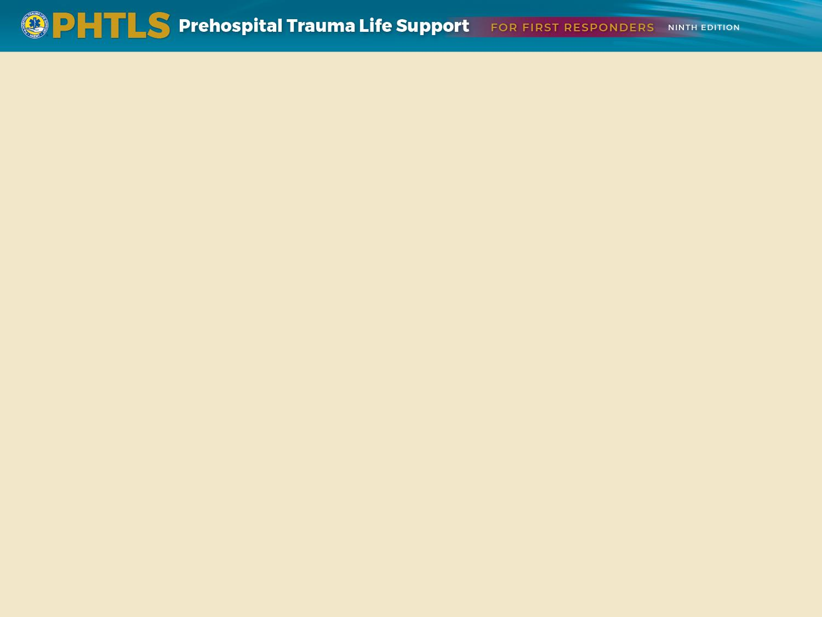
Εκπαιδευτικά Αντικείμενα
Επίδειξη ασφαλούς και αποτελεσματικής διαχείρισης σκηνής, συμπεριλαμβανομένων πρακτικών προστασίας από λοιμώξεις που ισχύουν για όλους τους ασθενείς
Διεξαγωγή πρωτοβάθμιας εκτίμησης τραυματία, με έμφαση στον εντοπισμό και την αντιμετώπιση των άμεσων απειλητικών για τη ζωή τραυματισμών
Εφαρμογή κατάλληλων τεχνικών ελέγχου της αιμορραγίας
Διεξαγωγή Δευτεροβάθμιας εκτίμησης τραυματία, όταν αυτό κρίνετε απαραίτητο
Επικοινωνία με το Νοσοκομείο παράδοσης του τραυματία
Notes:
Instructor Notes
At the completion of this course, the participant should be able to:
Demonstrate safe and effective scene management, including infection protection practices that apply to all patients
Conduct a simple primary survey with emphasis on identifying and managing immediate life-threatening injuries
Apply anatomically appropriate hemorrhage control techniques
Perform basic airway management in a critically injured patient
At the completion of this lesson, the participant should be able to:
Recognize signs and symptoms of shock and provide basic care procedures
Demonstrate appropriate management practices in skeletal and central nervous system trauma patients
Perform a secondary assessment
Communicate pertinent patient information to transporting EMS agency

Slide 3
Οικονομικές Επιπτώσεις του «Τραύματος»
Θάνατοι από «Τραύμα»
Οικονομικές επιπτώσεις
Επιπτώσεις από την παρέμβαση των «Πρώτων Ανταποκριτών»
Notes:
Instructor Notes
Expand on the following points.
Trauma deaths
Unintentional injury is leading cause of death between ages of 1 and 45.
Results in 14,000 deaths each day worldwide due to an injury
Combined total deaths from diseases such as malaria, tuberculosis, and HIV/AIDS amount to approximately half as many deaths as those resulting from injury.
Economic impact
Financial burdens are incurred to care for those who survive traumatic events.
National Safety Council estimated a financial impact of approximately $886.4 billion in 2015 from both fatal and nonfatal trauma in the United States.
Wages and productivity lost was approximately $458 billion annually due to trauma, more than twice as much as the costs associated with injuries resulting in fatalities.
To compare, costs associated for cancer and heart diseases per patient are much less.
Impact of first responders
First responders can reduce the costs of trauma in society by using their skills and equipment properly.
For example, protecting a fractured cervical spine properly may make a difference between quadriplegia and productive, healthy life with unrestricted activity.

Slide 4
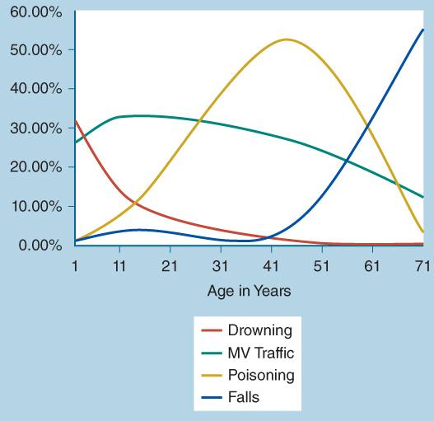
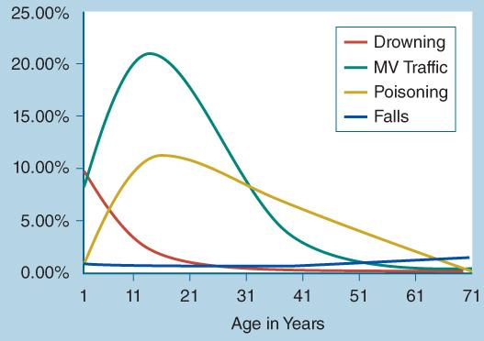
Κοινωνικές επιπτώσεις του «Τραύματος»
Data from the National Center for Injury Prevention and Control: WISQARS. Leading Causes of Death Reports 1981-2015. Centers for Disease Control and Prevention. https://webappa.cdc.gov/sasweb/ncipc/leadcause.html."
Data from the National Center for Injury Prevention and Control: WISQARS. Leading Causes of Death Reports 1981-2015. Centers for Disease Control and Prevention. https://webappa.cdc.gov/sasweb/ncipc/leadcause.html.
Notes:
Instructor Notes
Expand on the following points.
Worldwide, injury has a profound effect on society.
Over 5 million people die annually as a result of injury, accounting for 9% of deaths.
Motor vehicle collisions (MVCs) and drowning are substantial causes of death in early life.
Examining death rates due to trauma is only the tip of the iceberg.
The number one cause of nonfatal injuries in the United States during 2015 was unintentional falls.
More than 3 million patients hospitalized, 27 million treated in emergency departments and released
Review these sobering statistics.
The Centers for Disease Control and Prevention (CDC) lists the top 10 causes of traumatic death by age group.
MVCs are among the top causes of death for any age group.
Inattentiveness to driving is a major cause of motor vehicle fatalities and injuries in the United States.
At an individual level, injuries can have a devastating impact on the quality of life. As participants if they can think of any examples they have witnessed.

Slide 5
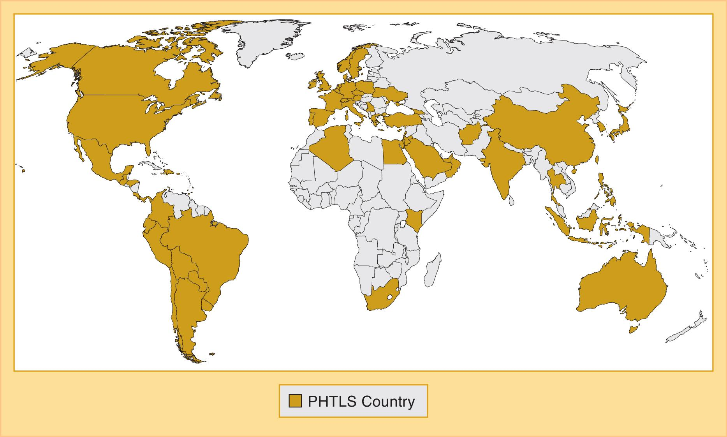
Ιστορία του PHTLS
Notes:
Instructor Notes
Expand on the following points.
Past:
Based on the Advanced Trauma Life Support (ATLS) course started in 1978
2 years after a plane crash involving the pilot (orthopedic surgeon), wife, and four children in a rural area of Nebraska
Norman McSwain, known as the father of PHTLS, established a draft curriculum of what became Prehospital Trauma Life Support (PHTLS).
PHTLS committee established in 1983.
Brings work of practitioners and researchers around the globe together to determine standards of trauma care for the new millennium
Support of the PHTLS family worldwide enables PHTLS leadership to keep PHTLS growing.
Builds upon each participant’s current knowledge base and skills to enrich critical thinking and problem-solving abilities
Stresses importance of teamwork between providers with various levels of knowledge, skills, and resources
Provides environment conducive to learning to practice trauma assessment and treatment skills

Slide 6
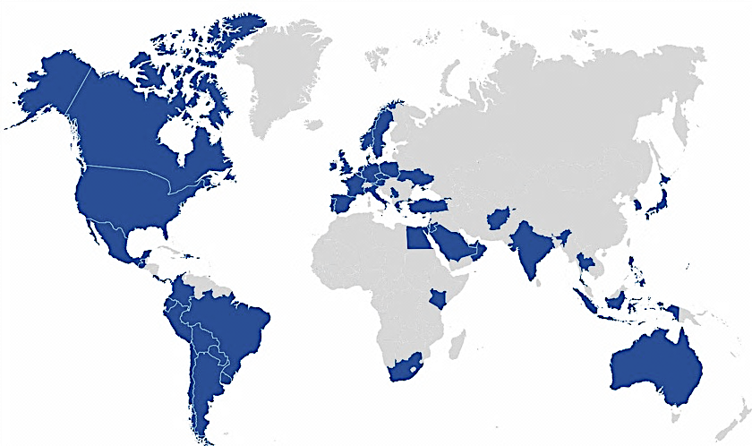
PHTLS – Ένα παγκόσμιο «κίνημα»
11,222 PHTLS instructors, μεταλαμπαδεύουν τις αρχές του PHTLS σε
69 χώρες παγκοσμίως με 700,000 εκπαιδευόμενους
Παγκόσμια κοινή προσέγγιση / «κίνημα» στην αντιμετώπιση του τραυματία στον προ – νοσοκομειακό χώρο
Notes:
You have come from all across the United States and across the globe, representing the 11,222 PHTLS instructors from 69 countries providing PHTLS to prehospital providers in their communities. PHTLS is truly a global movement dedicated to excellence in prehospital trauma care.

Slide 7

PHTLS – Ελλάδα
1998 – 2021
ΠΡΟΝΟΣΟΚΟΜΕΙΑΚΗ ΦΡΟΝΤΙΔΑ
  National Coordinating Organization – NCO
  Member of Regional European Education Committee – REEC
6 εκπαιδευτικά κέντρα ενεργά & 2 εκπαιδευτικά κέντρα ανενεργά
PHTLS (1999 – 2021): 234 εκπαιδευτικά προγράμματα με 5.190 εκπαιδευθέντες
PHTLS for First Responders (2012 – 2021): 33 εκπαιδευτικά προγράμματα με 640 εκπαιδευθέντες
130 ενεργοί εκπαιδευτές στην 9η έκδοση

Slide 8
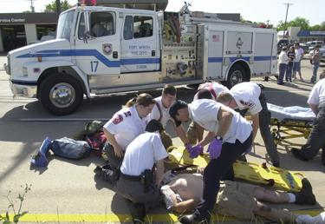
Στόχοι
Μείωση τραυματισμών και θανάτων από τραύμα.
Εκπαίδευση πρώτων ανταποκριτών σε σύγχρονες τεχνικές και δεξιότητες.
Παροχή κατάλληλης φροντίδας στους τραυματίες.
© Glen E. Ellman.
Notes:
Instructor Notes
Expand on the following points.
Prehospital care providers must have a good foundation of knowledge, be critical thinkers, and have the appropriate technical skills necessary to provide patient care to trauma patients in less-than-optimal circumstances.
PHTLS supplies the knowledge and skills to enable the use of critical thinking by prehospital care providers in achieving the best care possible for the trauma patient.

Slide 9

Φιλοσοφία του PHTLS
Έλεγχος
Παρεμβάσεις
Φροντίδα του τραυματία - Μεταφορά
© Elise Amendola/AP images.
Notes:
Instructor Notes
Expand on the following points.
Research
Provides us with the foundation for the best practices for trauma care
Validates or contests current practices and determines future practices
Must be critically evaluated if findings apply to EMS systems and patient populations before a practice can be changed
The PHTLS textbook and program are based on current research.
Prehospital care providers should continue to be involved with research in prehospital care.
Direct participants to Lesson 1: Introduction and Overview of Trauma Care and PHTLS in the PHTLS 9e Course Manual.
Interventions
Appropriate interventions are based on the assessment of each patient.
Knowing when not to do something is more important than knowing when to do something.
Therefore, prehospital care providers shall provide the most appropriate interventions for each patient.
Patient care delivery
Prehospital care providers must deliver the trauma patient:
To the right facility
Utilizing the right mode of transport
In the right amount of time
As safely as possible

Slide 10
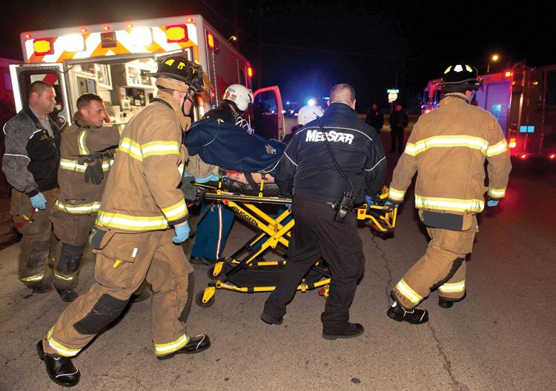
Η προσέγγιση του PHTLS
Ομαδική δουλειά
Εκτίμηση και αντιμετώπιση με τις αρχές του
  X – ABCDE
© Glen E. Ellman.
Notes:
Instructor Notes
Expand on the following points.
Team approach
PHTLS stresses utilizing a team approach between people with various levels of knowledge and skills.
Discuss various members of a trauma team.
Trauma is a global problem, where prevention is a vital part of our job.
Working together provides trauma patients with the highest chance of survival.
Assessment and treatment of trauma patients
PHTLS now uses the XABCDE approach to assessment and in providing lifesaving care in a trauma patient.
eXsanguination
X is added to the ABCDE approach in trauma care to correct immediate life-threatening bleeding.
Locating the source of bleeding
Applying pressure to the source until bleeding stops
Using hemostatic dressings or tourniquets to stop bleeding
Avoid popping the clot and further diluting the blood through fluid resuscitation.
ALL RBCs COUNT!!
Airway
Breathing
Circulation
Disability
Expose/environment
This approach is similar to the MARCH and CABCDE approach.
Massive bleeding, Airway, Respirations, Circulation, Head
Catastrophic hemorrhage control, Airway, Breathing, Circulation, Disability, Expose/environment
Let students know they will see this new approach throughout the PHTLS course, textbook, and course manual.

Slide 11
Αρχές ή Προτιμήσεις;
    Αρχές : Τι είναι σωστό να γίνει ;
      Βασίζονται στις ανάγκες του ασθενή
    Προτιμήσεις : Πως πρέπει να γίνει ;
      Ο τρόπος που επιτυγχάνονται οι αρχές
      Οι προτιμήσεις αλλάζουν ανάλογα με τα:
        Κατάσταση στη σκηνή
        Κρισιμότητα τραυματία
        Γνώσεις και ικανότητα του διασώστη
        Διαθέσιμα μέσα
Notes:
Instructor Notes
Expand on the following points.
PHTLS teaches the principles of care rather than focusing on preferences.
The principle is what needs to be done for a patient based on the patient assessment.
The preference is how the principle is accomplished.
The preference may change depending on:
Situation at scene
Patient severity
Prehospital care provider knowledge and skills
Resources available

Slide 12

Οι φάσεις της φροντίδας του τραυματία (1 of 3)
Πριν το συμβάν
Κατά το συμβάν
Μετά το συμβάν
© becon/iStockphoto.
Notes:
Instructor Notes
Expand on the following points.
Pre-event phase
Circumstances leading up to injury
Primarily focuses on injury prevention
For example, there are an estimated 660,000 drivers using a mobile device while operating motor vehicles any given day.
Distracted driving in 2015 led to 3,500 deaths and 400,000 injuries in the United States.
Prevention efforts have taken place to curb this rising trend.
Legal enforcement is aimed specifically to prevent traffic accidents.
Preparation of prehospital care providers for events that are not preventable
Maintain your education on the most current evidence-based medical practices.
Medicine is much like technology, you must update your medical knowledge much like you update your handheld devices.
Review new and current equipment on your response unit at the beginning of your shift and in training.
Discuss individual responsibilities and expectations of shift and patient care duties.

Slide 13
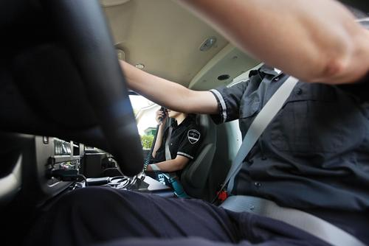
Οι φάσεις της φροντίδας του τραυματία (2 of 3)
Πριν το συμβάν
Κατά το συμβάν
Μετά το συμβάν
© Montgomery Martin/Alamy.
Notes:
Instructor Notes
Expand on the following points.
Event phase
Moment of actual trauma
Actions taken during this phase aim to minimize injuries as a result of trauma.
Motor vehicle safety restraint systems, air bags, and motorcycle helmets play a role in injury reduction.

Slide 14

Οι φάσεις της φροντίδας του τραυματία (3 of 3)
Πριν το συμβάν
Κατά το συμβάν
Μετά το συμβάν
© Gustavo Frazao/Shutterstock.
Notes:
Instructor Notes
Expand on the following points.
Postevent phase
Outcome from a traumatic event.
First phase of death occurs within first hour after an incident.
Massive hemorrhage occurs for some while waiting for medical care to arrive.
Public awareness campaigns encourage education on the use of tourniquets by lay persons and an increased presence of hemorrhage control kits made available in public areas and in police vehicles.
Second phase of death occurs within the first few hours of an incident.
Preventable with quality prehospital and hospital care.
Third phase of death occurs several days to several weeks after the incident.
Caused by multiple organ failure
Future research is needed for managing and preventing multiple organ failure.
Early and aggressive treatment of shock in prehospital setting can prevent come of these deaths.

Slide 15
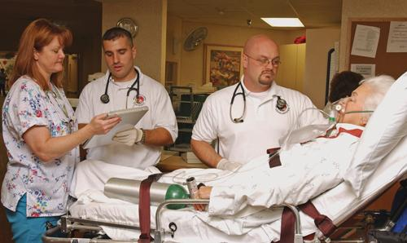
Χρυσή περίοδος
Η γνωστή μας «Χρυσή ώρα»
Ευθύνες του διασώστη
  Μείνετε στη σκηνή το λιγότερο δυνατόν
  Προβείτε σε σωστικές παρεμβάσεις και μεταφέρετε στον τόπο οριστικής αντιμετώπισης.
© Jones & Bartlett Learning. Courtesy of MIEMSS.
Notes:
Instructor Notes
Expand on the following points.
Golden Hour
A historical term used to define the general goal of delivering definitive care within 60 minutes of being injured to maximize chance of survival.
Since not all trauma patients have 60 minutes and some interpreted the term Golden Hour very literally when it was actually only intended to remind people of the urgency of addressing shock, the term Golden Period has been adopted by some as an alternative.
Golden Period
Urban prehospital systems in the United States average 8 to 9 minutes in response between activation of emergency services and scene arrival.
Does not include time between injury and emergency services activation
Average transport time to receiving facility is an additional 8 to 9 minutes.
Some patients have less than an hour in which to receive care, whereas others have more time.
Direct participants to Lesson 1: Introduction and Overview of Trauma Care and PHTLS in the PHTLS 9e Course Manual for more information.
Responsibilities
Prehospital care providers must spend as little time on scene as possible.
Patients must be transported to the most appropriate facility.
A factor to patients’ survival is the length of time that elapses between incident and provision of definitive care.

Slide 16
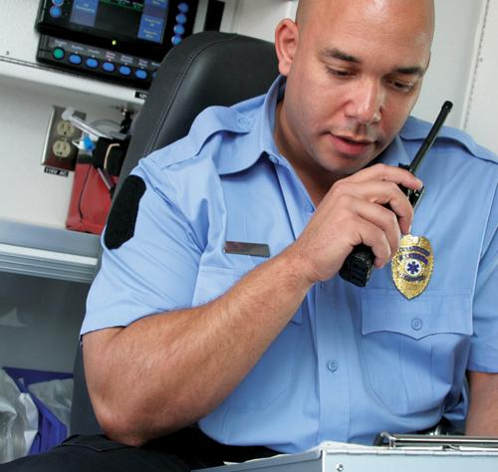
Επικοινωνία και καταγραφή
Για τη σωστή φροντίδα του τραυματία είναι απαραίτητη η:
  Αποτελεσματική επικοινωνία
    Με την ομάδα
    Με τις υπηρεσίες
  Σωστή καταγραφή
    Διασφαλίζει την συνέχεια της θεραπείας
© Jones & Bartlett Learning. Courtesy of MIEMSS.
Notes:
Instructor Notes
Expand on the following points.
Communication
Communicating effectively among team members is critical to ensure quality and timely patient care.
Complete and clear communication between receiving agencies and prehospital providers will further optimize care.
Assists with activating needed hospital resources such as trauma teams and surgical resources
Discuss effective communication when used within a team based approach.
Effective documentation
Required to maintain continuity of patient care
For legal purposes
To support and continue trauma research
To support trauma system funding

Slide 17
Ανακεφαλαίωση
Εκτίμηση των πράξεων και ενεργειών μας.
Η επιστήμη θα μας καθοδηγήσει.
Προσαρμογή στις αλλαγές
Προσεχώς:
  «Εκτίμηση Σκηνής και Πρωτοβάθμια Εκτίμηση»
Notes:
Instructor Notes
Expand on the following points.
We must critically examine how and why we do everything.
Science is always evolving, helping us to verify or refute our approach to trauma care.
We must be able to adapt to changes.
Coming up:
Lesson 2: Scene Management and Primary Survey

