Slide 1
Fourth Edition
Lesson 11: Pediatric Behavioral Health
Notes:
Welcome to Lesson 11: Pediatric Behavioral Health.

Slide 2
Lesson Objectives
Identify types of pediatric behavioral health disorders.
Recognize signs and symptoms of behavioral health disorders.
Discuss the management of pediatric behavioral health disorders.
Use the most appropriate pediatric behavioral health management intervention based on the patient’s assessment findings.
Notes:
Instructor Notes
Discuss each learning objective and the importance of thoroughly understanding each one.
Identify types of pediatric behavioral health disorders.
Recognize signs and symptoms of behavioral health disorders.
Discuss the management of pediatric behavioral health disorders.
Use the most appropriate pediatric behavioral health management intervention based on the patient’s assessment findings.

Slide 3
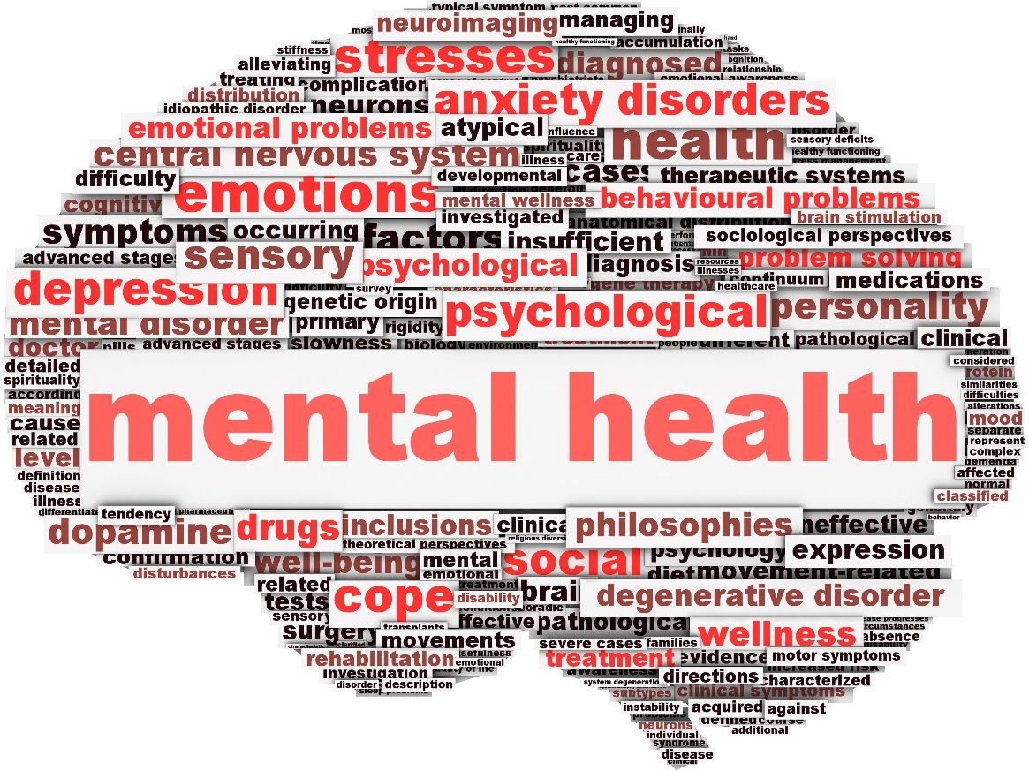
Introduction
© Andrii Kondiuk/Shutterstock
Notes:
Instructor Notes
A behavioral health disorder can include an extensive range of conditions affecting the mood, thinking, and behavior of an individual.
Children grow, learn, and reach milestones throughout their early years.
They learn how to act, respond to social situations, regulate emotions, and cope with their everyday fears and worries.
All children have stages during which they may have difficulty dealing with a stressful situation or may even exhibit disruptive behaviors, but it isn’t until these events interfere with their daily life and their interactions with others that they become problematic.
If a child exhibits serious, persistent changes in the way he or she acts or copes with his or her emotions, and these changes interfere with daily life, parents or healthcare providers should consider that the child may have a behavioral health disorder.

Slide 4

Common Pediatric Behavioral Health Disorders (1 of 8)
Attention-deficit/hyperactivity disorder (ADD/ADHD)
  Characterized as a group of symptoms with an onset prior to age 12 that are present at least 6 months.
  Symptoms
  Treatment
© soul kitchen/Shutterstock
Notes:
Instructor Notes
Attention-deficit/hyperactivity disorder (ADHD) is the most common behavioral health disorder in pediatrics.
ADHD, behavior problems, anxiety, and depression clearly lead the way in prevalence, with ADHD being the most diagnosed condition.
Many of these disorders tend to occur together, such as anxiety and depression (73.8%) or anxiety and behavioral problems (37.9%).
Characterized as a group of symptoms with an onset prior to age 12 that are present at least 6 months.
Median age of onset is 6 years.
Three subtypes:
Predominantly inattentive
Predominantly hyperactive/impulsive
Combined
Symptoms, which can be mild, moderate, or severe, include:
Hyperactivity
Lack of attention
Impulsivity
Forgetfulness
There is no single test to diagnose a child with ADHD.
For an ADHD diagnosis, the child’s behavior must be inconsistent with expected developmental milestones for the child’s age and have a significant impact on the child’s function at school or home.
The first-line pharmacologic treatment for children ages 6 years and older is stimulants.
Early recognition of ADHD is critical because it is a common comorbidity with other behavioral health disorders.
Categorized as a learning disorder, because impaired attention and impulsivity can impact the ability to learn, be successful, and develop healthy meaningful friendships (due to impulsivity).

Slide 5
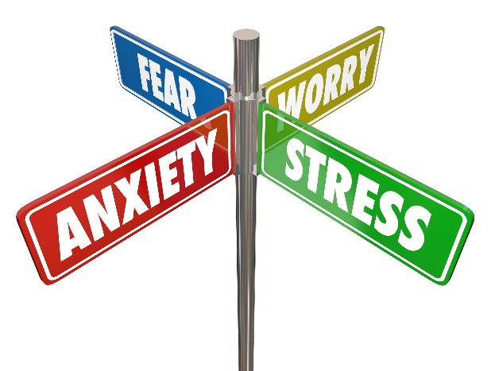
Common Pediatric Behavioral Health Disorders (2 of 8)
Anxiety
  Fears and worries become so serious that they affect daily life
  Types of anxiety disorders
    Phobias
    General, social, separation, and panic disorders
  Symptoms
  Treatment
© iQoncept/Shutterstock
Notes:
Instructor Notes
Anxiety
When a child does not outgrow their fears and worries or when they become so serious that they begin to affect the child’s everyday life, he or she may be considered to have an anxiety disorder.
Different types of anxiety disorders:
Phobias
Extreme fears of objects or situations
Spiders (arachnophobia)
Dogs (cynophobia)
Tight spaces (claustrophobia)
General anxiety
Excessive and uncontrollable worry about things in general, life, the future, friendships, academic performance, bad things that could happen
Social anxiety
Being afraid of unfamiliar people (particularly adults)
Social situations and being in public cause severe distress
Separation anxiety
Being inordinately afraid of anticipated or actual separation from parents/caregiver
Panic disorders
Sudden, unexpected panic attacks that can consist of trouble breathing, shaking, rapid heartbeat, and sudden, intense fear of something intangible.
Typical onset is post-puberty/adolescence.
Most common occurrence when EMS is called.
Anxiety manifests in three symptoms groups: behaviors, thoughts, and somatic symptoms.
Somatic symptoms include increased heart rate, diaphoresis, dizziness, difficulty breathing, tingling in hands, and syncopal episodes.
The child may describe having a “racing heart.”
Physiologically, anxiety results from an adrenaline dump into the child’s system. This can be due to a number of medical pathologies, including shock. Therefore, it is important to verify the potential physiologic cause of the anxiety.
Anxiety as a behavioral disorder is a diagnosis of exclusion.
Richmond Agitation-Sedation Scale (RASS)
Allows you to monitor the anxiety and sedation levels of your patient.
The RASS is a 10-point scale.
Four levels of agitation/anxiety
Five levels of sedation
Treatment
Ensure personal safety.
Approach the child slowly and get eye level with them.
Use a calm voice when communicating.
Assess history of anxiety and any known triggers.
Find out how the patient commonly manages their anxiety.
Explain your treatment.
In most cases, pharmacotherapy is not needed in the treatment of anxiety.
Involve the caregiver.
Monitor ETCO₂.
Coach patient breathing if hyperventilating.
Consider sedatives for severe cases or agitation with a known established diagnosis.
Benzodiazepines or ketamine.
Do NOT use sedatives if anxiety is a new symptomatology.

Slide 6

Common Pediatric Behavioral Health Disorders (3 of 8)
Depression
  Affects how you think, feel, and address daily activities
  Symptoms
  Treatments
© fizkes/Shutterstock
Notes:
Instructor Notes
Depression
A parent or provider may consider depression if a child exhibits persistent, severe sadness or hopelessness for a period of 2 weeks or greater.
Affects approximately 3.2% of children ages 3 to 17 years.
Symptoms may include the child not enjoying things they normally do, persistent sadness, hopelessness, changes in their sleep pattern, or even exhibiting self-destructive behavior.
In younger children depression may present as anger, aggression, and/or irritability.
Marked changes in eating or energy patterns should also be considered red flags.
It is important to recognize changes in children’s behavior, and to consider them as potential indicators of anxiety or depression.
Treatment includes medication and psychotherapy.
Ensure personal safety.
Establish trust.
Use eye contact.
Speak clearly and calmly when communicating.
Use effective listening by allowing the patient to talk.
Paraphrasing back to the patient demonstrates empathetic listening.
Do not force the patient to talk if they want to remain silent.
Contact law enforcement for assistance with suicidal or homicidal ideation and if patient is refusing care.
Patients exhibiting suicidal or homicidal ideation must be transported to an appropriate facility to ensure their safety.
When depression goes undiagnosed it can culminate in suicidal thoughts or a suicide attempt.

Slide 7

Common Pediatric Behavioral Health Disorders (4 of 8)
Bipolar disorder
  Causes extreme changes in mood and behavior
    Manic and depressive episodes
  Symptoms depend on episode
  Treatment
© delcarmat/Shutterstock
Notes:
Instructor Notes
Bipolar disorder
Less common in the pediatric population.
Known prior as manic-depressive disorder; causes children to experience extreme changes in their mood and behavior.
Manic episode
More active and energetic than usual for their age.
Symptoms include short temper, intense silliness or happiness, trouble sleeping, difficulty remaining focused.
Depressive episode
Much less active or more sad than usual for their age.
Symptoms include frequent sadness, difficulty concentrating, increased anger and irritability, and change in eating habits.
Consists of mood changes that are often unprovoked, much more extreme than normal, with changes in energy level, sleep, or ability to think clearly.
Most often children are diagnosed in adolescence.
A child must exhibit the behavior of both manic and depressive disorders to obtain a diagnosis of bipolar disorder.
Treatment includes medications and psychotherapy.
Ensure personal safety.
Include the caregiver.
Limit the number of caregivers on scene and interaction with the child.
Speak clearly and calmly when communicating.
Move slowly when approaching the patient.
Be prepared to change your approach if the child becomes aggressive.
Discuss when to use physical or chemical restraints.
Calming agents include benzodiazepines.
Contact law enforcement for assistance with suicidal or homicidal ideation.
Discuss physical and chemical restraints used in your region.

Slide 8
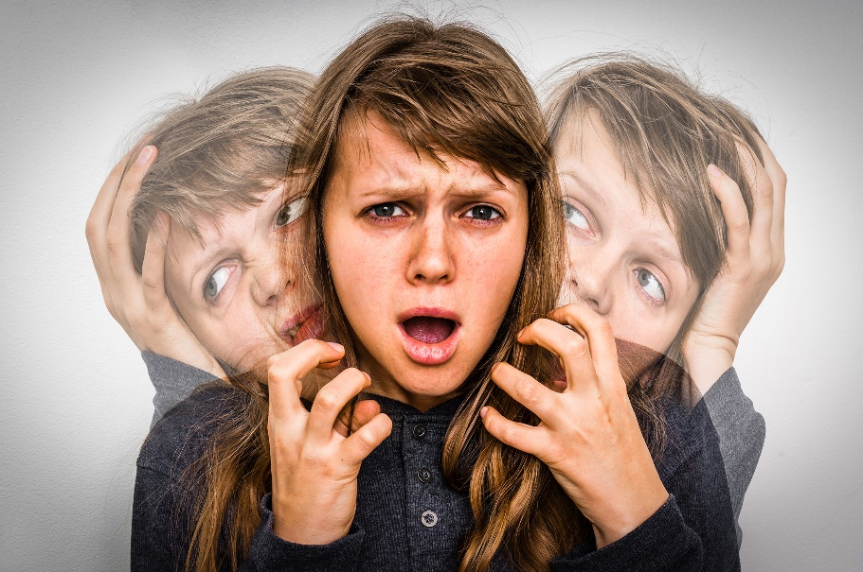
Common Pediatric Behavioral Health Disorders (5 of 8)
Schizophrenia
  Complex psychiatric disorder affecting how a person feels, thinks, and behaves
  Symptoms
  Treatment
© andriano.cz/Shutterstock
Notes:
Instructor Notes
Schizophrenia
Much like bipolar disorder, schizophrenia is rare in the pediatric population.
A complex psychiatric disorder affecting how a person feels, thinks, and behaves.
Psychosis can be a gradual process or occur without warning, although very early-onset schizophrenia often presents insidiously.
A rare diagnosis in pediatrics younger than 12 years of age.
Typically not diagnosed until mid-20s, but early onset schizophrenia may be diagnosed in patients younger than 18 years.
Diagnosis often occurs after the first psychotic episode.
Symptoms typically fall into three categories:
Psychotic symptoms: Delusions, hallucinations, or thought disorder (e.g., thought insertion, thought broadcasting)
Negative symptoms: No expressions of emotions or facial expressions (blunt affect), lack of motivation, decreased feelings of pleasure, poverty of speech (not talking very much)
Cognitive symptoms: Difficulty paying attention or processing information to make decisions
May progress slowly or suddenly in children.
Treatment
Ensure personal safety.
Include the caregiver.
Establish trust.
Limit the number of caregivers on scene and interaction with the child.
Speak clearly and calmly when communicating.
Do not attempt to alter their beliefs or tell them that the hallucinations are not real.
To the patient they are very real.
Be prepared to change your approach, because the child may become aggressive.
Consider when to use physical or chemical restraints.
Calming agents: Benzodiazepines.
Contact law enforcement for assistance with suicidal or homicidal ideation.

Slide 9
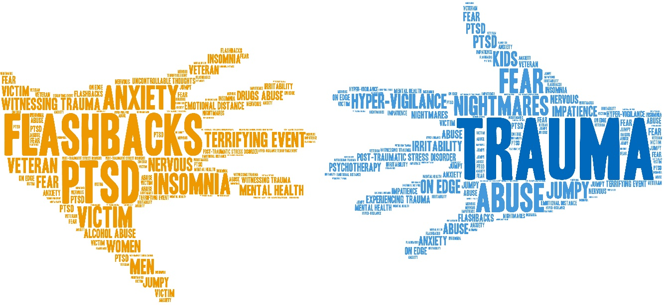
Common Pediatric Behavioral Health Disorders (6 of 8)
Post-Traumatic Stress Disorder (PTSD)
  Develops in some pediatrics who experience or witness a traumatic event
  Symptoms
  Treatment
© arloo/Shutterstock
Notes:
Instructor Notes
Post-traumatic stress disorder (PTSD)
Develops in some pediatric patients who experience or witness a traumatic event.
The traumatic event does not have to be directed at the child; PTSD can also develop from witnessing a trauma occurring to another person.
May follow abuse, kidnapping, death of a family member, neglect/abandonment, or other major life events.
Duration, intensity, age, and other related risk factors all tie in together to help formulate a diagnosis of PTSD.
Symptoms
Reliving the traumatic event
Nightmares
Intense fear
Anger outbursts
Feelings of hopelessness
Trouble sleeping
May present with anxiety
PTSD in children is often associated with ongoing psychological issues into adulthood, to include anxiety and conduct disorders.
Critical to understand and identify any triggers the patient has from the trauma, in order to avoid them.
For example, if a child has a history of sexual abuse, they may be triggered by physical restraints, and these should be avoided when at all possible.
Treatment
Ensure personal safety.
Use a calm voice when communicating.
Monitor ETCO₂.
Coach patient breathing if hyperventilating.
Consider sedatives such as benzodiazepines or ketamine for severe cases or agitation.

Slide 10

Common Pediatric Behavioral Health Disorders (7 of 8)
Suicide attempt/suicidal ideation
  Suicide is the second leading cause of death in children 10 to 17 years of age.
  Symptoms
  Treatment
© Orawan Pattarawimonchai/Shutterstock
Notes:
Instructor Notes
Suicidal attempt/suicidal ideation
Suicide is death caused by self-inflicted injury or poisoning.
Suicide is the second leading cause of death in children aged 10 to 17 years.
Common causes of suicide in children include guns, overdose, and strangulation/hanging.
Males most commonly use firearms.
Females most commonly ingest toxins or overdose on medications (poisoning).
Suicide is of epidemic proportions in the U.S.
The CDC reports that the suicide rate of people ages 10 to 24 have increased 56% between 2007 and 2017.
This is 6.8 persons per 100,000.
The suicide rate for children ages 10 to 14 nearly tripled from 2007 to 2017.
The suicide rate worsened during the COVID-19 pandemic due to stress and social isolation.
A significant percentage of pediatric transports are due to pediatric behavioral health issues, of which suicidality is the most common.
Suicide attempt
Nonfatal, potential injury with the intent to die.
May or may not result in an injury.
Suicidal ideation
The thought, planning, or consideration of suicide.
Symptoms include:
Discussions of guilt, without reason to live, wanting to die, burden to others.
Use of alcohol or recreational drugs.
Withdrawal from friends and family.
Risk factors
Depression
Chronic pain
Previous attempts at suicide
Family history of suicide
Substance abuse
Violence
Treatment includes medication and psychotherapy.
Personal safety is critical.
Establish trust.
Limit the number of caregivers on scene and interaction with the child.
Speak clearly and calmly when communicating.
Use effective listening by allowing the patient to talk.
Contact law enforcement for assistance with person with suicidal or homicidal ideation who is refusing transport.

Slide 11

Common Pediatric Behavioral Health Disorders (8 of 8)
Autism spectrum disorder (ASD)
  Complex neurodevelopmental disability defined by a certain set of behaviors which affects individuals differently and in varying degrees.
  Signs
  Treatment
© vetre/Shutterstock
Notes:
Instructor Notes
Autism spectrum disorder (ASD)
A lifelong, complex neurodevelopmental disability defined by a certain set of behaviors which affects individuals differently and in varying degrees.
There is no single known cause.
Is 4.5 times more common in boys than girls.
Estimated to occur in 1 of every 59 children to varying degrees.
Most children on the autism spectrum have sensory sensitivities.
Behavioral signs of ASD may include:
Inability to maintain typical back-and-forth conversations.
Behavior that deviates from expected developmental milestones:
Difficulty initiating social interactions.
Lack of eye contact.
Lack of facial expressions.
Abnormalities of body gestures or other social cues such as posture, vocal tone, or not understanding personal space.
Important to recognize that some children with ASD may have no physical limitations, whereas others may have severe physical disabilities.
Autism is often accompanied by behavioral health conditions that can exacerbate the symptoms.
ADHD (28%)
Anxiety (20%)
Depression, schizophrenia, OCD, bipolar disorder and sleep-wake conditions are all more prevalent in individuals on the spectrum than in the general population.
Treatment
Ensure personal safety.
Include the caregiver.
Children with severe developmental delay often respond better to distraction techniques.
Fidget tools, light, videos/music.
Work with the family to determine what has worked best for the patient in the past.
Avoid use of flashing lights and sirens.
Limit the number of caregivers on scene and interaction with the child.
Explain the restraints on a stretcher are just like a seat belt they would wear in the car and are needed for safety.
Move slowly when approaching the patient.
Be prepared to change your approach, because the child may become aggressive due to their inability to communicate verbally.
May have difficulty performing procedures due to the patient continuously refusing or aggressiveness.
May need to evaluate the risk vs benefit of a procedure.
Restraints and medications should be considered a last resort.
Restraints can be particularly stressful and worsen the agitation a child is experiencing.
In many cases, papoose restraints work better than typical soft restraints due to providing a feeling of comfort (similar concept to weighted blankets).
Discuss the stigma of mental illness and why people may be opposed to lumping some of these disorders under the “behavioral health” umbrella.

Slide 12
Case Study 1
Dispatch
  You are dispatched to a local school for a 13-year-old male with difficulty breathing on a fall morning. The outside temperature is 56°F (13°C).
Notes:
Instructor Notes
For students other than prehospital practitioners, dispatch information can be modified.
What are your initial concerns and possible differential diagnosis from the dispatch information?
Initial impression begins when the dispatch information is received.
Initial concerns
Difficulty breathing
Differential diagnosis:
Asthma attack
Pneumonia
Upper respiratory infection (URI)
Panic attack
Chemical exposure
Illicit drug use
Seasonal allergies
Discuss the importance of scene assessment and awareness.
Expand on how it applies to this case
Case 1 involves a 13-year-old male with difficulty breathing.
Diagnosis: Panic attack

Slide 13

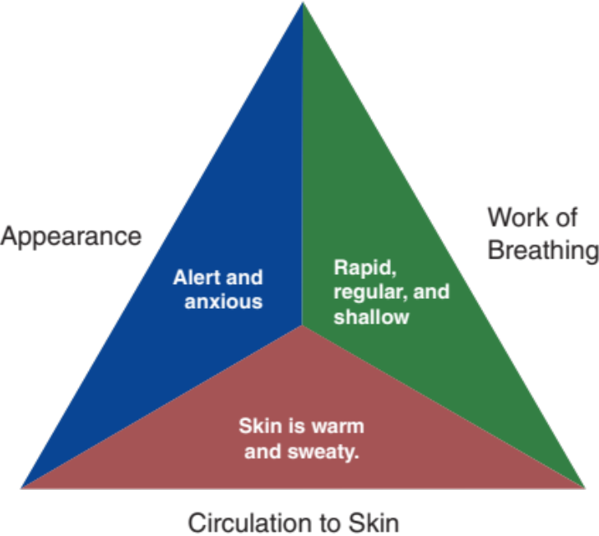
Initial Observations
© Sabphoto/Shutterstock
Used with permission of the American Academy of Pediatrics, Pediatric Education for Prehospital Professionals, © American Academy of Pediatrics, 2000
Notes:
Instructor Notes
Discuss the following initial findings at the scene and PAT findings:
You are met by the nurse and patient outside in front of the school.
PAT
Appearance: Alert and anxious.
Work of breathing: Rapid, regular, and shallow.
Circulation: Skin is warm and sweaty.
The nurse states that she was advised by students that the patient was sitting on a bench in front of the school having trouble breathing.
The child states that his heart is racing and that he is unable to catch his breath.
The nurse advises you the mother will meet you at the hospital.
Discuss additional precautions or concerns that may be warranted based on initial observations.
Is this patient “Quick” or “Not Quick”?
The patient is “Not Quick.”
Explain how this determination was made.
Have you identified any possible red flags?
Tachycardia and tachypnea

Slide 14
Primary Survey
    Primary survey
  X ‒ No bleeding found.
  A ‒ Patent.
  B ‒ Regular, rapid, and shallow. Lung sounds are clear bilaterally.
  C ‒ Radial pulses are strong and rapid. Skin is warm, dry, and pink.
  D ‒ Alert and anxious, GCS = 15 (E4, V5, M6).
  E – Sitting on school bench, good hygiene.
Notes:
Instructor Notes
Discuss the primary survey.
Note that the PAT is completed prior to the primary survey.
Ask participants to explain any abnormal findings of their patient(s), whether physical and/or developmental, and why.
Discuss any life threats identified in this case.
There are no life threats.
Primary survey
X – No bleeding found.
A – Patent.
B – Regular, rapid, and shallow. Lung sounds are clear bilaterally.
C - Radial pulses are strong and rapid. Skin is warm, dry, and pink.
D – Alert, GCS = 15 (E4, V5, M6).
E – Sitting on school bench, good hygiene.
What would your initial treatment be?
Discuss treatment options per local guidelines and policy.
Treatment should focus on calming and coaching the child’s breathing.

Slide 15
Detailed Assessment
History taking
  O – Sudden
  P – When he discusses the reason, his symptoms increase, and he gets upset
  Q – None
  R – None
  S – None
  T – 20 minutes
Notes:
Instructor Notes
Review history taking using the OPQRST mnemonic.
O – Sudden
P – When he discusses the reason, his symptoms increase, and he gets upset
Q – None
R – None
S – None
T – 20 minutes
Participant engagement:
Expand on additional measures that may be used to calm the patient.

Slide 16
Detailed Assessment
History taking
  S ‒ Rapid breathing, anxiety, heart racing with palpitations.
  A ‒ No known allergies.
  M ‒ Zoloft.
  P ‒ Depression.
  L ‒ Breakfast this morning.
  E ‒ Has had problems with being bullied this year, and was being bullied this morning for not having a girlfriend.
  R – History of being bullied.
Notes:
Instructor Notes
Review history taking using SAMPLER.
S ‒ Rapid breathing, anxiety, heart racing with palpitations.
A ‒ No known allergies.
M ‒ Zoloft.
P ‒ Depression.
L ‒ Breakfast this morning.
E ‒ Has had problems with being bullied this year, and was being bullied this morning for not having a girlfriend.
R – History of being bullied.

Slide 17
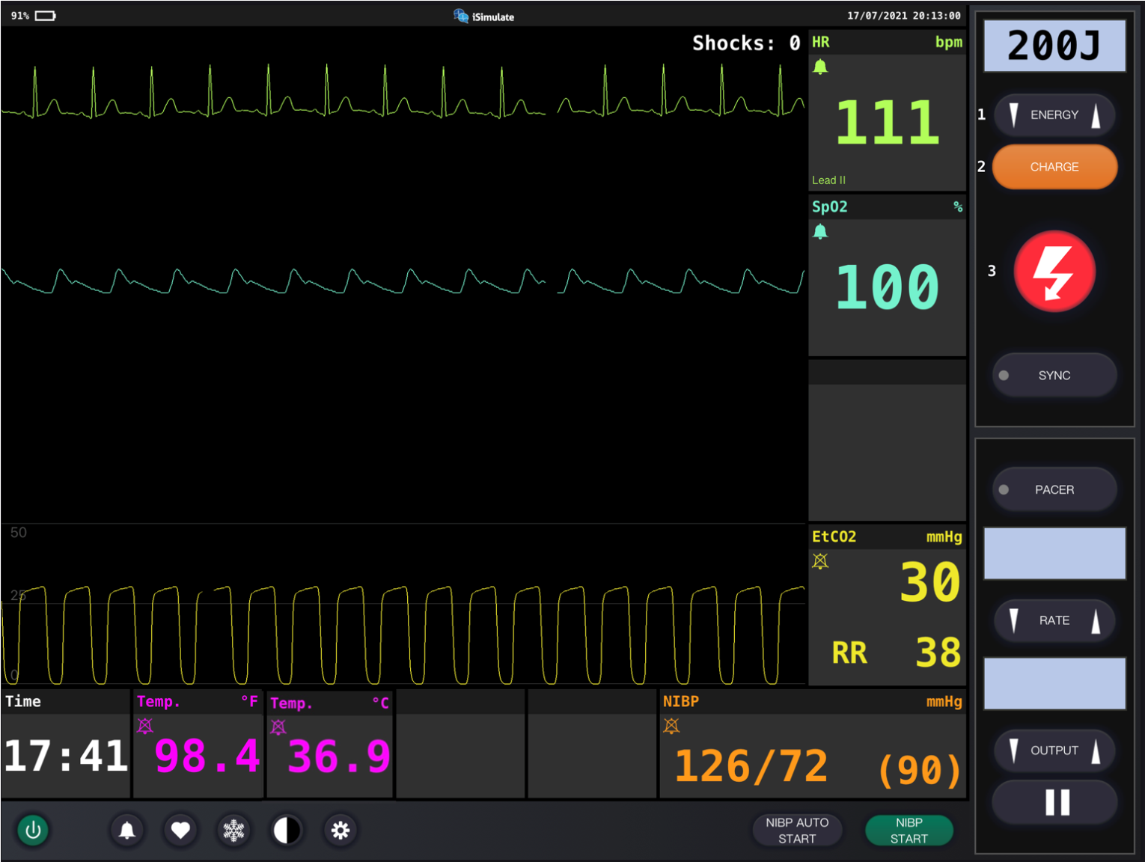
Vital Signs
Notes:
Instructor Notes
Discuss what the vital signs tell us about the patient:
SpO₂: 100% on room air.
Is oxygen needed?
Discuss treatment options in your region.
ETCO₂ is 30.
Discuss reason for low ETCO₂.
Excess CO₂ exhaled through hyperventilation.
Respiratory rate is 38.
Blood pressure is 126/72.
Blood glucose is 88 mg/dL (4.9 mmol/L).
Weight is 40 kg.
ECG indicates ST.
Participant engagement:
Discuss expected typical vital signs for age.
A patient with anxiety may present with increased HR and RR and lower ETCO₂.
Additional vital signs should be within normal limits for their age.
The presence of tachycardia indicates the need for an ECG.
Expand on initial measures that may be used to slow the heart and ventilatory rate.

Slide 18
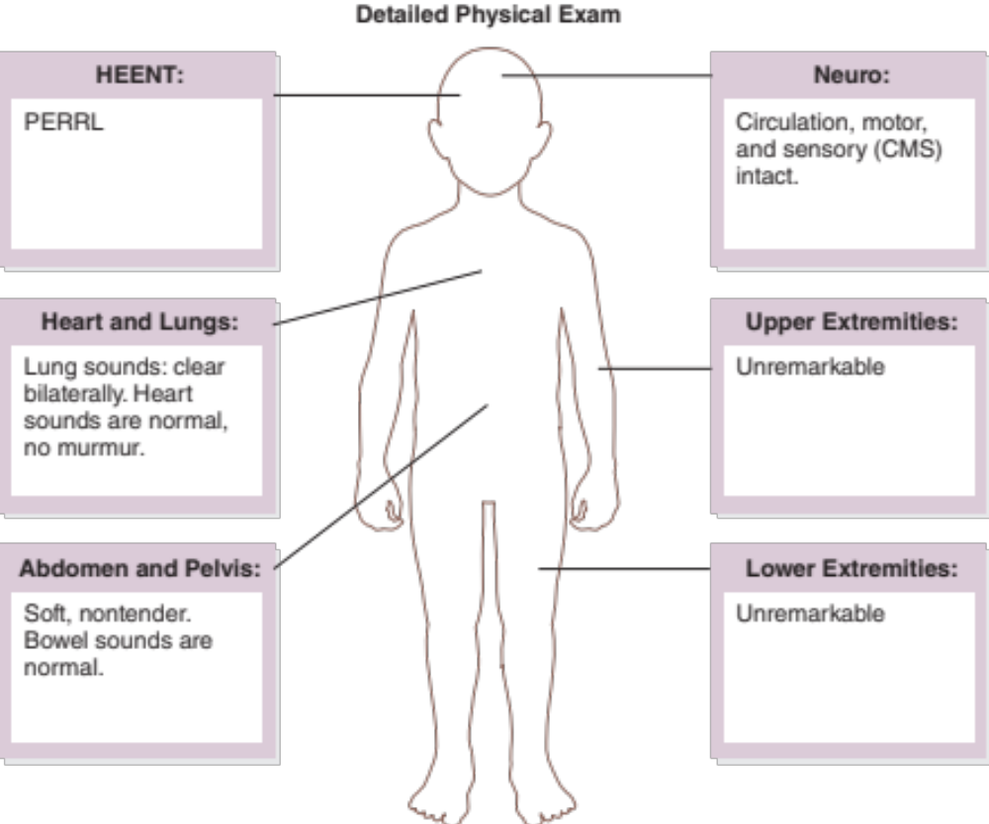
Detailed Assessment
Notes:
Instructor Notes
*Ask participants: Given the age of this child, would you perform a head-to-toe or toe-to-head assessment?
HEENT
Head: Unremarkable
Eyes: PERRL
Ears: Unremarkable
Nose: Unremarkable
Throat: Unremarkable
Heart and lungs
Lung sounds, clear bilaterally. Heart sounds are normal, no murmur.
Respirations rapid with good rise and fall.
Capillary refill <2 seconds.
Neuro
Circulation, motor, and sensory (CMS) intact.
Abdomen and pelvis
Soft, nontender. Bowel sounds are normal.
Upper extremities
Unremarkable
Lower extremities
Unremarkable

Slide 19
Treatment
BLS
  Position of comfort
  Maintain airway
  Oxygen as needed
  Coach breathing
  Therapeutic communication
ALS
  BLS care
Critical care
  BLS/ALS care
Notes:
Instructor Notes
Ask students how they would treat this patient according to their local protocol and scope of practice.
Patient management:
What are your goals for this patient?
Discuss treatment options for this patient.
The patient should be calmed and coach the child’s breathing.
What conditions are part of your potential differential diagnosis?
Asthma attack
Pneumonia
Upper respiratory infection (URI)
Panic attack
Chemical exposure
Illicit drug use

Slide 20
Ongoing Management
Reassess the patient.
Where is the most appropriate treatment destination and why?
Can you safely transport this child in your ambulance?
Notes:
Instructor Notes
Discuss ongoing management options based on scope of practice and local protocols.
Therapeutic communications should be used and breathing monitored.
There are no further changes during transport to the emergency department.
Where is the most appropriate treatment destination and why?
Discuss regional transportation destination options for pediatrics.
Share with students when and if it would be appropriate to bypass certain facilities for this patient.
Identifying behavioral health resources available at a receiving hospital ED, such as 24/7 availability of social workers and psychiatric capabilities, is critical for improved patient outcomes.
This child should be transported to the closest appropriate facility with pediatric mental health capabilities.
How would you safely transport this child in your ambulance?
Discuss policies and procedures for transporting pediatrics in your region.

Slide 21
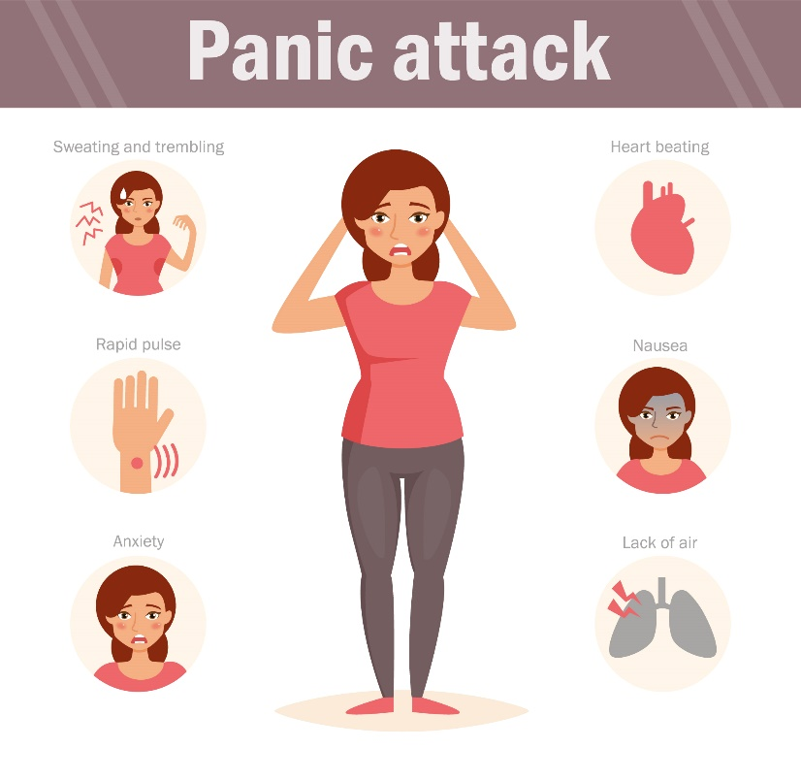
Case Wrap-Up
Diagnosis: Panic Attack
© Anna Violet/Shutterstock
Notes:
Instructor Notes
Panic attack
Anxiety affects 7.1% of children ages 3 to 17 years.
Case wrap-up
Discharged from the ED and referred to pediatric behavioral health.

Slide 22
Case Study 2
Dispatch
  You are dispatched to a residence for a 16-year-old female with reported suicide attempt. A friend called 911 after she witnessed a social media post regarding the suicide attempt. The friend advised the patient posted an image of several pills with the caption, “I’m going to die today; I hope you’re happy.” It is a spring Saturday afternoon with an outside temperature of 75°F (24°C).
Notes:
Instructor Notes
For students other than prehospital practitioners, dispatch information can be modified.
What are your initial concerns and possible differential diagnosis based on the dispatch information?
Initial impression begins when the dispatch information is received.
Initial concerns
Toxic ingestion
Differential diagnosis
Toxic ingestion
Suicidal ideation
Depression
Anxiety
Panic attack
Illicit drug use
Discuss the importance of scene assessment and awareness.
Expand on how it applies to this case.
Case Study 2 involves a 16-year-old female attempting to overdose on antidepressants.
Diagnosis: Suicidal ideation.

Slide 23

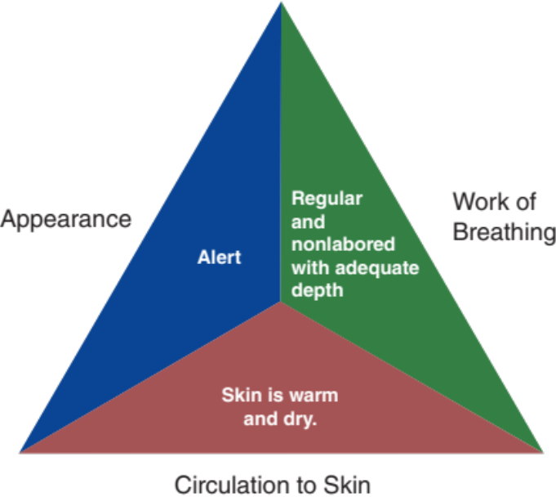
Initial Observations
© Antonio Guillem/Shutterstock
Used with permission of the American Academy of Pediatrics, Pediatric Education for Prehospital Professionals, © American Academy of Pediatrics, 2000
Notes:
Instructor Notes
Discuss the following initial findings at the scene and PAT findings:
You are met at the door by local law enforcement advising the scene is safe to enter.
PAT
Appearance: Alert.
Work of breathing: Regular and nonlabored with adequate depth.
Circulation: Skin is warm and dry.
The patient is crying and states she is tired of all the rumors at school that she and another girl are dating the same boy.
She further states, “I just don’t want to live anymore.”
The patient’s mother is on scene and explains that she was unaware of her daughter’s problems at school.
Mother advised that her daughter has a history of self-cutting but thought “we were past that.”
She noticed her daughter being more to herself today but didn’t think anything of it.
She hands you the daughter’s prescription bottle of Zoloft (sertraline) found in the daughter’s hand.
Discuss additional precautions or concerns that may be warranted based on initial observations.
Identify if the patient has taken any of her medication and how many.
The patient contemplated taking the whole bottle of pills and denies taking any of the medication.
The patient’s medication was changed to Zoloft 5 days ago.
Prescription was filled 4 days ago and contains 26 pills out of a 30-day supply.
Is this patient “Quick” or “Not Quick”?
The patient is “Not Quick.”
Expand how this determination was made.
Have you identified any possible red flags?
The patient is stating that she doesn’t want to live.

Slide 24
Primary Survey
    Primary survey
  X ‒ No bleeding found.
  A – Patent.
  B – Regular and nonlabored with adequate depth. Lung sounds are clear bilaterally.
  C – Radial pulses are strong and regular. Skin is warm and dry.
  D – Alert, GCS = 15 (E4, V5, M6).
  E – Sitting on bed, good hygiene.
Notes:
Instructor Notes
Discuss the primary survey.
Note that the PAT is completed prior to the primary survey.
Ask participants to explain any abnormal findings of their patient(s), whether physical and/or developmental, and why.
Discuss any life threats identified in this case.
There are no life threats.
Primary survey
X – No bleeding found.
A – Patent.
B – Regular and nonlabored with adequate depth. Lung sounds are clear bilaterally.
C - Radial pulses are strong and regular. Skin is warm and dry.
D – Alert, GCS = 15 (E4, V5, M6).
E – Sitting on bed, good hygiene.
What would your initial treatment be?
Discuss treatment options per local guidelines and policy.
Treatment should focus on therapeutic interventions.
Approach the patient with a degree of understanding.

Slide 25
Detailed Assessment
History taking
  O – Sudden
  P – None
  Q – None
  R – None
  S – None
  T – 30 minutes
Notes:
Instructor Notes
Review history taking using the OPQRST mnemonic.
O – Sudden
P – None
Q – None
R – None
S – None
T – 30 minutes
Participant engagement:
Expand on additional therapeutic measures that may be used with this patient.

Slide 26
Detailed Assessment
History taking
  S – Depressed mood, suicidal ideation.
  A – No known allergies.
  M – Zoloft.
  P – Depression; history of self-cutting.
  L – Fruit chews; hasn’t eaten much today.
  E – Rumors at school and does not want to live anymore.
  R – Depression; rumors spread at school.
Notes:
Instructor Notes
Review history taking using SAMPLER
S – Depressed mood, suicidal ideation.
A – No known allergies.
M – Zoloft.
P – Depression; history of self-cutting.
L – Fruit chews; hasn’t eaten much today.
E – Rumors at school and does not want to live anymore.
R – Depression; rumors spread at school; denies alcohol and illicit drug use.

Slide 27
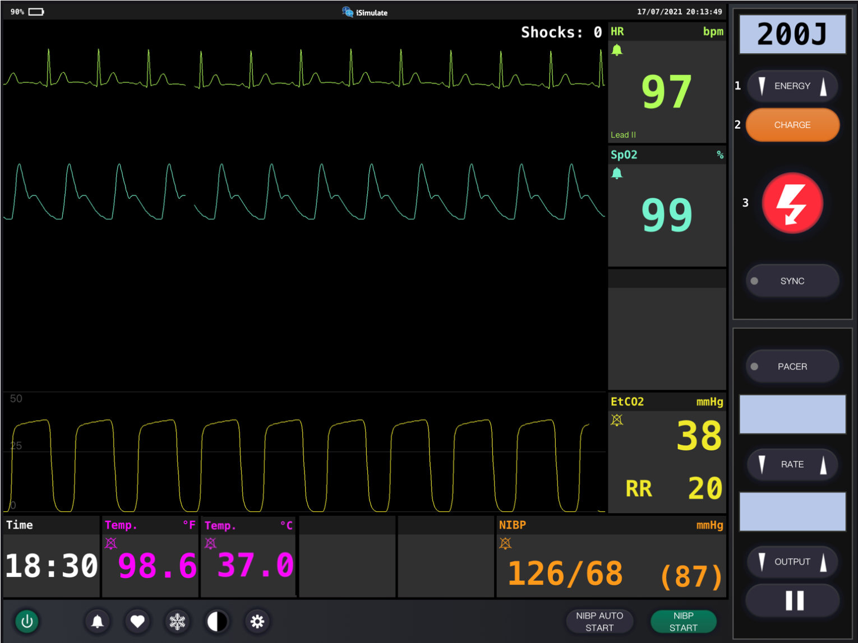
Vital Signs
Notes:
Instructor Notes
Discuss what the vital signs tell us about the patient:
SpO₂: 99% on room air.
ETCO₂ is 38.
Respiratory rate is 20.
Blood pressure is 126/68.
Blood glucose is 100 mg/dL (5.6 mmol/L).
Weight is 50 kg.
ECG indicates SR.
Participant engagement:
Discuss expected typical vital signs for age.
Expand on initial therapeutic measures that may be used to calm an upset patient.

Slide 28
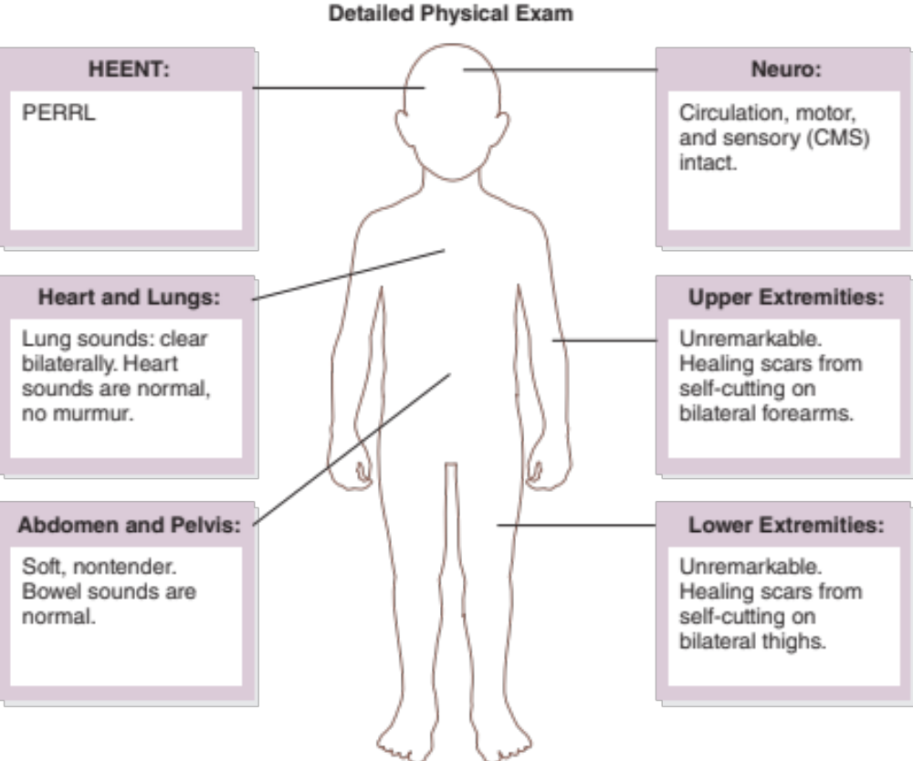
Detailed Assessment
Notes:
Instructor Notes
*Ask participants: Given the age of this child, would you perform a head-to-toe or toe-to-head assessment?
HEENT
Head: Unremarkable
Eyes: PERRL
Ears: Unremarkable
Nose: Unremarkable
Throat: Unremarkable
Heart and lungs
Lung sounds, clear bilaterally. Heart sounds are normal, no murmur.
Respirations rapid with good rise and fall.
Capillary refill less than 2 seconds.
Neuro
Circulation, motor, and sensory (CMS) intact.
Abdomen and pelvis
Soft, nontender. Bowel sounds are normal.
Upper extremities
Unremarkable. Scars from history of self-cutting on bilateral forearms.
Lower extremities
Unremarkable. Scars from history of self-cutting on bilateral thighs.

Slide 29
Treatment
BLS
  Position of comfort
  Oxygen as needed
  Therapeutic communication
ALS
  BLS care
Critical care
  BLS/ALS care
Notes:
Instructor Notes
Ask students how they would treat this patient according to their local protocol and scope of practice.
Patient management:
What are your goals for this patient?
Discuss treatment options for this patient.
Provide therapeutic communication.
Speak in a calm, soft tone.
Be supportive and caring.
Do not judge or downplay a patient’s issues or concerns.
Do not provide a moral stance or establish blame.
What conditions are part of your potential differential diagnosis?
Suicidal ideation
Depression
Toxic ingestion
Anxiety
Panic attack
Illicit drug use

Slide 30
Ongoing Management
Reassess the patient.
Where is the most appropriate treatment destination and why?
Can you safely transport this child in your ambulance?
Notes:
Instructor Notes
Discuss ongoing management options based on scope of practice and local protocols.
Continued therapeutic communications should be used.
For patients admitting to thoughts of suicide, determine their plan of action by asking the following questions:
How long have you been feeling this way?
Have you had thoughts of suicide before?
When did you have these thoughts?
Have you ever acted on these thoughts?
Have you thought about how you would do it?
If you haven’t tried, have you been rehearsing or contemplating how you would attempt suicide?
Responses to the above questions could determine whether a patient can return home or requires involuntary commitment.
There are no further changes during transport to the emergency department.
Where is the most appropriate treatment destination and why?
Discuss regional transportation destination options for pediatrics in your area.
Share with students when and if it would be appropriate to bypass certain facilities for this patient.
Identifying mental health resources available at a receiving hospital ED, such as the availability of social workers 24/7, is critical for improved patient outcomes.
This child should be transported to the closest appropriate facility with pediatric mental health capabilities.
How would you safely transport this child in your ambulance?
Discuss policies and procedures for transporting pediatrics in your region.

Slide 31

Case Wrap-Up
Diagnosis: Suicidal Ideation
© HowLettery/Shutterstock
Notes:
Instructor Notes
Suicidal ideation
From 2009 to 2018, suicide rates in teens ages 14 to 18 years increased 61.7% in the U.S.
In 2019, 18.8% of high school students reported seriously contemplating suicide.
24.1% of those were identified as female.
8.9% of high school students reported having attempted suicide.
Suicide prevention programs and practices, supporting at-risk populations, and preventing reattempts would reduce suicidal ideation and associated consequences.
Case wrap-up
At the hospital, the patient required involuntary commitment to a mental health facility.
She was later discharged and referred to follow-up with her pediatric mental health provider.

Slide 32
Lesson Wrap-Up
Identifying differences in pediatric behavioral health disorders allows for proper treatment.
Anxiety disorders can manifest in a variety of ways.
Recognize and employ effective management strategies for suicidal ideation.
Coming up, Simulations.
Notes:
Instructor Notes
Identifying differences in pediatric behavioral health disorders allows for proper treatment.
Anxiety disorders can manifest in a variety of ways.
A child may have trouble sleeping, be irritable or angry, or even exhibit physical symptoms such as aches and pains.
Recognize and employ effective management strategies for suicidal ideation.
Therapeutic management is key to successful outcomes.
Be prepared to listen.
Do not pass judgment.
Coming up, Simulations.

Slide 33

Questions?
© Nujumuddin Mohamad Yaman/EyeEm/Getty Images
© Nujumuddin Mohamad Yaman/EyeEm/Getty Images
Notes:
Instructor Notes
Allow time for a question-and-answer session about the topics presented in the lesson.

