Slide 1
Fourth Edition
Lesson 9: Obstetric/Newborn Care and Congenital Birth Defects
Notes:
Welcome to Lesson 9: Obstetric/Newborn Care and Congenital Birth Defects.

Slide 2
Lesson Objectives
Review the physiologic changes of the obstetric patient.
Differentiate between various complications during pregnancy.
Discuss the management of a delivery using XABCDE and the Pediatric Assessment Triangle.
Identify cardiopulmonary failure and management interventions in a newborn.
Analyze congenital heart conditions.
Notes:
Instructor Notes
Discuss each learning objective and the importance of thoroughly understanding each one.
Review the physiologic changes of the obstetric patient.
Differentiate between various complications during pregnancy.
Discuss the management of a delivery using XABCDE and the Pediatric Assessment Triangle.
Identify cardiopulmonary failure and management interventions in a newborn.
Analyze congenital heart conditions.

Slide 3
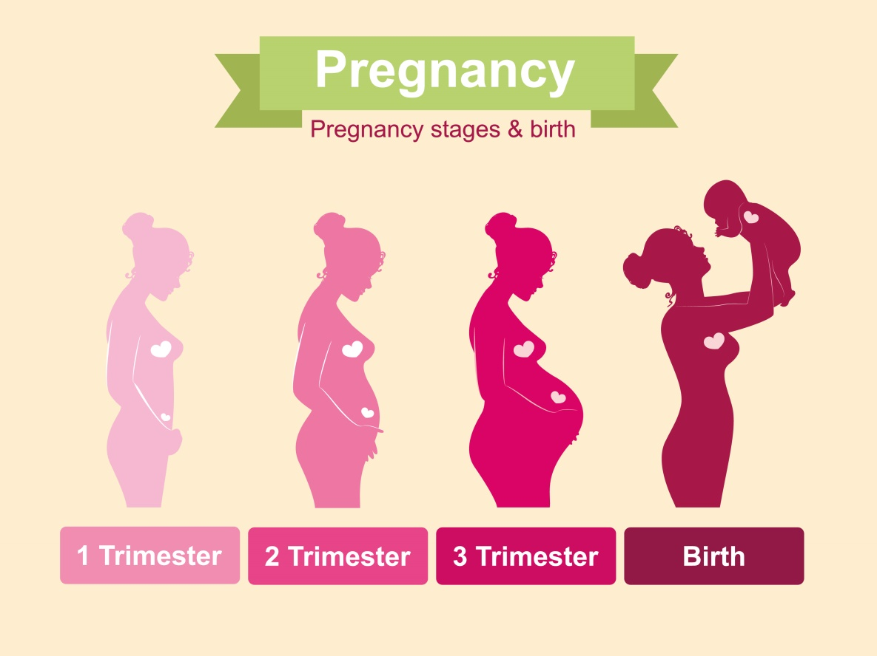
Introduction
© Maria Kolyadina/Shutterstock
Notes:
Instructor Notes
Discuss the physiologic changes of the obstetric patient.
The gestational period is typically 38 weeks and is calculated from the first day of the last menstrual cycle.
Physiologic changes occur throughout pregnancy that can produce or aggravate a medical disorder or alter the body’s normal response to trauma.
Circulatory changes
Red blood cell volume could increase by 30% at term gestation.
50% increase of cardiac output by 8 weeks.
30% increase in stroke volume by third trimester.
80% increase in plasma volume to the kidneys during second trimester.
Blood volume to the liver and brain is not increased during pregnancy.
During labor cardiac output increases 40% more than normal and up to 75% following the delivery.
Respiratory changes
Functional residual capacity (FRC) can decrease anywhere from 10% to 25% during pregnancy.
Tidal volume increases up to 45%.
Minute ventilation will also increase.
During labor, minute ventilation could increase to 104% to 200%.
Renal changes
Due to increased cardiac output, the kidneys increase in size by about 30%.
The glomerular filtration rate (GFR) increases 50% more than normal due to the increase in renal blood flow.
Gastrointestinal changes
A reduction in esophageal sphincter tone leads to a higher risk of reflux of gastric contents due to the stomach rotating and becoming displaced during pregnancy.
Increase risk of constipation could arise due to the increase of intestinal transport times.
Endocrine changes
Increase in progesterone allows for systemic vasodilation and decrease in blood pressure. Also relaxes ligaments, softens and widens cervix for delivery.
Thyroid hormone increases to about 50% more than normal.
Endorphins and enkephalin increase to allow for a higher pain threshold during labor.
Free cortisol levels increase to 2.5 times higher.

Slide 4
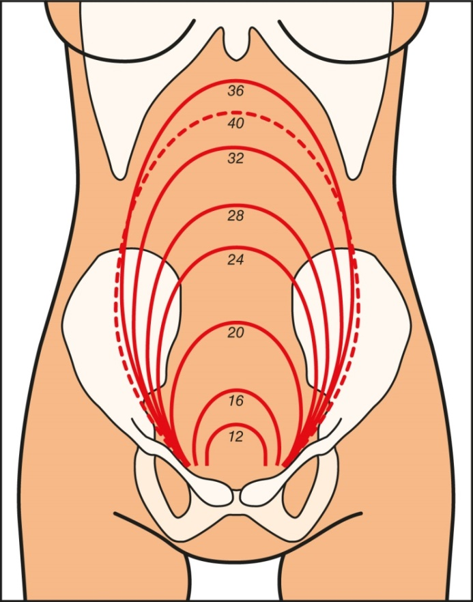
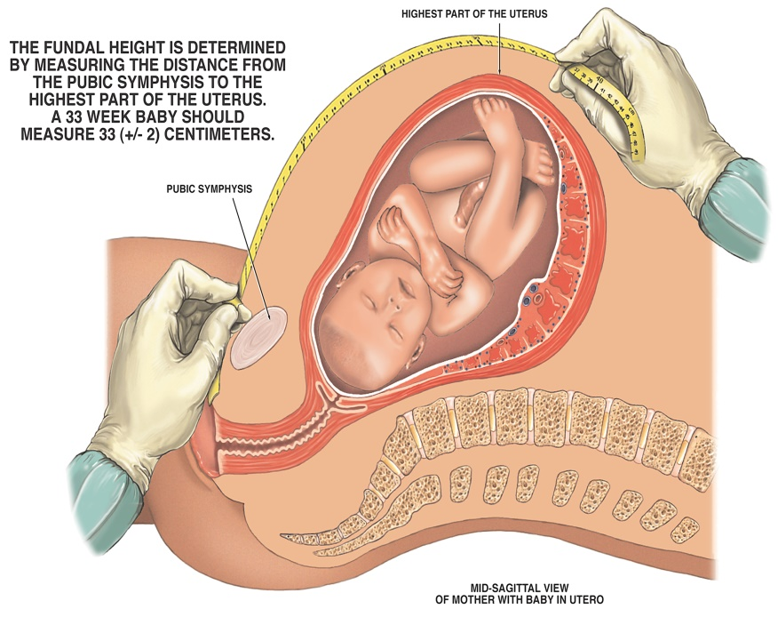
Measuring Fundal Height for Viability
© Nucleus Medical Media Inc/Alamy Stock Photo
Notes:
Instructor Notes
Discuss measurement of the fundus.
Measurement of the fundus may indicate developmental problems.
Lay patient on their back.
Use a tape measure to measure from the symphysis pubis to the highest part of the uterus.
Ensure measurement matches gestational age.
Measurement is more accurate after 20 weeks, once the fundus passes the belly button.
At 12 weeks, the fundus is above the symphysis pubis.
At 12 to 20 weeks, the fundus is between the symphysis pubis and the belly button.
Once the length reaches 20‒36 cm, the fundus reflects the mother’s weeks in pregnancy.
Viable gestational age is at least 24 weeks.
Most infants born at 26 weeks are extremely viable, below 22 weeks the newborn is not likely viable.
At 36 weeks, the fundus is at the xiphoid process.
By 37 to 40 weeks, the fundus moves down about 4 cm as the baby moves down to pelvic cavity and the body prepares for birthing.
A measurement that differs from what is expected could indicate:
Uterine growth problems or breech position
Possibility of twins

Slide 5

GTPAL
Gravida
Term
Preterm
Abortion
Live births
© Valeria Aksakova/Shutterstock
Notes:
Instructor Notes
Discuss these terms and what they mean:
G – Gravida. The number of times a woman has been pregnant, regardless of pregnancy outcome.
T – Term. The number of pregnancies delivered at 37 weeks 0 days of gestation and beyond.
P – Preterm. The number of pregnancies delivered from 20 weeks 0 days of gestation through 36 weeks 6 days of gestation.
A – Abortion. The number of pregnancies ending before 20 weeks 0 days gestation; these may be spontaneous (miscarriage) or induced abortions.
L – Living. The number of currently living children.
Practitioners may also hear gravida/para in referring to a woman’s pregnancy history. Para is an umbrella term for all pregnancies that reached viable status (i.e., >20 weeks gestation).

Slide 6

High-Risk Deliveries
Maternal factors
Pregnancy factors
Delivery factors
© urbazon/E+/Getty Images
Notes:
Instructor Notes
Potential high-risk deliveries include:
Multiple previous births
Increases the risk of rapid progression of the delivery.
Prematurity
Delivery of less than or equal to 36 weeks, indicates a greater chance the newborn will need sustained resuscitation and specialty care.
Carrying multiple babies
Associated with a higher risk of preterm delivery and complications that may require advanced resuscitation of the newborns and specialized hospital care.
You may need to call for additional personnel in order to provide adequate care for both mother and baby or when faced with the imminent delivery of multiple babies.
Presence of meconium
Brown- or green-colored fluid after membrane rupture signals intrauterine fetal distress and an increased risk of the need for resuscitation.
Placental abnormalities
Placental abnormalities, such as placenta previa, have an increased risk of significant bleeding that may compromise both mother and baby.

Slide 7
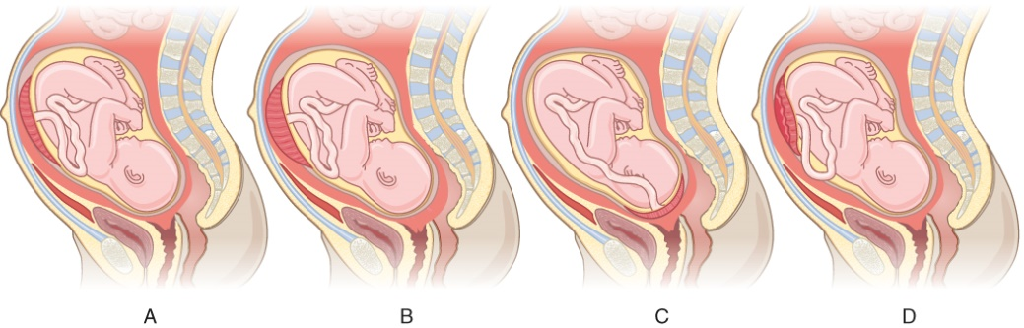
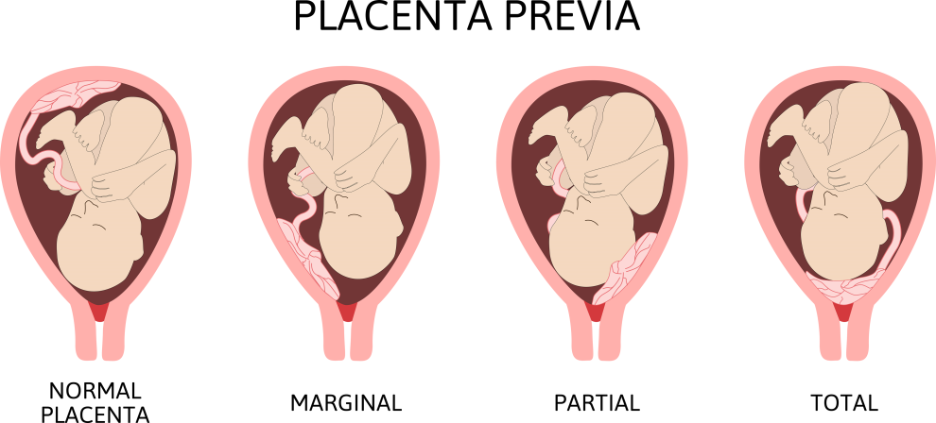
OB Complications
Placenta previa
Placenta abruptio
Preeclampsia
Eclampsia
© Betty Ray/Shutterstock
Notes:
Instructor Notes
OB complications
Placenta previa
Abnormal implantation of placenta on lower half of uterine wall, partially or completely covering the cervical opening.
Pulls placenta away from uterine wall, causing bright red vaginal bleeding. As the mother enters labor, cervical dilation causes tearing of the placenta and hemorrhage.
Classically presents as painless vaginal bleeding in the third trimester.
Symptoms
Vaginal bleeding (usually occurs in third trimester, may be bright red) that is painless.
Hypotension if bleeding is severe.
Tachycardia.
Uterus remains soft and nontender.
Treatment
Placing a sanitary pad over vagina to measure blood loss, if vaginal bleeding is present.
Transport in left lateral recumbent position.
Monitor and treat for shock.
Fluid resuscitation.
Fetal stress may increase before maternal signs are present; it is important to monitor and treat for shock early.
Fetal monitoring if Doppler ultrasound is available.
Attempts to deliver vaginally carry high mortality for both infant and mother.
Placenta abruptio
The placenta separates from the uterus before childbirth. Consider the extent of separation (partial or complete) and the location of separation (marginal or central).
Partial abruption
Vaginal bleeding but no increase in pain.
Complete abruptio placentae
Vaginal bleeding and/or maternal hypotension.
Central abruption
Placenta separates centrally; bleeding trapped between placenta and uterine wall; no vaginal bleeding; sudden sharp, tearing pain and development of stiff, boardlike abdomen.
Marginal abruption
Most common; placenta is near the cervix; blood collects below the chorionic membrane.
Most often occurs around 25 weeks of pregnancy.
Trauma is the most common cause (even minor motor vehicle collisions and/or falls).
High degree of suspicion with any form of trauma, especially in the last trimester of pregnancy.
Complications for the baby can include fetal distress, low birthweight, preterm delivery, and stillbirth.
Treatment
Place a sanitary pad over vagina to measure blood loss, if vaginal bleeding is present.
Transport in left lateral recumbent position.
Monitor and treat for shock.
Fluid resuscitation.
Fetal stress may increase before maternal signs are present; it is important to monitor and treat for shock early.
Fetal monitoring if Doppler ultrasound is available.
Preeclampsia
Disorder of pregnancy characterized by the onset of high blood pressure and often a significant amount of protein in the urine.
When it arises, the condition begins after 20 weeks of pregnancy.
Symptoms
Hypertension
Swelling/edema
Headaches
Nausea/vomiting
Abdominal and/or shoulder pain (referred as it radiates to right shoulder from liver)
Lower back pain
Short of breath/anxiety
Treatment
Maintain ABCs.
High-flow oxygen due to possible fetal hypoxia.
ECG monitor.
Saline lock (volume depleted but have hypertension).
Contact medical control for prophylactic magnesium sulfate.
Eclampsia
A severe complication of preeclampsia.
A rare but serious condition in which high blood pressure results in seizures during pregnancy.
Signs and symptoms
Pre-eclampsia symptoms plus seizure
Tachycardia
Altered mental status
Increased sense of anxiety
Dyspnea
Weakness or a feeling of malaise
Hyperreflexia
Focal neurologic deficits
Seizure
Petechiae (pinpoint hemorrhages to the skin) and bruising
Oliguria (decreased urine output)
Treatment
Maintain ABCs.
High-flow oxygen due to possible fetal hypoxia.
ECG monitor.
Saline lock (volume depleted but have hypertension).
Magnesium sulfate according to protocol: 1 to 2 g over 20 minutes up to 4 to 6 g over 20 minutes, with an infusion of 1 to 2 g/hour after.

Slide 8
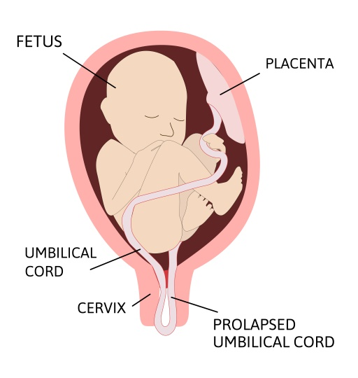
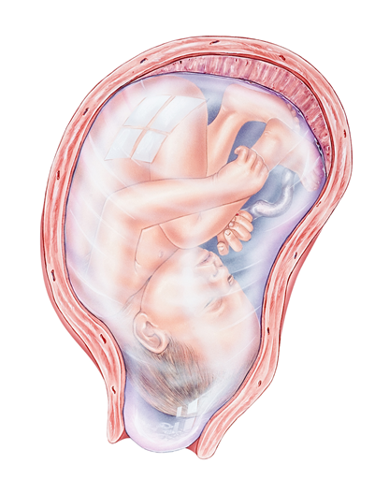
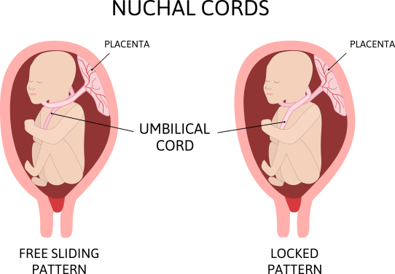
Abnormal Presentations (1 of 2)
Bulging sac
Prolapsed cord
Nuchal cord
© Medical Art Inc/Shutterstock
© Betty Ray/Shutterstock
© Betty Ray/Shutterstock
Notes:
Instructor Notes
Bulging sac
The amniotic sac presenting on cervical exam.
Not a problem if full-term and in labor.
Assist with sac rupture and deliver.
Dangerous if preterm as the sac can rupture and expose fetus to bacteria.
Prolapsed cord
Umbilical cord prolapse is an uncommon but deadly complication.
The cord will present outside the vagina and/or baby will have abnormal fetal heart rate.
More likely to occur in women with multiple births, shoulder dystocia, and breech birth.
If you see an imminent birth with shoulder dystocia and/or breech birth, there could also be a prolapsed cord.
Place the patient in the knee-to-chest position with their hips elevated.
Patients should be told not to push, to prevent further movement of the fetus.
This patient will need a C-section.
Nuchal cord
The umbilical cord is wrapped around the infant’s neck.
Work a finger under the umbilical cord, gently pull some slack on it and lift it up and over the infant’s neck, continuing with normal delivery.
If that fails, carefully clamp and cut the cord prior to delivery of baby.

Slide 9
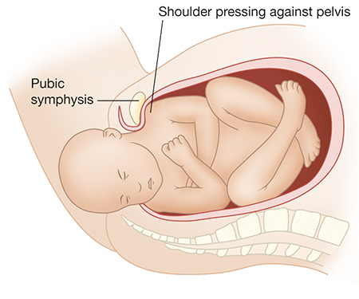
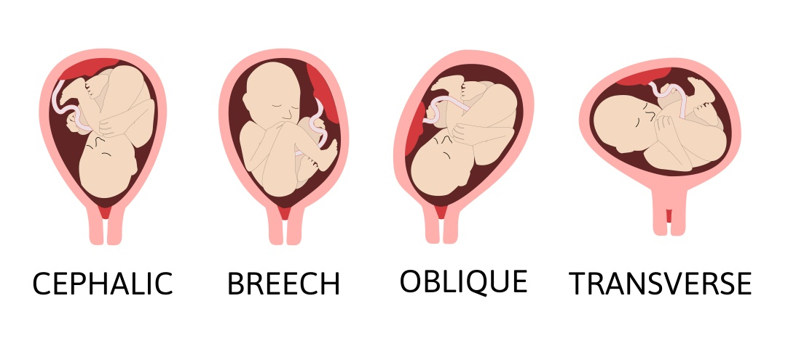
Abnormal Presentations (2 of 2)
Breech presentation
Shoulder dystocia
© Betty Ray/Shutterstock
Notes:
Instructor Notes
Breech presentation
Three types of breech presentation:
Frank
Feet up by head and buttocks entering birth canal first.
66% of all breech births.
Complete
Buttocks and feet presenting first in the birth canal.
Incomplete
One foot by head and one by the buttocks.
The problem with breech births is that they cannot open the cervix like a head-first presentation.
The head coming last is a problem, and a prolapsed cord can result from breech presentation.
If imminent delivery, prepare for the birth as normal and alert the receiving hospital.
Support the feet as they deliver.
Then support the trunk, leaving the feet dangling.
The head generally delivers facedown.
If the head gets stuck, insert your fingers into the birth canal and create an open airway to the child's face by creating a V with your fingers.
You can do blow-by O₂.
If delivery is not imminent, place mother in knee-to-chest position with her hips elevated.
Shoulder dystocia
Occurs when the infant’s shoulders are too broad and get lodged in the birth canal.
Risk factors include maternal diabetes, maternal obesity, and prolonged pregnancy.
The most common danger is fetal tearing of the brachial plexus nerves. It is critical that providers recognize that, due to laxity of joints, injury to nerves often occurs in the absence of shoulder dislocation or fracture.
Other dangers include fetal asphyxiation and clavicle fracture.
A common presentation is the “turtle sign” where the head pops in and out of the vaginal canal as the mother pushes.
Treatment includes the McRoberts maneuver.
Hyperflex the mother's hips by forcefully pushing her thighs back onto her abdomen/chest, allowing more room for the passage of the anterior shoulder.

Slide 10
Case Study 1
Dispatch
  You and your partner respond for an 18-year-old female in labor. It is a mild spring morning, temperature 60°F (15.6°C).
Notes:
Instructor Notes
For students other than prehospital practitioners, dispatch information can be modified.
What are your initial concerns and possible differential diagnosis based on the dispatch information?
Initial impression begins when the dispatch information is received.
Initial concerns
18-year-old female in labor
Differential diagnosis
Braxton Hicks contractions and labor.
Prepare for potential complications.
Discuss the importance of scene assessment and awareness.
Expand on how it applies to this case.
Discuss with participants what equipment they should bring for an imminent labor 911 call.
Equipment needed:
Obstetric (OB) kit, which should include sterile disposable scalpel or scissors, disposable towels, receiving blanket, sterile disposable bulb syringe, sterile umbilical clamps or ties, large plastic bag with twist tie (to store placenta), plastic-lined under pads, disposable plastic apron, mask, and protective eyewear.
Discuss the equipment found in the participants’ organization’s OB kits.
Oxygen
Airway bag
Pediatric bag
What can you do en route in the back of the ambulance that will prepare for transport of the baby and mother?
Think about the possible need for additional resources should there be complications with the mother or neonate.
Start warming the environment in the back of the ambulance. Turn up the heat until you are uncomfortable and turn off air conditioning.
If there is family on scene that is hindering your care, what kind of tasks can you ask them to complete while you prepare to assist with the delivery?
If delivering in the home and setting allows, have a family member warm towels in the dryer.
Case Study 1 involves an 18-year-old female in labor.
Diagnosis:
Mother
Vaginal delivery with no complications
Newborn
Meconium aspiration

Slide 11

Initial Observations
As you arrive at the front entrance of the residence you are met by the patient’s mother, who appears anxious.
© Prostock-studio/Shutterstock
Notes:
Instructor Notes
Discuss the following initial findings at the scene:
Mother states patient has been laboring for awhile and her water broke a couple of hours ago.
Patient tried to wait until doctor office opened for the day.
Patient states, “Help! This baby is coming right now, and I need to push!”
Discuss additional precautions or concerns that may be warranted based on initial observations.
Should you consider moving this patient off the couch? Why or why not?
If the scene is safe and delivery is clearly imminent, it is often best to delay transport until the baby has been born.
Leave patient on the couch or move to floor and deliver.
Should you place anything under the patient to prevent contamination? Why or why not?
You can place sheets/bath blankets under the patient to control fluids.
Have hand towels or towels on hand to cover possible incontinence.
Based on the patient’s history or baby’s presentation vaginally (prolapsed cord, breech, excessive hemorrhage), should you request a second EMS unit or fire department for assistance? Why or why not?
Be sure to have adequate personnel immediately available to care for both mother and infant when transporting any woman in active labor.
Call for backup personnel early; do not wait until complications occur to call for help.
Should you consider moving this patient to the stretcher if imminent delivery is noted? Why or why not?
General wait time is transport after 30 minutes if delivery does not begin immediately.
Contractions over 5 minutes apart, transport.
2 to 3 minutes apart, stay and deliver.
On the other hand, it may be wise to expedite the transport of a woman with a high-risk or actively complicated delivery.
Can you allow the patient’s partner to be present and assist with the delivery if no life threats are noted?
Patient’s partner can be used to assist or calm the patient.
If bystander is causing an issue, have them attend to another task that will distract them.
What facility does this patient need to be transported to, and can you separate the baby and mother? Why or why not?
Although it is preferable to keep mother and baby together, any newborn requiring more than transient basic resuscitation should be transported to a facility with advanced neonatal care capabilities whenever possible.
Discuss guidelines in your region for recommendations about when, how, and where to transport women in active labor.

Slide 12
Primary Survey
    Primary survey
      X ‒ No bleeding found.
      A ‒ Patent.
      B ‒ Respirations are rapid with mild to moderate retractions.
      C ‒ Radial pulses are strong and regular. Capillary refill time is brisk. Skin is warm and diaphoretic.
      D ‒ Alert and anxious; GCS = 15 (E4, V5, M6).
      E ‒ Lying on couch. Uterine fundus is at xiphoid. Contractions every 3 minutes.
Notes:
Instructor Notes
Discuss the primary survey.
Note that the PAT is not used because the current patient is an adult.
Ask participants to explain any abnormal findings of their patient(s), whether physical and/or developmental, and why.
Discuss any life threats identified in this case.
Abnormal for adults: Tachypnea and retractions.
Primary survey
X ‒ No bleeding found.
A ‒ Patent.
B ‒ Respirations are rapid with mild to moderate retractions.
C ‒ Radial pulses are strong and regular. Capillary refill time is brisk. Skin is warm and diaphoretic.
D ‒ Alert and anxious; GCS = 15 (E4, V5, M6).
E ‒ Lying on couch. Uterine fundus is at xiphoid. Contractions every 3 minutes.

Slide 13
Discussion
Is this patient “Quick” or “Not Quick”?
Have you identified if delivery is imminent?
What preparations can you take to prepare for delivery?
What would your initial treatment be?
Notes:
Instructor Notes
Is this patient “Quick” or “Not Quick”?
The patient is “Quick.”
Expand how this determination was made.
Have you identified if delivery is imminent?
A pelvic exam reveals crowning, supporting that delivery is imminent.
Expand on determining transport considerations for this patient.
What preparations can you take to prepare for delivery?
Discuss pertinent questions that can be asked of the patient that will aid in the preparation of delivery.
Has the mother received regular prenatal care?
Regular prenatal care typically means a healthier mother and baby.
Does the patient have any chronic or pregnancy-related medical problems?
If so, ask the family what they have been told about possible complications at or soon after delivery.
Some medical conditions, such as maternal diabetes, hypertension, cardiac or pulmonary disease, or previous problems during childbirth, may place the patient, the child, or both at risk of complications.
Has the patient used any legal or illegal drugs during the pregnancy?
Drugs of abuse and some prescribed medications can cause central nervous system (CNS) depression or excitation, drug dependency, hypoglycemia, and other complications in the newborn.
If the mother has used drugs, ask when was the last time she used them.
Addicted mothers who stop using their drugs close to the time of delivery may suffer from withdrawal, as can their babies.
Recent use of depressant drugs may result in a depressed newborn.
Has the patient participated in any high-risk behaviors during the pregnancy?
Such behaviors include alcohol use, smoking, multiple sexual partners, unprotected sex, poor diet, and eating disorders.
Any of these behaviors may have an adverse impact on the health of both mother and baby and increase the chances that you may need to resuscitate a newborn.
Note that the most common complication for the mother after delivery is excessive bleeding.
Normal blood loss is approximately 500 cc (mL) with a vaginal delivery.
Orthostatic hypotension and tachycardia begins after 1200–1500 mL of blood loss.
What would your initial treatment be?
Discuss treatment options per local guidelines and policy.
Treatment should focus on the delivery of a newborn.
Participant engagement:
Remind participants that recognizing and managing the delivery of a newborn or when to transport is critical for good patient outcomes.
Being prepared for potential OB complications and newborn resuscitative care is equally as critical for improving patient outcomes.

Slide 14
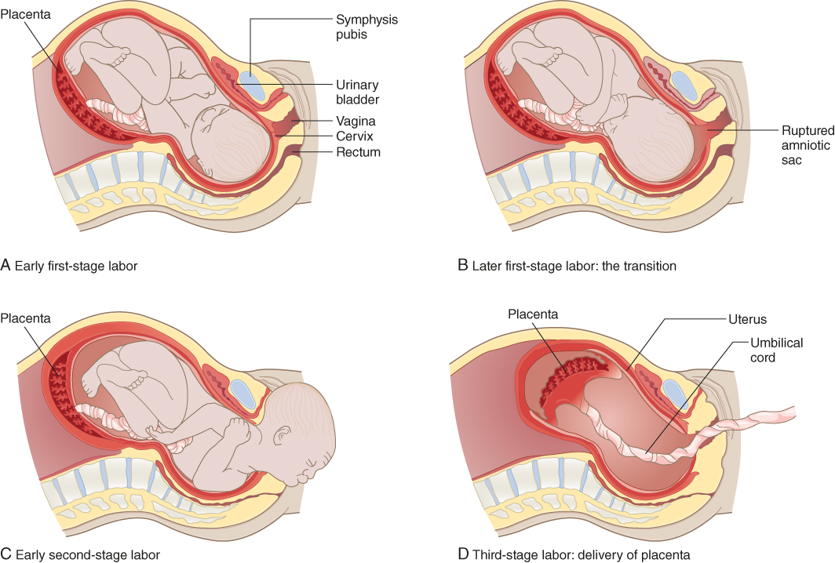
Stages of Labor
First
Second
Third
Fourth
Notes:
Instructor Notes
Discuss the stages of labor.
First stage
Begins with the beginning of contractions that cause progressive changes in the cervix and ends when the cervix is fully dilated.
Early labor phase
Contractions will last about 30 to 45 seconds and give about 5 to 30 minutes of rest in between contractions.
Contractions may feel like aching in lower back, menstrual cramps, and pressure on pelvis area.
Increase in mucous vaginal discharge, which may be tainted with blood, the so-called bloody show.
Possible for water to break (amniotic sac rupture) during this time.
Active labor phase
Contractions become more frequent, longer, and strong.
Contractions will last about 60 seconds, every 5 minutes, for an hour.
Cervix dilates from 4 to 10 cm.
Toward the end, baby begins to descend, or it will start to drop.
Transition phase
The last part of active labor, when cervix dilates from 8 cm to a full 10 cm.
Contractions come every 2.5 to 3 minutes and last a minute or more.
Second stage
Continues after the cervix is dilated to 10 cm until the delivery; often referred to as the “pushing stage.”
Contractions will last 45 to 90 seconds with a 3- to 5-minute rest period.
Baby begins to descend with the strength of each contraction of the uterus, and the abdominal muscles help move the baby through the birth canal.
Once uterus is relaxed, the baby’s body moves in a two step forward, one step back kind of process.
Third stage
Delivery of the placenta.
After giving birth, uterus begins to contract.
These first contractions separate the placenta from uterine wall.
Uterine contractions squeeze shut the exposed blood vessels.
Placenta is expelled.
Typically happens within 5 to 30 minutes after the delivery.
Fourth stage
This stage may be referred to as the postpartum stage.
Occurs the first hour after delivery.

Slide 15
Post Delivery Care for Mother
Don’t forget to continue care for the mother
Placenta delivery
Postpartum hemorrhage
Notes:
Instructor Notes
Discuss post delivery care for the mother.
Do not forget care should continue for the mother.
Putting baby to mother's breast stimulates uterine contractions.
Inspect mother’s perineum for tears.
If tears present, apply direct pressure to tears.
Continuously monitor vital signs for decline.
Note any continued hemorrhage.
Place maternal pad over vagina.
Is the placenta delivery an emergency, and when does it usually deliver?
The placenta should deliver between 5 and 30 minutes after delivery.
Do not delay transport for delivery of the placenta.
It is not an emergency procedure and generally occurs spontaneously.
Never pull the umbilical cord to facilitate this process.
Place in biohazard bag and transport with patients.
Postpartum hemorrhage
Losing more than 500 mL of blood after vaginal delivery of the baby.
Visual estimation of blood loss generally underestimates when the amount of blood volumes are high and overestimates when volumes are low.
Providers should massage the uterine fundus to help initiate uterine contraction to reduce hemorrhage.
Avoid overmassage.
Prehospital personnel should take the patient’s vitals, establish IV access, and administer fluids, as necessary.

Slide 16
Detailed Assessment
History taking
  O – Intermittent with contractions (every 2 to 3 minutes, 30 to 50 seconds duration)
  P – Contraction induced
  Q – Intense achy pain with pressure in pelvis
  R – Back to lower abdomen
  S – 10/10
  T – 2 hours
Notes:
Instructor Notes
Review history taking using the OPQRST mnemonic.
O – Intermittent with contractions (every 2 to 3 minutes, 30 to 50 second duration)
P – Contraction induced
Q – Intense achy pain with pressure in pelvis
R – Back to lower abdomen
S – 10/10
T – 2 hours

Slide 17
Detailed Assessment
History taking
    S – Labor with contractions
    A – No known allergies
    M – Prenatal vitamins
    P – Primigravida
    L – Dinner yesterday evening
    E – Has gotten worse over the last 2 hours since water broke
    R – 40 weeks pregnant
Notes:
Instructor Notes
Review history taking using SAMPLER.
S – Labor with contractions
A – No known allergies
M – Prenatal vitamins
P – Primigravida
L – Dinner yesterday evening
E – Has gotten worse over the last 2 hours since water broke
R – 40 weeks pregnant

Slide 18
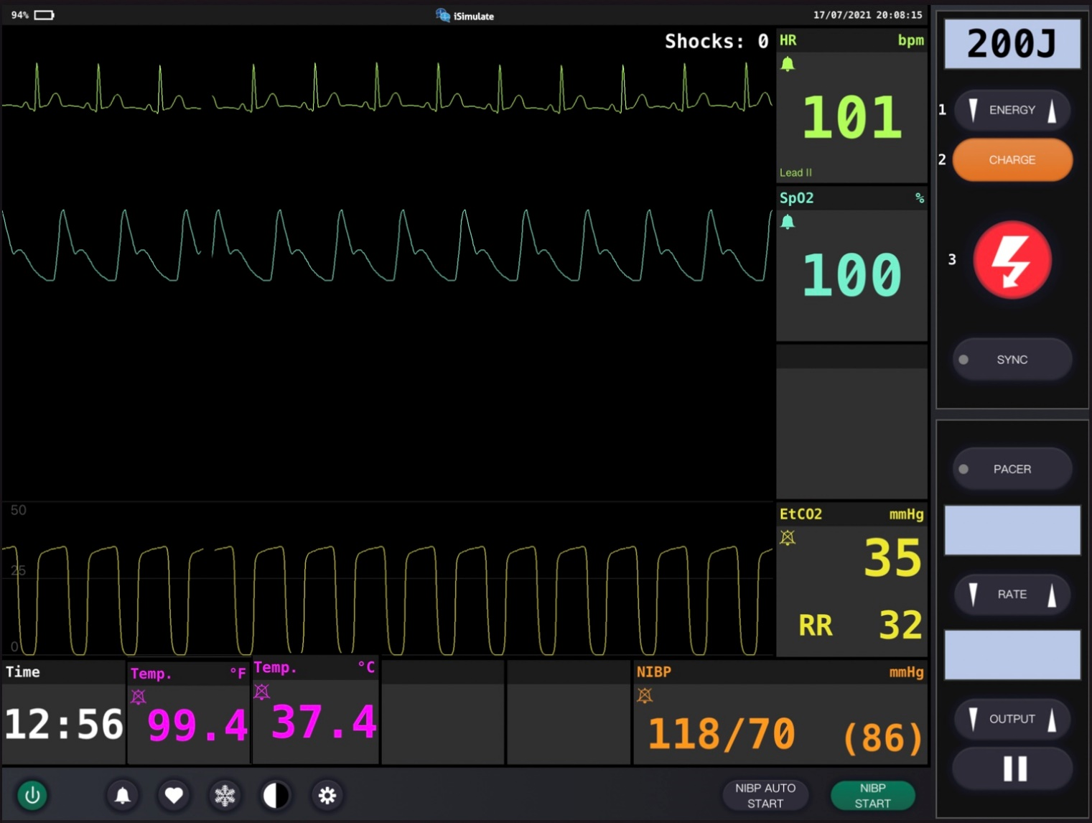
Vital Signs
Notes:
Instructor Notes
Discuss what the vital signs show about the mother:
SpO₂: 100% on room air
She has elevated respiratory rate and heart rate as she has contractions and prepares for delivery.
Fetal heart rate is 125/min.
Ask students about fetal heart rate.
Do you expect the fetal heart rate to be low, high, or normal?
Average fetal heart rate is 140 to 180.
What should you think about when you see low fetal heart rate?

Slide 19
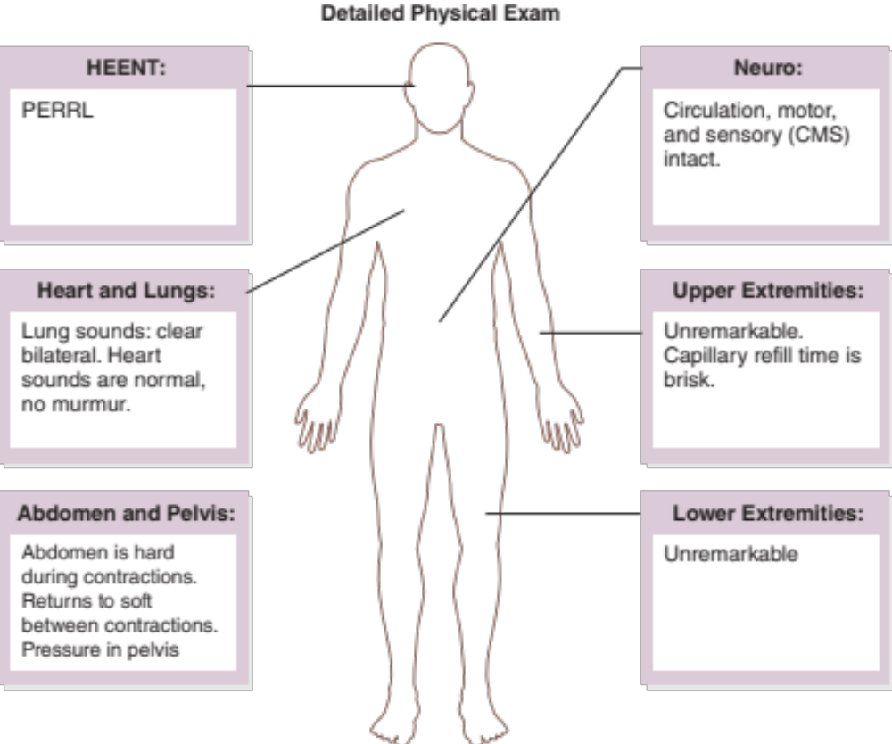
Detailed Assessment
Notes:
Instructor Notes
HEENT
Head: Unremarkable
Eyes: PERRL
Ears: Unremarkable
Nose: Unremarkable
Throat: Unremarkable
Heart and lungs
Lung sounds, clear bilaterally. Heart sounds are normal, no murmur.
Neuro
Circulation, motor, and sensory (CMS) intact.
Abdomen and pelvis
Abdomen is hard during contractions. Returns to soft between contractions. Pressure in pelvis.
Upper extremities
Unremarkable. Capillary refill time is brisk.
Lower extremities
Unremarkable

Slide 20
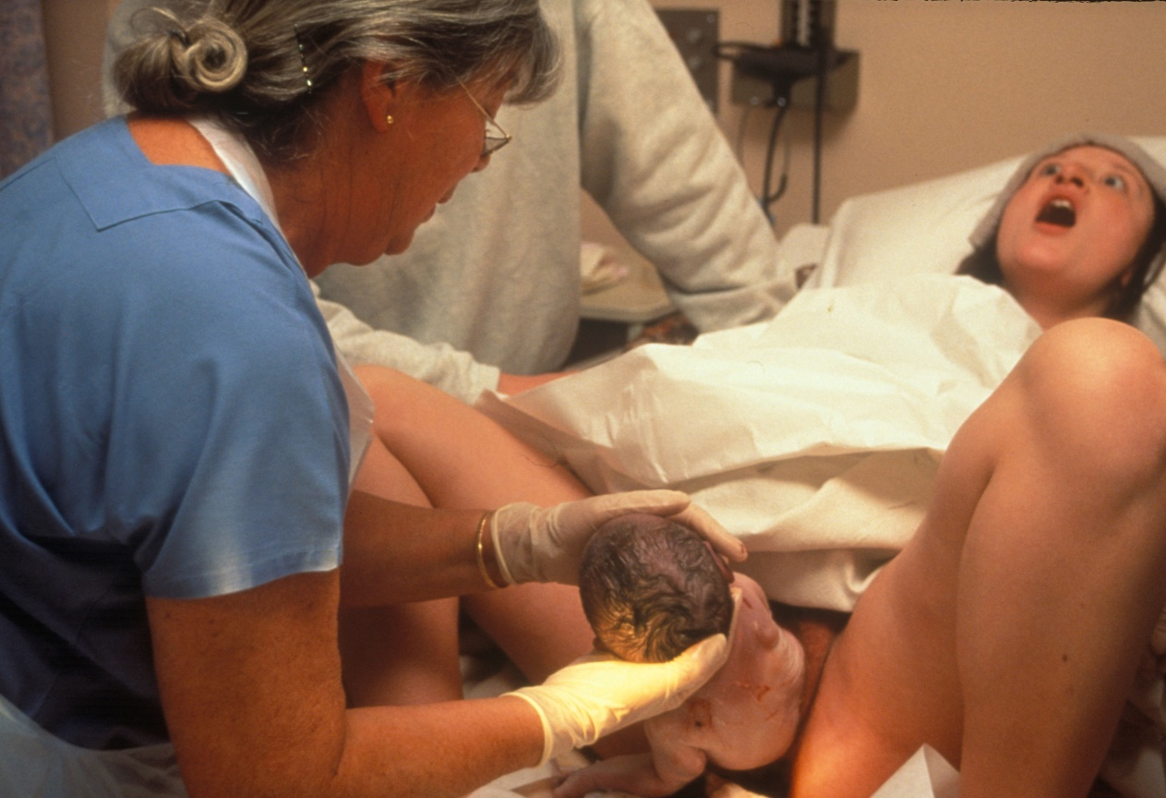
Case Progression
© Angela Hampton Picture Library/Alamy Stock Photo
Notes:
Instructor Notes
The providers visualize crowning at this point.
The mother begins pushing.
Discuss with students that meconium is present at crowning.
Further discuss expectations of the newborn and preparations that can be made as the delivery proceeds for the newborn.

Slide 21
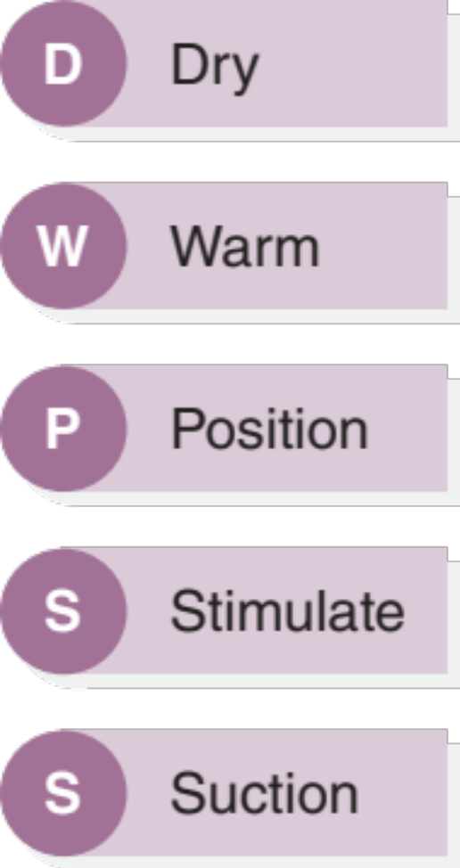
Newborn Care (1 of 2)
Notes:
Instructor Notes
Discuss the DWPSS mnemonic.
This set of basic interventions is easy to recall if you think of the first letters of the actions and remember the sentence: “Do What Probably Seems Simple.”
Dry ‒ Dry infant.
Warm ‒ Warm infant.
Position ‒ Maintain an open airway.
Stimulate ‒ Gently, if infant not vigorous.
Suction ‒ Suction the mouth, then the nose, if needed (an easy way to remember this is that M comes before N in the alphabet).
Dry and warm
Hypothermia is a major complicating factor in the newborn.
A cold baby will most likely present like they are in shock.
It is extremely important to warm the baby and then place a hat on the head, because that is where the baby loses the most heat.
In order to warm the newborn, start by drying the baby and keeping all surfaces dry that touch the baby.
Replace the towels or blankets used to dry the baby with clean dry ones as they get soiled.
If you’re not hot in the environment in which you’re delivering and treating the newborn, it’s probably too cold for the baby.
Mom’s body can make an excellent warmer!
Skin-to-skin contact is optimal.
Allowing the mother to hold her healthy, dry, wrapped baby close to her skin is good medicine for both of your patients.
Position
Ensure that you position the baby to maintain an open airway.
Stimulate
Overly vigorous stimulation is not helpful and can cause serious injury.
If a newborn is in primary apnea, almost any form of stimulation will initiate breathing.
If a baby is in secondary apnea, no amount of stimulation will work.
One or two flicks to the soles of the feet or rubbing the back once or twice should be sufficient.
If the newborn remains apneic, positive pressure ventilation should be initiated immediately.
Do not waste time with continued use of tactile stimulation if there is no response.
Hazardous stimulation: Slapping the back or buttocks, squeezing the rib cage, forcing thighs onto abdomen, dilating anal sphincter, using hot or cold compresses or bath, shaking.
Suction
Avoid unnecessary suctioning.
Suctioning provides no protection against fluid aspiration.
Routine intrapartum suctioning is no longer recommended.
If after the delivery the airway is obstructed (visualize secretions), suction the mouth and then the nose.
It is no longer routine to suction a delivered newborn.
If using a suction bulb, remember to squeeze the bulb before placement into the mouth or nose.
When you suction (especially when using a catheter), do not suction deeply or vigorously, because this may stimulate the posterior pharynx.
Stimulating this during the first few minutes after birth can produce a vagal response, causing severe bradycardia or apnea.
Brief, gentle suctioning with a bulb syringe usually is adequate to remove secretions.
If bradycardia occurs during suctioning, stop suctioning and reevaluate the heart rate.
Light meconium rarely causes respiratory problems.
If the baby has already started crying and breathing, treat him as if there was no meconium but be sure to advise the receiving hospital staff that meconium was present.

Slide 22
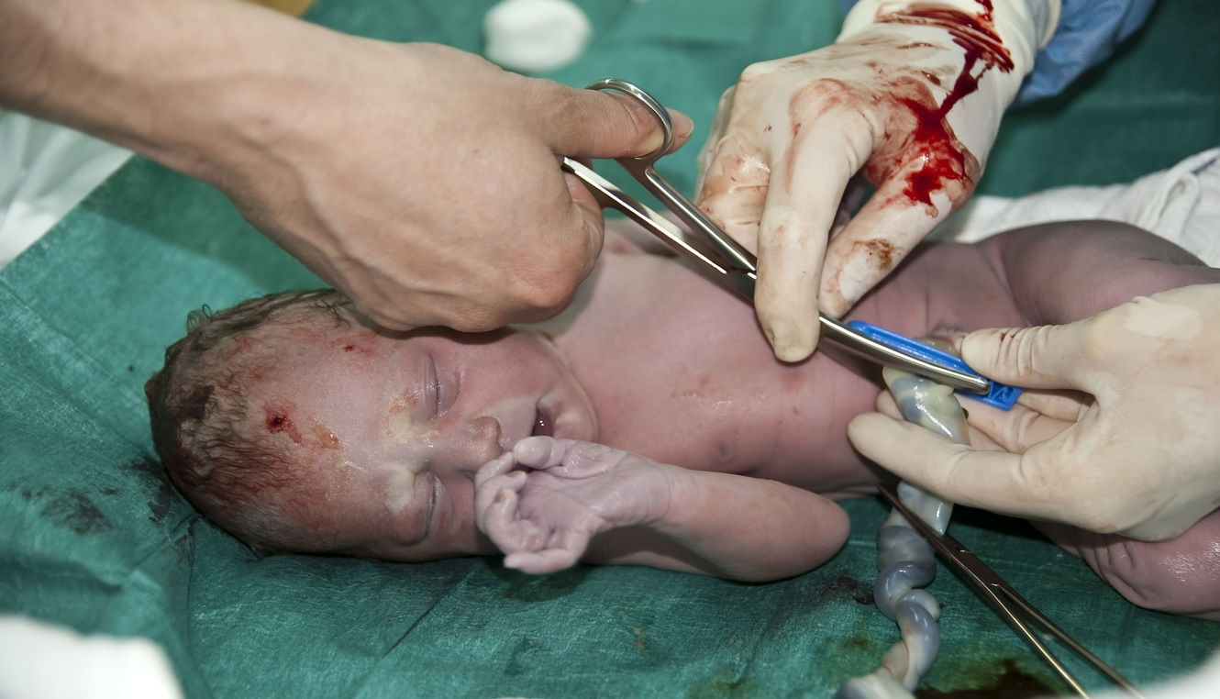
Newborn Care (2 of 2)
© vidka/E+/Getty Images
Notes:
Instructor Notes
Discuss the delivery of the newborn during normal circumstances.
Delay cord clamping in uncomplicated deliveries.
Wait 30 to 60 seconds after delivery to clamp the cord.
Benefits include:
Increased hemoglobin levels and iron stores for infant.
Better RBC volume and less need for blood transfusions.
Lower incidence of necrotizing enterocolitis and intraventricular hemorrhage.
The first umbilical clamp should be placed 10 cm from the child’s umbilicus and the second clamp placed 5 cm from the first clamp.
The cord can then be cut with a scalpel or a sharp pair of scissors.
Why keep the baby at the level of the mother?
Keep the child at the level of mom’s perineum until the delivery is complete.
If the infant is held higher than the uterus or womb before the cord is clamped, it can cause fetal placental transfusion (transfusion of blood from the baby to the placenta), hypovolemia, and anemia.
If the infant is held lower, transfusion can occur from the placenta to the baby and cause a high hematocrit.

Slide 23
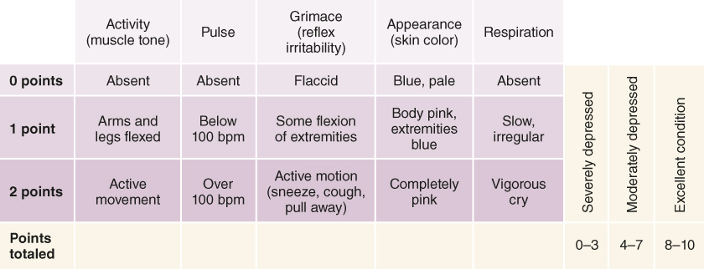
Notes:
Instructor Notes
Review the Apgar scoring system with participants.
Apgar is a quick test performed on a baby at 1 and 5 minutes after birth.
The 1-minute score determines how well the baby tolerated the birthing process.
The 5-minute score tells the healthcare provider how well the baby is doing outside the mother's womb.
In rare cases, the test will be done 10 minutes after birth.
Apgar scores are translated as follows:
0–3: Severely depressed
4–7: Moderately depressed
8–10: Excellent condition
Although the Apgar score is the traditional way to record a newborn’s physiologic status, you can use the PAT to obtain virtually the same information without having to memorize numbers.
Your EMS service may require that you record Apgar scores, but do not let that process delay patient care.
First, check the baby’s general appearance.
How is the baby’s muscle tone? Is the baby active?
An active baby with good muscle tone and spontaneous movement probably needs little care other than drying, warming, and possibly suctioning or blow-by oxygen.
A limp baby with little movement needs treatment “quick” and needs resuscitation.
It is critical to recognize that premature infants have little muscle development; therefore, respiratory distress is often apnea or shallow breathing, because they do not have the strength to breathe fast or deep.
Next, assess the work of breathing.
Is the baby’s airway open?
Normally, they are open and patent and do not require suctioning.
Is the baby breathing?
A crying baby is breathing.
A baby that is not crying is apneic.
Is there meconium present?
Meconium-stained amniotic fluid may affect the infant’s respiratory status.
Brown or green amniotic fluid with a thicker or soupy consistency is called “heavy meconium” or “thick meconium.”
Meconium is generally only present in post-date infants (>40 weeks).
If aspirated into the baby’s lungs, this heavy or thick meconium may cause critical respiratory failure in the hours and days after birth.
What is the work of breathing and the effort and character of the baby’s crying?
A newborn with shallow breathing, a weak cry and poor muscle tone is in respiratory failure and requires immediate life-saving intervention.
The most critical factors that drive resuscitation are heart rate and respiratory effort.

Slide 24
Quick vs. Not Quick with Newborns
Not Quick
Quick
Term gestation
Clear amniotic fluid
Good muscle tone
Breathing without distress
Crying
Poor muscle tone
Meconium present
Apneic
Weak cry
Respiratory distress
Shallow breathing
Gasping respiration
Notes:
Instructor Notes
Discuss a newborn’s presentation that would be considered “Quick” versus “Not Quick.”
“Not Quick:
Consider the following:
Term gestation? Clear amniotic fluid? Breathing or crying? Good muscle tone?
If yes, provide routine care (warmth, clear airway, dry, assess color) and continue with an examination.
This should include evaluation of respirations, heart rate, and color.
What is our focus with a child appearing like this?
Continued assessment
Allow nursing if the child would like.
Keep the infant warm!
“Quick”
What would your first steps be for treatment?
Assist ventilations, monitor the heart rate, stimulate, warm, begin to look for underlying causes.
What questions should you ask the mother?
Maternal drug use or any possible congenital heart defects she was told the child may have.
If there was drug use potentially affecting the child, do we treat them?
No, we no longer treat a child with Narcan or other meds because of the withdrawal symptoms and negative side effects like seizures.
Remember, gasping respirations are ineffective and require the same intervention as for apnea.

Slide 25
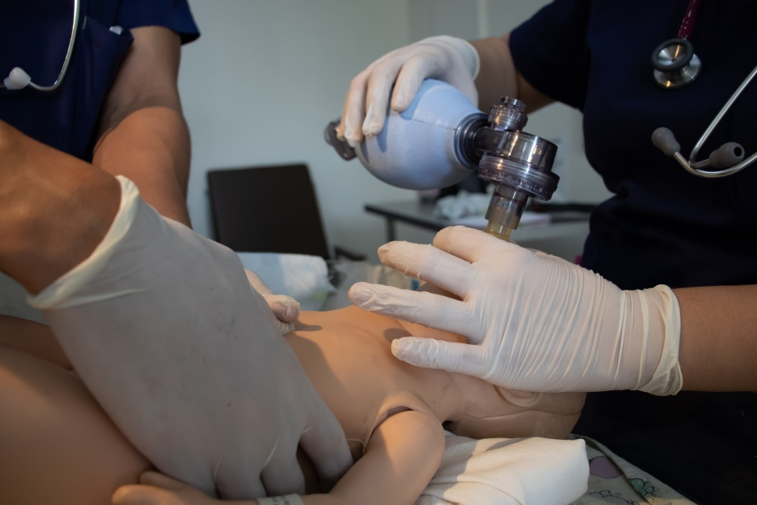
Newborn Resuscitation
When to begin ventilations
When to begin chest compressions
© Loren_Zecena/Shuttrerstock
Notes:
Instructor Notes
Discuss when to begin ventilations.
Begin immediate bag-valve mask ventilations for any baby who is apneic or has a heart rate less than 100 beats per minute after your initial rapid drying, warming, positioning, stimulation, and suctioning.
Positive pressure ventilation may help facilitate the transition in the lungs from a fetal high-pressure circuit to a newborn low-pressure circuit.
You also must ventilate babies with central cyanosis who do not improve after 30 seconds of blow-by oxygen.
Newborns with increased work of breathing or inadequate respiratory effort and a poor general appearance are in respiratory failure also require positive pressure ventilation.
Ventilate with just enough volume and pressure to achieve gentle chest rise.
Initial ventilatory volume for a full-term newborn should be only 20–25 mL of air.
Increase the ventilatory pressure if you are unable to obtain good chest rise despite a tight mask seal.
Ventilatory volumes for premature infants are even smaller.
Practice filling a 30-mL syringe with 20 mL of air and then pushing it out to get a feel for how small that volume really is.
Ventilate at a rate of 40 breaths per minute, being sure to allow adequate time for passive exhalation.
Increasing the rate of bagging to a maximum of 60 breaths per minute is an option if your patient does not improve within 30 seconds.
Signs of improvement include a heart rate rising above 100 beats per minute, attempts at spontaneous respirations, improved color, better muscle tone, and spontaneous movement.
You may consider discontinuing ventilation if the newborn’s heart rate rises above 100 beats per minute, the baby has good respiratory effort with a respiratory rate of 40 breaths per minute or more, and the color is pink.
Be prepared to resume ventilation if the baby deteriorates.
If the newborn deteriorates acutely during or soon after ventilation by bag-valve mask or endotracheal tube, think about:
Technical problems such as a kinked or obstructed endotracheal tube, poor mask seal, or a depleted oxygen supply.
A displaced endotracheal tube.
A pneumothorax caused by positive pressure ventilation.
Discuss when to begin chest compressions.
Treat these complications as you would for a child of any age.
Start chest compressions on any newborn whose heart rate is less than 60 after 30 seconds of positive pressure ventilation.
Do not wait to apply a cardiac monitor to confirm bradycardia or a collapsed rhythm.
Oxygenation and ventilation are the most effective actions in neonatal resuscitation.
This means that newborn CPR priorities are exactly the opposite of those for infants, children and adults.
In the case of newborns, effective ventilation is more critical than maintaining coronary perfusion pressure; therefore, compressions are paused during ventilation to facilitate active oxygen delivery and passive exhalation.
Oxygen is the drug of choice in neonatal resuscitation.
The goal is to provide 90 compressions and 30 ventilations per minute or 120 total events lasting approximately 1/2 second each.
The compression to ventilation ratio is 3:1.
After three rapid compressions, allowing the chest wall to recoil between each one, pause compressions to deliver one ventilation.
Reassess the patient about every 30 seconds.
Discontinue compressions when the infant can sustain a spontaneous heart rate of at least 60, with good peripheral perfusion.
Cardiac arrest drugs are rarely indicated in newborns.
Epinephrine is indicated when the newborn’s heart rate remains less than 60 despite positive pressure ventilation with chest compressions for 30 seconds.
The IV or IO dose of epinephrine is 0.01 mg/kg of the 1:10,000 solution.

Slide 26
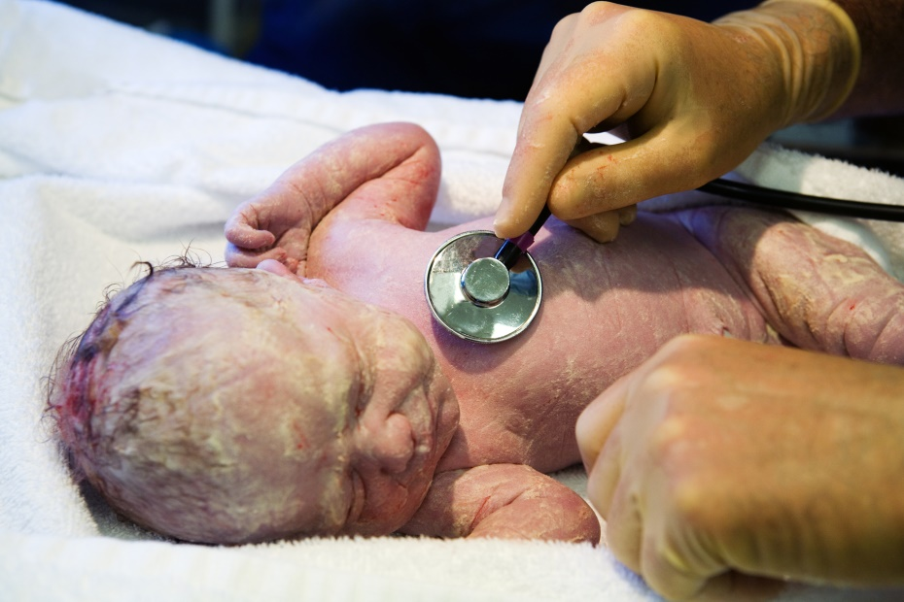
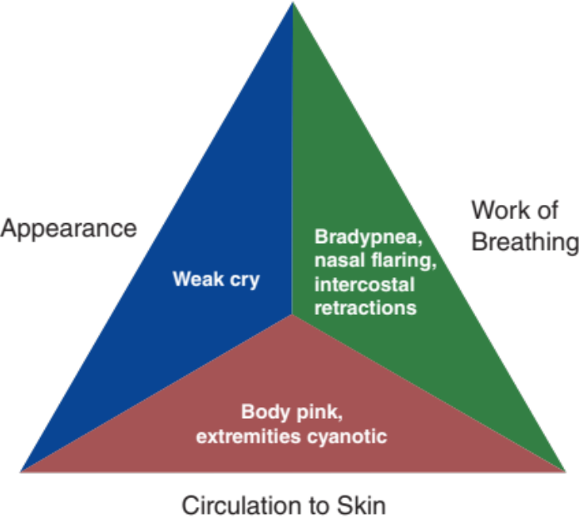
Initial Assessment
© RapidEye/E+/Getty Images
Used with permission of the American Academy of Pediatrics, Pediatric Education for Prehospital Professionals, © American Academy of Pediatrics, 2000
Notes:
Instructor Notes
Discuss the following initial and PAT findings of the newborn:
PAT
Appearance: Weak cry
Work of breathing: Bradypnea, nasal flaring, intercostal retractions
Circulation: Body pink, extremities cyanotic
Is this patient “Quick” or “Not Quick”?
The patient is “Quick.”
How was this determination made?

Slide 27
Primary Survey: Newborn Infant
Primary survey
  X ‒ No bleeding found.
  A ‒ Patent.
  B ‒ Respirations with nasal flaring and intercostal retractions. Lung sounds are adventitious and bilateral.
  C ‒ Brachial pulses are palpable. Capillary refill time is 4 seconds. Body is pink with blue extremities.
  D ‒ Depressed; APGAR = 6 (A1,P1,G1,A1,R2).
  E ‒ Yellowish-green substance present on newborn.
Notes:
Instructor Notes
Discuss the primary survey.
Note that the PAT is completed prior to primary survey.
Ask participants to explain any abnormal findings, both physical and/or developmental, and why.
Discuss any life threats identified in this case.
There are life threats: Weak cry, bradypnea, nasal flaring, intercostal retractions, and blue extremities.
Primary survey
X ‒ No bleeding found.
A ‒ Patent.
B ‒ Respirations with nasal flaring and intercostal retractions. Lung sounds are adventitious and bilateral.
C ‒ Brachial pulses are palpable. Capillary refill time is 4 seconds. Body is pink with blue extremities.
D ‒ Depressed; APGAR = 6 (A1,P1,G1,A1,R2).
E ‒ Yellowish-green substance present on newborn.
What would your initial treatment be?
Discuss treatment options per local guidelines and policy.
Treatment should focus on cardiopulmonary support.
Hypoxia is of great concern.

Slide 28
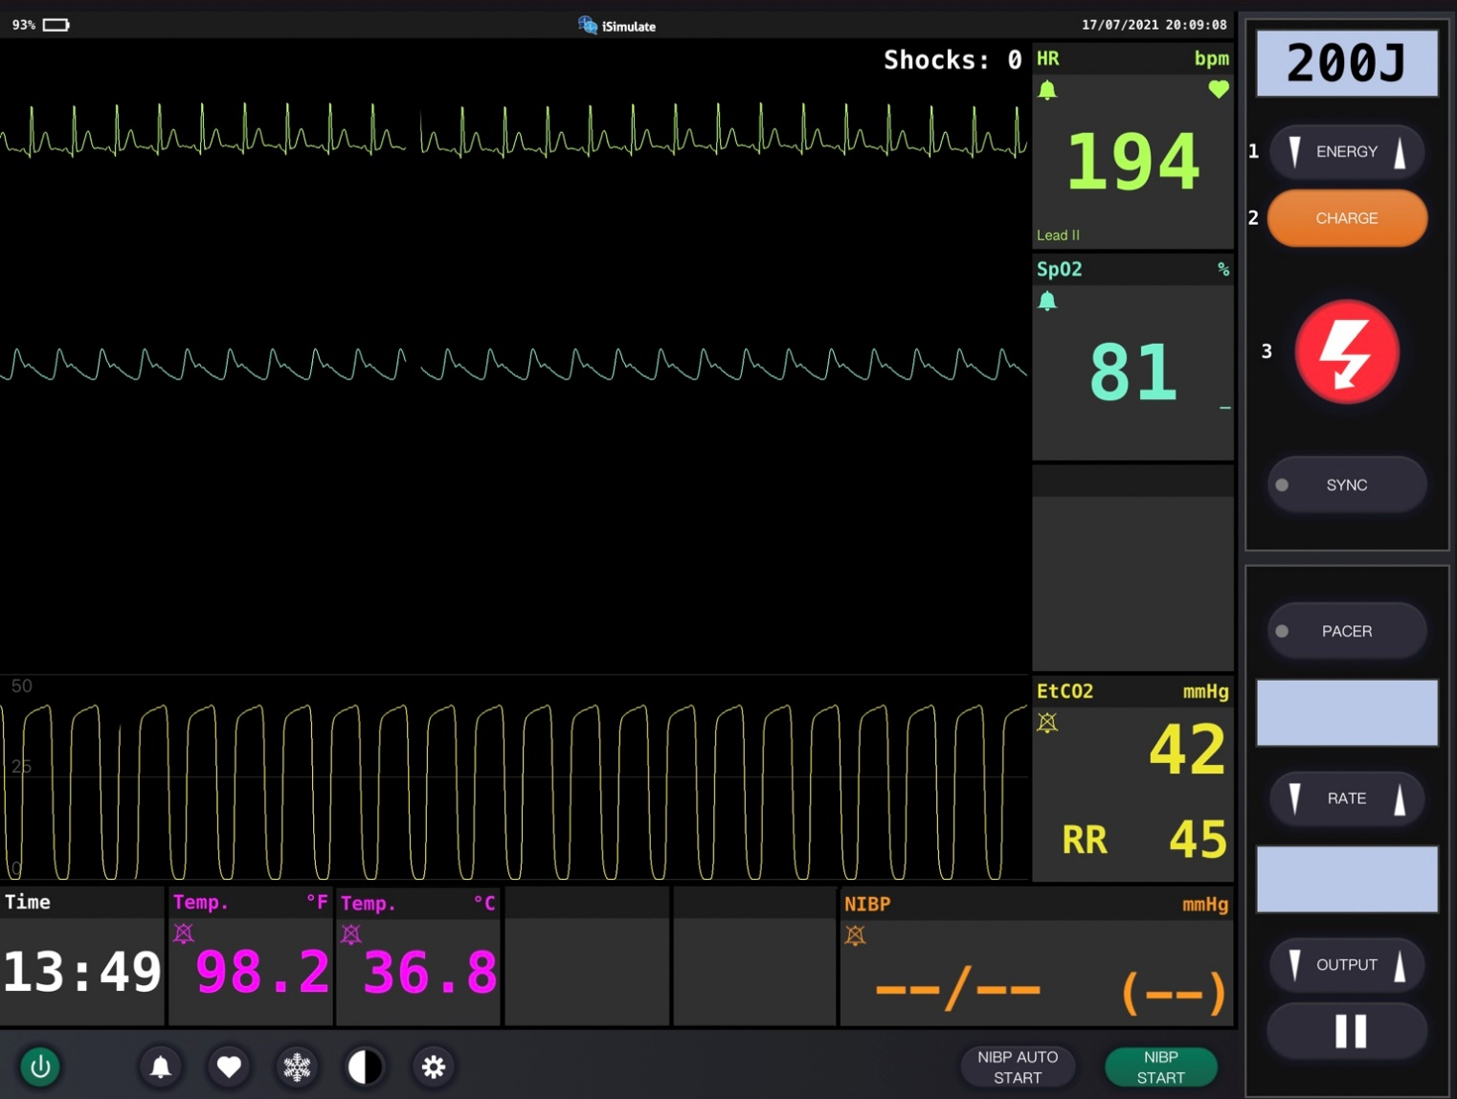
Newborn Vital Signs
Notes:
Instructor Notes
Discuss what the vital signs show about the patient. Vitals are taken 1 to 2 minutes post delivery.
SpO₂: 81% on room air and improves with PPV with oxygen. Generally, infants take 8 to 10 minutes to measure in the mid-90s.
He is hypoxic and tachypneic.
Visible nasal flaring and intercostal retractions.
Blood pressure not obtained at this time because focus is on infant resuscitation.
ECG indicates ST.
Participant engagement:
Discuss expected typical vital signs for age.
Discuss changes in oxygen saturation over time after delivery. It is important to note that pulse ox should not guide resuscitative efforts, only heart rate and respiratory effort.

Slide 29
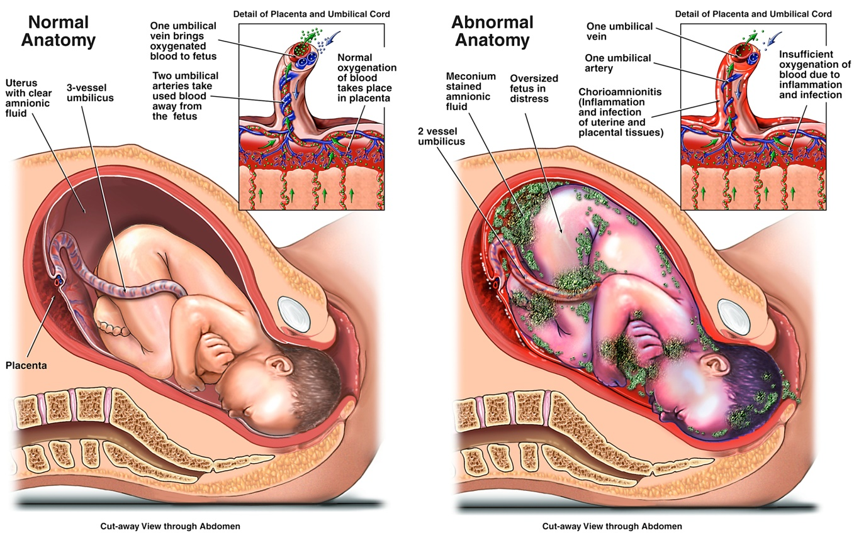
Meconium Delivery
© Nucleus Medical Media Inc/Alamy Stock Photo
Notes:
Instructor Notes
Discuss meconium delivery.
What is the yellow-green substance all over this neonate?
Meconium
What is this indicative of?
Fetal distress
What do we do with poor respiratory rate and meconium noted in the mouth?
If the infant is vigorous with good respiratory effort and muscle tone, the infant may stay with the mother to receive the initial steps of newborn care.
If the infant born through meconium-stained amniotic fluid presents with poor muscle tone and inadequate breathing efforts, the initial steps of resuscitation should be started.
Appropriate intervention to support ventilation and oxygenation should be initiated as indicated for each infant and, if the airway is obstructed and PPV is ineffective, then intubation and suction may be necessary.
If the child does not improve and the heart rate drops below 60 with assisted ventilations, what should we begin?
CPR
What are the effects of meconium in the lungs?
Meconium aspirated into the lungs also causes inflammation of the lungs (pneumonitis) and increases the risk of lung infection.
Newborns with meconium aspiration syndrome are also at increased risk of persistent pulmonary hypertension of the newborn.
Meconium release into the amniotic fluid is a sign of fetal stress.
It is the same as the incontinence we sometimes see in patients who have had a seizure.
The fetal stool floats in the amniotic fluid and can get into and around the baby’s nose and mouth during delivery, where it may be swallowed or aspirated into the airways and lungs once the baby starts breathing during or after delivery.
The stool is sterile, so there’s no added danger of infection, but it is chemically irritating to the lungs and can physically obstruct gas exchange in the alveoli when aspirated.

Slide 30
Treatment
Newborn
BLS
  Monitor airway
  Administer oxygen
  Position of comfort and keep warm
    PPV
ALS
  BLS care
    Do not intubate for deep tracheal suction in presence of meconium unless PPV is ineffective.
Critical care
  BLS/ALS care
Mother
BLS
  Monitor airway
  Administer oxygen
  Position of comfort and keep warm
    Sanitary pads for postpartum hemorrhage
ALS
  BLS care
  IV saline lock
Critical care
  BLS/ALS care
Notes:
Instructor Notes
Ask participants how they would treat both patients according to their local protocol and scope of practice.
Don’t forget to continue care for the mother.
Both patients should be treated with supportive care.
Patient management:
What are your goals for both patients?
The patients should be treated with supportive care.
Ensure a clear airway.
Keep newborn warm.
Take steps to minimize hypothermia.
Provide supplemental oxygen.
Provide PPV.
Frequently reassess condition.
Promptly identify respiratory distress, failure, and/or arrest, and intervene for patients who require escalation of therapy.
When would deep tracheal suctioning be needed in this newborn?
It may be necessary if PPV is ineffective and airway obstruction is suspected.

Slide 31
Ongoing Management
Reassess the patients.
Where is the most appropriate treatment destination and why?
Can you safely transport this child in your ambulance?
Will you allow grandmother to ride in the ambulance?
Notes:
Instructor Notes
Discuss ongoing management options based on scope of practice and local protocols.
Reassess the newborn for further deterioration.
Reassess mother for postpartum hemorrhage and further deterioration.
SpO₂ rises to 99% and the newborn’s 10-minute Apgar improves to Apgar = 9 (A2,P2,G1,A2,R2). Initial low 1-minute Apgar scores should be repeated at 5 and 10 minutes.
There are no further changes during transport to the emergency department.
Where is the most appropriate treatment destination and why?
Discuss transportation destination options for obstetrical emergencies and newborn emergencies in your region.
Share with students when and if it would be appropriate to bypass certain facilities for this patient.
If the newborn has a good general appearance with good work of breathing and circulation to the skin and vital signs are within normal limits, and if the mother is stable, transport using lights and sirens is not medically indicated.
This mother and infant should be transported to the same facility and the closest, most appropriate facility.
Generally, transport them to the mother’s choice of hospital where she was going to deliver the baby.
How would you safely transport both mother and child in your ambulance?
Discuss policies and procedures for transporting labor and delivery patients in your region.
The newborn was placed on mother’s chest for skin-to-skin contact during transport.
This is the greatest benefit in preventing hypothermia for newborn patients.
Will you allow the 18-year-old patient’s mother to ride in the ambulance?
The 18-year-old patient’s mother followed behind EMS to the hospital in her personal vehicle.

Slide 32

Case Wrap-Up
Diagnosis
  Mother
    Vaginal delivery with no complications
  Newborn
    Meconium aspiration
© Mamat Suryadi/Shutterstock
Notes:
Instructor Notes
Mother
Vaginal delivery with no complications
Newborn
Meconium aspiration
10% to 15% of deliveries
Most common in full-term babies that are small-for-gestational-age (SGA) or babies born post-term.
Case closure
Mother was fine post birth and transported to the ER without complication.
Newborn was transferred to NICU from ER.
Released to stepdown unit after 3 days treatment with antibiotics and O₂.

Slide 33
Congenital Heart Disease Causing Congestive Heart Failure at Different Times During Infancy
Age | Type of Congenital Heart Disease
Newborn | Hypoplastic left heart Severe pulmonic insufficiency Tetralogy of Fallot (te-ˈtral-ə-jē of fä-ˈlō) Severe tricuspid insufficiency Third-degree atrioventricular block Supraventricular Tachycardia (SVT) Total anomalous pulmonary venous return Transposition of the great vessels
First Month | Aortic coarctation with patent ductus arteriosus Ventricular Septal defect (VSD) Tricuspid atresia Truncus arteriosus
First 6 months | Ventricular septal defect (VSD) Patent ductus arteriosus
6-12 months | Ventricular septal defect (VSD) Endocardial fibrolastosis
© Jones & Bartlett Learning.
Notes:
Instructor Notes
The word congenital means “existing at birth.”
The terms congenital heart defect and congenital heart disease are often used to mean the same thing, but the word defect is more accurate.
This kind of heart ailment is a defect or abnormality, not a disease.
A congenital heart defect (CHD) results when the heart or blood vessels near the heart do not develop normally before birth.
Examples of defects that decrease pulmonary blood flow include:
Tetralogy of Fallot (TOF)
Transposition of the great arteries (TGA)
Pulmonary stenosis
Pulmonary atresia
Tricuspid atresia
Examples of defects that cause an obstruction to systemic blood flow include:
Coarctation of the aorta (CoA)
Aortic/mitral stenosis
Interrupted aortic arch

Slide 34
Congenital Heart Defects: Infant Presentation
Baby Presentation | Blue | Gray | Pink | Blue
Age | <2 weeks | <2 weeks | 1-6 months | 1-6 months
Pulmonary vs. systemic congestion | Poor lung circulation | Poor lung circulation and perfusion | Respiratory congestion | Blood return in the lungs is obstructed
Class | Right obstruction condition | Left obstruction condition | Left to right shunt | Mixing right to left shunt
Presentation | Central cyanosis | Cardiogenic shock | Heart failure | Cyanosis and heart failure
Findings | SpO2 <80%; Chest X-ray: black lungs; ECG: RVH | Differential SpO2, BP, and pulse in right upper extremity vs lower extremities. Slow capillary refill; Chest X-ray: white lungs ECG: LVH; in >7 days of life RVH in newborn | Hepatomegaly; murmur; Chest X-ray: white lungs ECG: Possible extreme tight axis deviation or AV block | SpO2 <80%; Hepatomegaly; Chest X-ray: white lungs
Treatments | Prostaglandin E1; intubate; oxygen and inhaled nitric oxide | Prostaglandin E1; intubate; minimal oxygen with PPV and inhaled nitric oxide; antibiotics; IV fluid therapy; Epinephrine and dopamine; milrinone or dobutamine | Minimal oxygen with PPV or intubate; careful IV fluid therapy; diuretics; milrinone or dobutamine | Minimal oxygen with PPV; antibiotics; restrict IV fluid therapy; diuretics
Conditions | Tricuspid atresia; pulmonary atresia; pulmonary stenosis; Ebstein’s anomaly | Hypoplastic left heart syndrome; coarctation of aorta; interrupted aortic arch; aortic stenosis or atresia | Patent ductus arteriosus; ventricular septal defect; arteriovenous malformation; arteriovenous canal defect | Total anomalous pulmonary venous return; truncus arteriosus; double outlet right ventricle; transposition of the great arteries with ventricular septal defect or patent ductus arteriosus
Data from Strobel AM, Lu le N. The Critically Ill Infant with Congenital Heart Disease. Emerg Med Clin North Am. 2015;33(3):501-518.
Notes:
Instructor Notes
Congenital heart diseases are discussed further in the Cardiac Emergencies lesson.
Cyanotic congenital heart diseases include the 5 Ts:
Tetralogy of Fallot
Transposition of the great arteries (TGA)
Total anomalous pulmonary venous return (TAPVR)
Truncus arteriosus
Tricuspid atresia
Acyanotic congenital heart diseases include:
Septal defects
PDA
Obstructive congenital heart diseases include:
Coarctation of the aorta (CoA)
Color guide
Cyanotic heart disease: “Blue baby”
Acyanotic heart disease: “Pink baby”
Obstructive heart disease “Gray baby”

Slide 35
Case Study 2
Dispatch
      You and your partner respond to an apartment building for a 10-month-old male turning blue and currently crying. It is a cool, summer evening. The air temperature is 76°F (24.4°C).
Notes:
Instructor Notes
For students other than prehospital practitioners, dispatch information can be modified.
What are your initial concerns and possible differential diagnosis from the dispatch information?
Initial impression begins when the dispatch information is received.
Initial concerns
10-month-old male turning blue with crying currently.
Differential diagnosis
Congenital heart defect
URI
Discuss the importance of scene assessment and awareness.
Expand on how it applies to this case.
Case Study 2 involves a 10-month-old male turning blue with crying currently.
Diagnosis: Tetralogy of Fallot

Slide 36
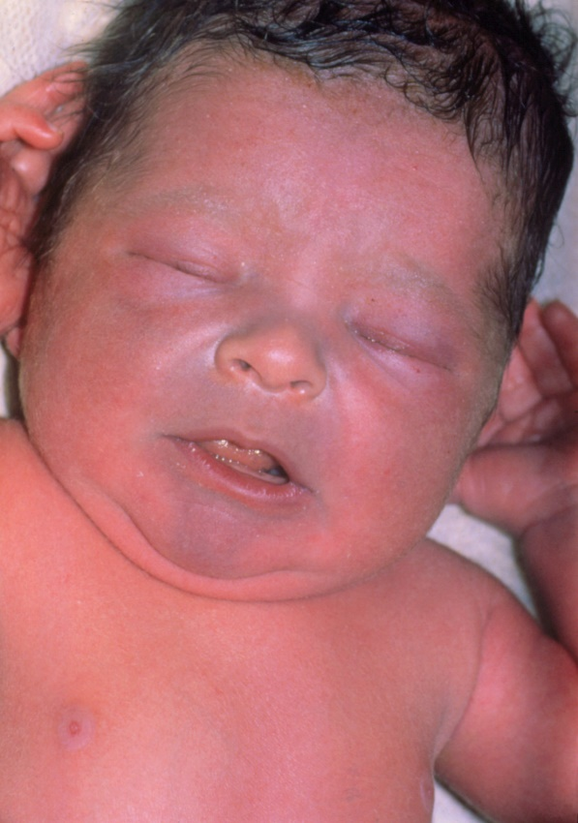

Initial Observations
© St Bartholomew's Hospital, London/Science Source
Used with permission of the American Academy of Pediatrics, Pediatric Education for Prehospital Professionals, © American Academy of Pediatrics, 2000
Notes:
Instructor Notes
Discuss the following initial findings at the scene:
As you arrive at the residence you are met by the father at the door.
He takes you to baby’s bedroom, where mom is holding the baby.
PAT
Appearance: Decreased consolability
Work of breathing: Grunting, tachypnea
Circulation: Cyanotic
The parents advise you that the patient’s history includes cyanosis since 6 weeks of age.
He has recently been diagnosed with tetralogy of Fallot and is unrepaired.
Parents are concerned with the baby’s increased crying and cyanosis.
Has had several days of URI symptoms.
Discuss additional precautions or concerns that may be warranted based on initial observations.
Is this patient “Quick” or “Not Quick”?
The patient is “Quick.”
Expand how this determination was made.

Slide 37
Primary Survey
    Primary survey
      X ‒ No bleeding found.
      A ‒ Patent.
      B ‒ Respirations rapid with grunting.
      C ‒ Brachial pulses are palpable and rapid. Capillary refill time is 3 seconds. Skin is cyanotic, warm, and clammy.
      D ‒ Crying with grunts; PGCS = 12 (E4, M6, V2).
      E ‒ No rashes or bruising noted. Mother is holding baby.
Notes:
Instructor Notes
Discuss the primary survey.
Note that the PAT is completed prior to the primary survey.
Ask participants to explain any abnormal findings of their patient(s), whether physical and/or developmental, and why.
Discuss any life threats identified in this case.
There are life threats: Tachypnea, cyanosis, and grunting.
Primary survey
X ‒ No bleeding found.
A ‒ Patent.
B ‒ Respirations rapid with grunting.
C ‒ Brachial pulses are palpable and rapid. Capillary refill time is 3 seconds. Skin is cyanotic, warm, and clammy.
D ‒ Grunting; PGCS = 12 (E4, M6, V2).
E ‒ No rashes or bruising noted. Mother is holding baby.
What would your initial treatment be?
Discuss treatment options per local guidelines and policy.
Priority treatment is knees to chest to increase blood flow to lungs.
Treatment should focus on calming the patient and improving circulation.

Slide 38

Discussion
Have you identified this patient's cyanosis as secondary to his recently diagnosed congenital heart defect?
© DeymosHR/Shutterstock
Notes:
Instructor Notes
Have you identified this patient's cyanosis is secondary to his recently diagnosed congenital heart defect?
Discuss the signs and symptoms of tetralogy of Fallot and how they connect with this patient.
Bluish color of skin due to low concentration of O₂ in blood (cyanosis)
Shortness of breath
Syncopal episodes
Poor weight gain, failure to thrive
Tiring easily
Irritability
Prolonged crying
Possible heart murmur

Slide 39
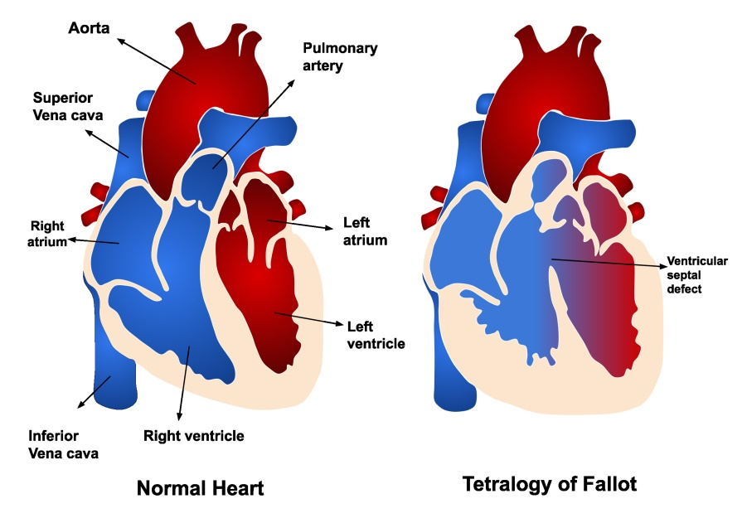
Tetralogy of Fallot
Ventricular septal defect
Pulmonary stenosis/right ventricular outflow tract obstruction
Overriding aorta
Right ventricular hypertrophy
© Ashraf Photography/Shutterstock
Notes:
Instructor Notes
Tetralogy of Fallot (ToF)
Combination of four heart defects
Ventricular septal defect
There is a hole in the wall (septum) between the right and left ventricles (pumping chambers) of the heart.
Pulmonary stenosis/RV outflow tract obstruction
The connection between the right ventricle of the heart and the lungs is narrowed, and the blood flow to the lungs is reduced.
Right ventricular hypertrophy
The right ventricle is more muscular than normal as a result of the right ventricular outflow tract obstruction and the need to pump harder.
Overriding aorta
The major blood vessel from the heart to the body, the aorta, is positioned more rightward than normal and sits above the ventricular septal defect.
Open heart surgery is required to correct.

Slide 40

Hypercyanotic Spells
© DeymosHR/Shutterstock
© St Bartholomew's Hospital, London/Science Source
Notes:
Instructor Notes
Hypercyanotic spells
Often referred to as “tet spells.”
Sometimes, babies who have tetralogy of Fallot will suddenly develop deep blue skin, nails, and lips after crying or feeding, or when agitated.
Tet spells are due to blood bypassing the lungs and moving directly from the right ventricle to the left ventricle due to increasing pressure in the right ventricle relative to the left.
The goal is to use medications/interventions that decrease pulmonary pressures and increase SVR to shift the blood back to the right heart and go through the lungs.
Tet spells are most common in young infants, around 2 to 4 months old.
Toddlers or older children might instinctively squat when they're short of breath to increase systemic vascular resistance and decrease the right to left shunt.
Squatting increases blood flow to the lungs.
Signs and symptoms include respiratory distress, cyanosis, and failure to thrive.
EMS treatment
Place knees to chest and hold.
Provide blow-by O₂.
Calm the child.

Slide 41
Detailed Assessment
History taking
  O – Sudden
  P – Increase cyanosis with crying
  Q – No discomfort
  R – None
  S – Unable to obtain
  T – 20 minutes
Notes:
Instructor Notes
Review history taking using the OPQRST mnemonic.
O – Sudden
P – Increased cyanosis with crying
Q – No discomfort
R – None
S – Unable to obtain
T – 20 minutes

Slide 42
Detailed Assessment
History taking
  S ‒ Tachypnea, cyanosis with crying, grunting.
  A ‒ No known allergies.
  M ‒ None.
  P ‒ Tetralogy of Fallot.
  L ‒ Bottle 2 hours ago.
  E ‒ Has gotten worse over the 20 minutes.
  R ‒ History of tetralogy of Fallot and cyanosis.
Notes:
Instructor Notes
Review history taking using SAMPLER.
S ‒ Tachypnea, cyanosis with crying, grunting.
A ‒ No known allergies.
M ‒ None.
P ‒ Tetralogy of Fallot.
L ‒ Bottle 2 hours ago.
E ‒Has gotten worse over the 20 minutes.
R ‒ History of tetralogy of Fallot and cyanosis.
Participant engagement:
Discuss the importance to continuously reevaluate for further decline in perfusion.
Expand on additional measures that may be used to calm the patient.
Identify methods in which the caregiver can assist healthcare personnel.

Slide 43
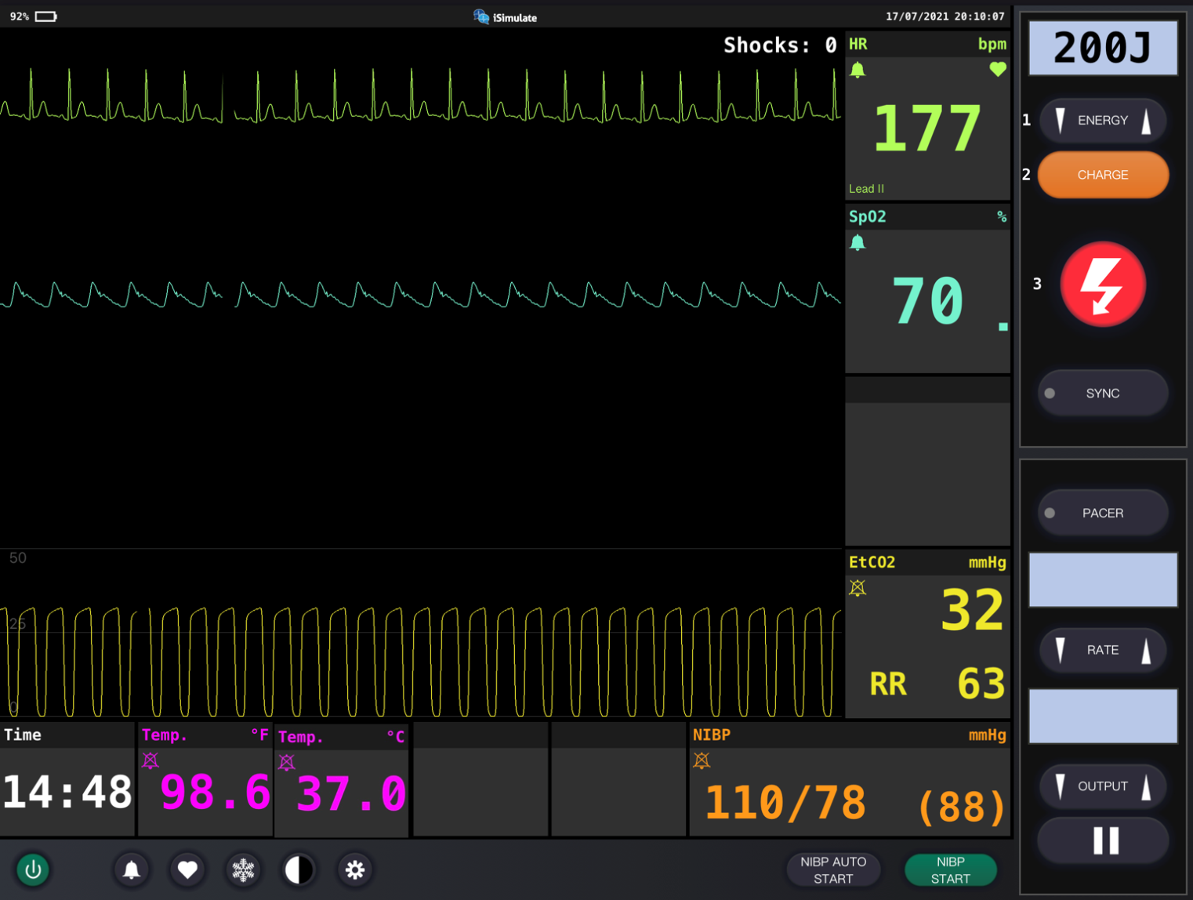
Vital Signs
Notes:
Instructor Notes
Discuss what the vital signs tell us about the patient.
SpO₂: 70% on room air
He is hypoxic.
ECG indicates ST.
Diagnostics indicate that he is cyanotic due to history of tetralogy of Fallot.
Participant engagement:
Discuss expected typical vital signs for age.
Baseline oxygen saturation level for this patient is 82%.

Slide 44
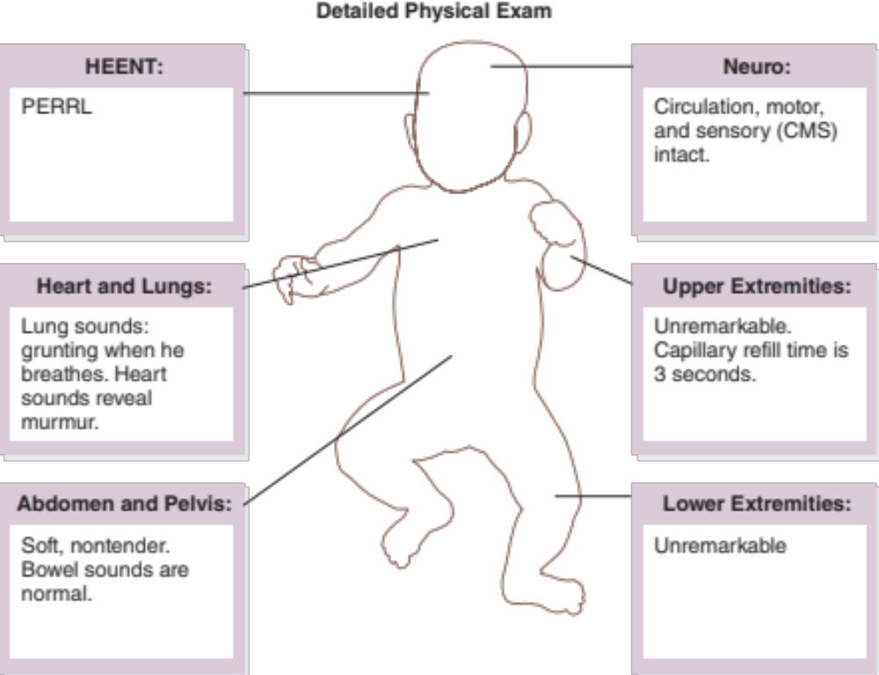
Detailed Assessment
Notes:
Instructor Notes
*Ask students: Given the age of this child, would you perform a head-to-toe or toe-to-head assessment?
HEENT
Head: Unremarkable
Eyes: PERRL
Ears: Unremarkable
Nose: Unremarkable
Throat: Unremarkable
Heart and lungs
Lung sounds, grunting when he breathes. Heart sounds reveal murmur.
Neuro
Circulation, motor, and sensory (CMS) intact.
Abdomen and pelvis:
Soft, nontender. Bowel sounds are normal.
Upper extremities
Unremarkable. Capillary refill time is 3 seconds.
Lower extremities
Unremarkable

Slide 45
Treatments
BLS
  Place child knee to chest.
  Provide blow-by O₂.
ALS
  BLS treatments.
  Establish IV saline lock.
  Place on cardiac and respiratory monitor.
  Patient can be treated with IV morphine.
Critical care
  BLS/ALS care
  Monitor for signs of respiratory failure.
Notes:
Instructor Notes
Ask students how they would treat this patient according to their local protocol and scope of practice.
Patient Management:
What are your goals for this patient?
Primary goal should be to improve circulation
Calming the patient
Establish IV en route saline lock.
Place child knee to chest.
This helps to increase systemic vascular resistance, thereby reducing the right-to-left shunt and resulting in more blood flow through the lungs.
Place on cardiac and respiratory monitor.
Patient can be treated with IV morphine.
IV 0.05 - 0.2 mg/kg/dose (Max: 2 - 4 mg)
Transport to pediatric receiving facility or critical care center based on local policy.
What conditions are part of your potential differential diagnosis?
Congenital heart defect
URI

Slide 46
Ongoing Management
Reassess the patient.
Where is the most appropriate treatment destination and why?
Can you safely transport this child in your ambulance?
Notes:
Instructor Notes
Discuss the ongoing management options based on scope of practice and local protocols.
Reassess the patient’s circulatory status throughout transport.
Child was kept calm.
Knees to chest increased systemic vascular resistance.
Gave IV morphine. Morphine helps to decrease pulmonary pressures.
Patient status improves during transport.
There are no further changes during transport to the emergency department.
Where is the most appropriate treatment destination and why?
Discuss transportation destination options for pediatrics in your region.
Share with students when and if it would be appropriate to bypass certain facilities for this patient, per local protocols.
This patient should be transported to the closest appropriate facility with pediatric cardiac capabilities.
How would you safely transport this child in your ambulance?
Discuss policies and procedures for transporting pediatrics in your region.
This patient was restrained in a car seat to the stretcher safely.

Slide 47
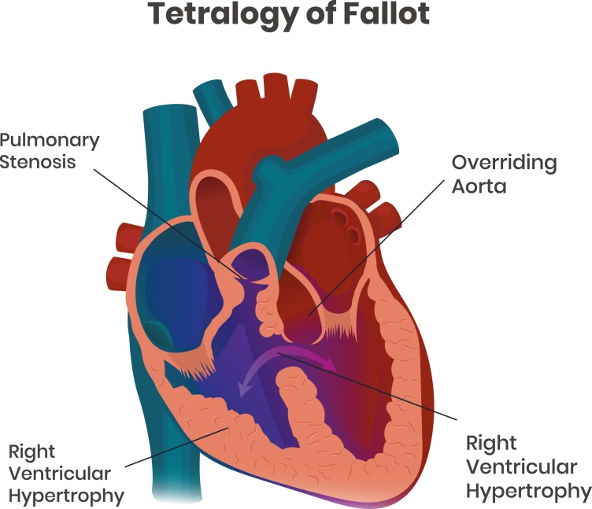
Case Wrap-Up
Diagnosis: Tetralogy of Fallot with “tet spell”
© Alkov/iStock/Getty Images Plus/Getty Images
Notes:
Instructor Notes
Tetralogy of Fallot is the most common cyanotic heart condition in children who have survived untreated beyond the neonatal age, with the need for an intervention in the first year of life.
Accounts for 7% to 10% of congenital defects, affecting males and females equally and occurring in 3 to 5 of every 10,000 live births.
Case closure
Child was transported to a specialty hospital.
At the hospital, the child was stabilized and heart surgery was scheduled.
The surgeon placed a temporary shunt to provide an additional pathway for blood to travel to the lungs for oxygen while awaiting full repair.
The child received a full repair surgery at a later date.
The predicted 30-day survivorship after repair is 90% to 99%
The child made a full recovery 6 weeks after repair surgery.

Slide 48
Lesson Wrap-Up
Know what is in your OB kit.
Recognize OB and neonate complications.
Do not forget about caring for the mother post delivery.
Prompt recognition and management of congenital heart defects could reduce recovery times and improve patient outcome!
Coming up, Lesson 10: Children with Special Healthcare Needs.
Notes:
Instructor Notes
Know what is in your OB kit.
Recognize OB and neonate complications.
Do not forget about caring for the mother post delivery.
Prompt recognition and management of congenital heart defects could reduce recovery times and improve patient outcome!
Coming up, Lesson 10: Children with Special Healthcare Needs.

Slide 49

Questions?
© Nujumuddin Mohamad Yaman/EyeEm/Getty Images
Notes:
Instructor Notes
Allow time for a question-and-answer session about the topics presented in the lesson.

