Slide 1
Fourth Edition
Lesson 5: Medical Emergencies
Notes:
Instructor Notes
Welcome to Lesson 5: Medical Emergencies in Pediatrics.

Slide 2
Lesson Objectives
  Discuss management of pediatric medical emergencies.
  Differentiate between medical emergencies in pediatrics.
  Discuss management of pediatric patients with medical emergencies using the Pediatric Assessment Triangle and XABCDE.
  Discuss the assessment and management of pain in the pediatric patient along with the impact that untreated pain has on them.
Notes:
Instructor Notes
Discuss the learning objectives and the importance of thoroughly understanding each one.
Discuss management of pediatric medical emergencies.
Differentiate between medical emergencies in pediatrics.
Discuss management of pediatric patients with medical emergencies using the pediatric assessment triangle and XABCDE.
Discuss the assessment and management of pain in the pediatric patient, along with the impact that untreated pain has on them.

Slide 3
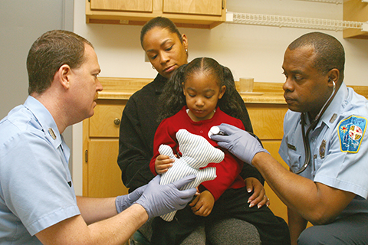


Introduction
© Jones & Bartlett Learning. Courtesy of MIEMSS.
© FatCamera/E+/Getty Images
© stockcreations/Shutterstock
Notes:
Instructor Notes
Expand on the following points:
In 2015, 17% of all children in the U.S. pursued emergency care at least once.
This translates to a rate of roughly 383 per 1000 children visiting the ED per year.
Approximately 97% were treated and discharged from the ED.
Respiratory disorders, injury, and poisoning were the most common reasons for pediatric ED visits in 2015.
Respiratory illness, which we covered in Lesson 2, and seizures are the most common prehospital medical emergencies.
Upper respiratory disease is the most common diagnosis.
Fever is common, but typically is not an emergency.
However, it may be a sign of an underlying illness.
Infants and children younger than 5 years of age accounted for more than 40% of the pediatric ED visits in the U.S. in 2015.

Slide 4
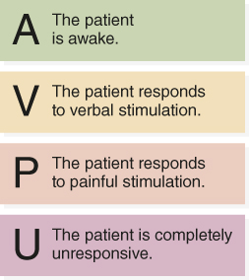
Altered Mental Status
A | Alcohol
E | Epilepsy
Endocrine
I | Insulin
Intussusception
Intoxication
O | Oxygen
U | Uremia
T | Trauma
Temperature
Tumors
I | Infection
P | Psychiatric
S | Stroke
Notes:
Instructor Notes
Expand on the following points:
Altered mental status (AMS) in pediatrics is an indicator of a serious or potentially life-threatening medical emergency.
Many disorders can lead to altered mental status, including metabolic problems, infectious diseases, intracranial structural abnormalities, trauma, hypoxia, and poisonings.
Endocrine disorders represent a common pediatric emergency involving AMS—in particular, hypoglycemia is a common cause of pediatric AMS.
A child with diabetes may have taken too much insulin, experienced excessive exertion, vomited after taking insulin, or skipped a meal.
The mnemonic AEIOUTIPS may be used for remembering and identifying causes of altered mental status:
Alcohol, epilepsy/endocrine, insulin/intussusception/intoxication, oxygen, uremia, trauma/temperature/tumors, infection, psychiatric, stroke.
Of these, epilepsy/endocrine issues, intussusception/intoxication, trauma, and infection should be of highest consideration in pediatric patients.
GCS is a commonly used tool to assess AMS in trauma patients, but it is not intended for use in the medical population.
AVPU is an additional tool used for assessing mental status that can be quickly used in the field.
It stands for “alert/awake, verbal, painful, unresponsive” and refers to the patient’s response to a stimulus.
Other tools include family reports of changes in behavior, especially in special needs children. Ask the family/caregiver, “Is the child’s behavior abnormal?” This is an important component of family-centered care. Family members or other trusted caregivers can better recognize moderate alterations in mental status.
Participant engagement:
Discuss the tools used in your region for assessing altered mental status.

Slide 5
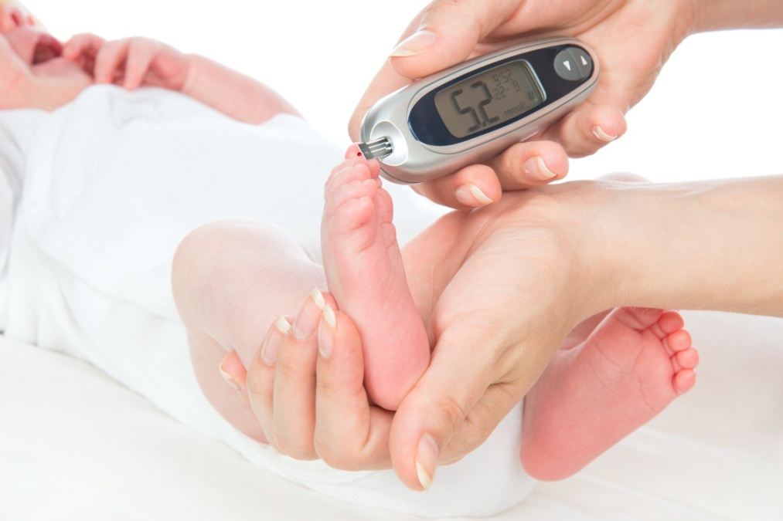
Hypoglycemia (1 of 2)
Sign and symptoms
  Adrenergic symptoms
    Tremor, pallor, increased heart rate
  Neuroglycopenic symptoms
    Lethargy, fatigue, behavior changes
  Behavioral symptoms
© Dmitry Lobanov/Shutterstock
Notes:
Instructor Notes
Discuss the signs and symptoms of hypoglycemia.
Hypoglycemia is a common cause of altered mental status in pediatric patients.
Adrenergic symptoms include tremor, pallor, rapid heart rate, palpitations, and diaphoresis.
Neuroglycopenic symptoms include fatigue, lethargy, headaches, behavior changes, drowsiness, unconsciousness, seizure, or coma. Symptom severity increases with the severity of hypoglycemia and resultant central nervous symptom energy deprivation.
Behavioral symptoms include irritability, agitation, erratic behavior, quietness, or tantrums; most common in young children.

Slide 6

Hypoglycemia (2 of 2)
Pathophysiology
  Diabetes
  Secondary to illness
  Other causes
© WiP-Studio/Shutterstock
Notes:
Instructor Notes
Mild or severe hypoglycemia is most commonly due to type 1 diabetes.
Children are also more prone to hypoglycemia during illness secondary to lower glycogen stores in the liver.
Additional causes of hypoglycemia include hyperinsulinemia; glucose-processing defects; hepatic glucose production diseases (maple syrup urine disease); hormonal abnormalities; toxins (salicylate ingestion); or certain illnesses (malaria).

Slide 7
Mild to Moderate Hypoglycemia
Mild hypoglycemia: 55‒70 mg/dL
Moderate hypoglycemia: Between 35‒40 mg/dL and 55 mg/dL
Management
  Oral glucose
    0.5‒1 g/kg when blood glucose is less than 60 mg/dL.
    15‒20 g when blood glucose is less than 70 mg/dL.
Notes:
Instructor Notes
General guidelines:
Mild: Less than 70 mg/dL, but more than 55 mg/dL.
Moderate: Between 35 to 40 mg/dL and 55 mg/dL.
However, these ranges are not fixed and may vary from patient to patient.
Discuss the management of mild/moderate hypoglycemia.
Pediatric patients with mild to moderate hypoglycemia can be treated with oral glucose if they are alert and able to swallow.
Oral glucose dosing:
0.5‒1 g/kg when blood glucose is less than 60 mg/dL.
15‒20 g when blood glucose is less than 70 mg/dL.
Oral glucose may also be administered through an enteral feeding tube.
Administer 2 tubes of Glucogel in the tube.
Flush with 30 mL water.
Reassess blood glucose in 10 to 15 minutes.

Slide 8
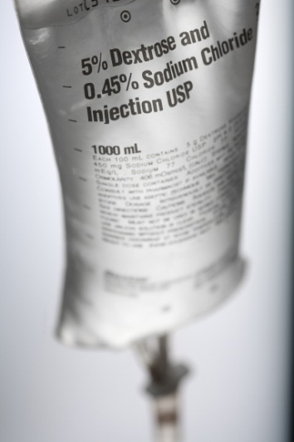
Severe Hypoglycemia
Severe hypoglycemia
  Less than 35‒40 mg/dL
  Management
    Dextrose (D-Glucose)
      0.5‒1 g/kg IV/IO of a concentration of no more that 25% in children younger than 8 years.
    Glucagon
© Thammasak Lek/Shutterstock
© Copyright Eli Lilly and Company. All Rights Reserved. Used with Permission
Notes:
Instructor Notes
General guidelines:
Mild: Less than 70 mg/dL, but more than 55 mg/dL.
Moderate: Between 35 to 40 mg/dL and 55 mg/dL.
However, these ranges are not fixed and may vary from patient to patient.
Discuss the management of mild/moderate hypoglycemia.
Pediatric patients with mild to moderate hypoglycemia can be treated with oral glucose if they are alert and able to swallow.
Oral glucose dosing:
0.5‒1 g/kg when blood glucose is less than 60 mg/dL.
15‒20 g when blood glucose is less than 70 mg/dL.
Oral glucose may also be administered through an enteral feeding tube.
Administer 2 tubes of Glucogel in the tube.
Flush with 30 mL water.
Reassess blood glucose in 10 to 15 minutes.

Slide 9
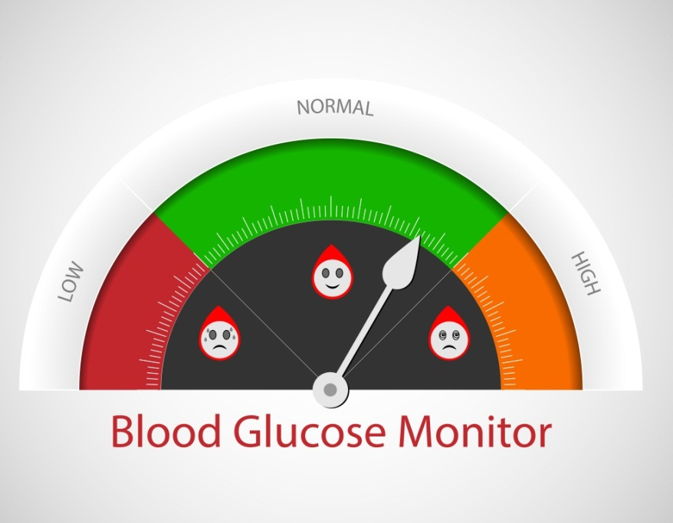
Hyperglycemia
Defined as blood glucose >200 mg/dL
Diabetes mellitus
  Type 1
  Type 2
© Ashalatha/Shutterstock
Notes:
Instructor Notes
Hyperglycemia is excess glucose in the bloodstream, generally considered to be a blood glucose level >200 mg/dL.
This can be due to a physiologic response to stress on the body or it can be pathologic (e.g., patients with diabetes).
Onset is generally slower than in hypoglycemia.
Diabetes mellitus is a disorder of glucose utilization.
There are two types of diabetes: type 1 and type 2.
Children are more likely to have type 1, but incidence of type 2 in pediatrics is increasing due to rise in childhood obesity.
Among those patients experiencing a diabetic emergency, they can present with either diabetic ketoacidosis (DKA) or hyperglycemic hyperosmolar state (HHS).

Slide 10
Diabetic Ketoacidosis (DKA) vs. Hyperglycemic Hyperosmolar State (HHS)
DKA
  Hyperglycemia: Blood glucose of >200 mg/dL
  Metabolic acidosis: Venous pH <7.3 or bicarb <15 mEq/L (15 mmol/L)
  Ketosis: Presence of ketones in blood (ketonemia) or urine (ketonuria)
HHS
  Marked hyperglycemia: Blood glucose of >600 mg/dL
  Metabolic acidosis less severe: Venous pH >7.25 and arterial pH >7.30
  Small amounts of ketones in the urine; ketonemia is mild or absent.
  Altered consciousness or seizure in approximately 50% of cases.
Notes:
Instructor Notes
Discuss the criteria for DKA, particularly the blood glucose level.
Prehospital providers should not automatically discard the diagnosis of DKA because the glucose level isn’t high enough.
Signs of DKA:
Hyperglycemia: Blood glucose of >200 mg/dL.
Metabolic acidosis: Venous pH <7.3 or Bicarb <15 mEq/L (15 mmol/L).
Ketosis: Presence of ketones in blood (ketonemia) or urine (ketonuria).
Precipitating factors for DKA include the following:
Stress, which can lead to metabolic decompensation.
Infection is the most common cause.
Missed insulin doses.
Drugs and alcohol use in adolescents.
Clinical presentation:
Classic signs of DKA are more difficult to ascertain the younger the child is.
Symptoms include polyuria, polydipsia, and weight loss.
Majority of patients who present in DKA do so prior to being diagnosed with diabetes.
Thus, the history is often absent.
Consider a new diagnosis of diabetes in dehydrated children with polyuria, polydipsia, or “ketone “smelling breath.
Discuss the criteria for HHS.
Is associated with type 2 DM.
An increasing number of older children are beginning to develop type 2 DM due to obesity, placing them at risk for HHS.
Marked hyperglycemia with a blood glucose of >600 mg/dL.
Metabolic acidosis is less severe than in DKA, with a venous pH >7.25 and an arterial pH >7.30.
Small amounts of ketones may be found in the urine, and ketonemia is mild or absent.
Altered consciousness or seizure occurs in approximately 50% of cases.
Some children may have mixed features of DKA and HHS.

Slide 11
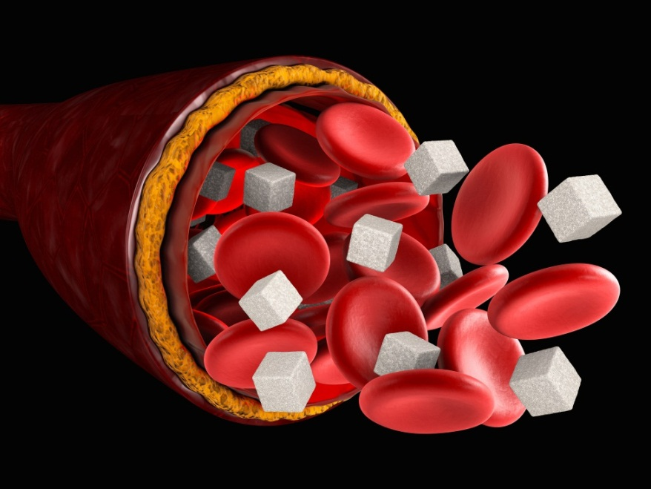
Hyperglycemia
Management of DKA and HHS
  DKA
    Assess severity of dehydration.
    Assess level of consciousness.
    Provide fluid.
      Slow correction of dehydration.
    Evaluate ECG for abnormal T wave changes.
  HHS
    Administer a fluid bolus and reassess.
© Victor Josan/Shutterstock
Notes:
Instructor Notes
Discuss the management of DKA and HHS.
You must estimate the degree of dehydration; this may be challenging.
Knowing the child’s body weight will assist with calculations in determining the degree of dehydration.
Skin turgor, tachycardia, prolonged capillary refill and dry mucous membranes are associated with dehydration in a child.
Assess child’s level of consciousness.
Fluid replacement should be provided slowly to correct the dehydration.
Saline 0.9%, 10 mL/kg should be administered to achieve a clinical response.
Although serum potassium is elevated at presentation, this is only a representation of the shift of intracellular potassium to the extracellular space.
The H+/K+ transporter helps to buffer the increasing acidity in the body by pushing K+ outside of the cells into the intravascular space.
There is still an overall deficit in potassium; this relative hyperkalemia places patients at risk for arrhythmias.
Therefore, ECGs should be monitored for DKA patients
HHS occasionally occurs in younger pediatric patients, though it most often occurs in adolescents with type 2 diabetes.
In HHS, the goals of initial fluid therapy are to expand the intravascular and extravascular volumes and to restore renal perfusion.
Administer a fluid bolus and reassess.

Slide 12
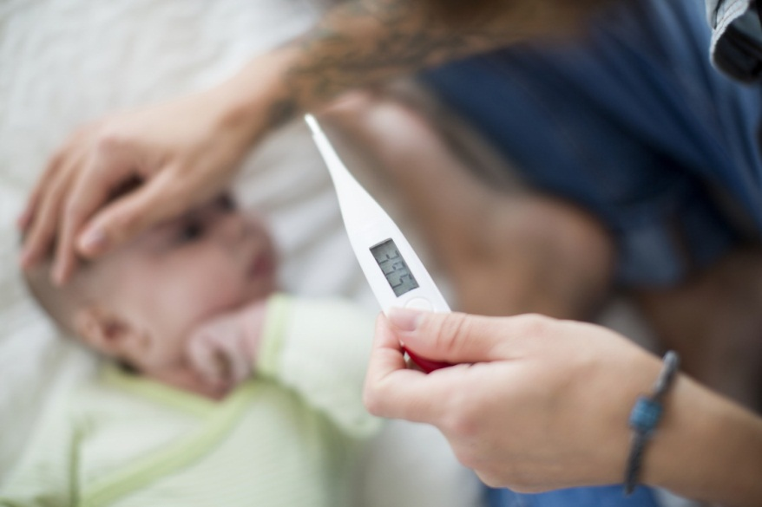
Fever
Temperature >100.4°F (38°C)
Benefits
Myths
Management
© Johner Images/Getty Images
Notes:
Instructor Notes
A fever is defined as a temperature greater than 100.4°F (38°C) in children.
Discuss the pathogenesis of fever.
Several endogenous pyrogenic cytokines such as interleukin 1 and 6 enter the blood and are transmitted to the hypothalamus where the body sets a new homeostasis temperature.
Once the new target temperature is set the body increases its metabolic rate and increases muscle tone and activity.
The body also diminishes perfusion of the skin in order to retain heat.
Benefits
Slows the growth and reproduction of some bacteria and viruses.
Enhances neutrophil production and T-lymphocyte proliferation.
Myths
Discuss the fever phobia that parents may have.
How do we educate and alleviate fear in the family as part of family-centered care?
Parents often express the need to normalize their child's temperature.
Parents will administer antipyretics even if there is minimal to no fever present.
As many as ONE-HALF of parents administer an incorrect dose, with approximately 15% giving too much.
Discuss the belief that high fevers in febrile illnesses are more dangerous despite there being no evidence to associate a fever of greater than 104°F with an increased risk of adverse outcomes.
This is not to say that a heat stroke with 104°F temperature is not dangerous, just that a child with a fever is a far different situation from that of heat stroke.
However, there are situations in which a fever could be indicative of a more serious medical issue.
Fever in children younger than 3 months is always concerning for bacterial illness.
The higher the fever (<104ºF), the greater the likelihood of a more severe infection.
Some children with a history of febrile seizures may be prone to recurrent febrile seizures, and this may be part of the parents’ effort to control fevers.
Management
Fevers are managed with antipyretic medications.
Antipyretics should only be given on a case-by-case basis guided by local protocol.
Ibuprofen: 10 mg/kg q6h
Tylenol: 15 mg/kg q4h
Cases in which short-term fever reduction may be indicated include underlying disease or injuries, such as burns, or to reduce discomfort.

Slide 13
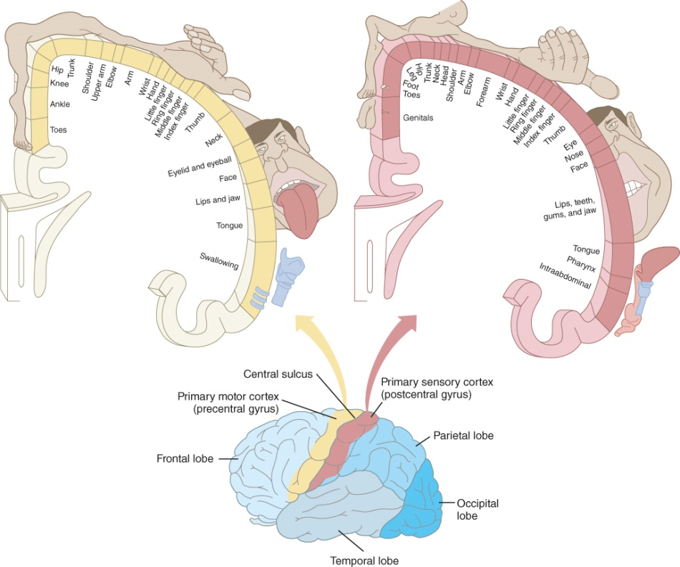
Seizures (1 of 3)
Focal (partial) seizures
Generalized seizures
Notes:
Instructor Notes
Seizures can be defined as sudden abnormal or hyperexcitable electrical activity in the brain. The phenotypic presentation of the seizure depends on what part of the brain is impacted.
Not all seizures are associated with generalized tonic-clonic (GTC) activity or altered mental status.
Seizures in young children can be very subtle and difficult to recognize.
Lip smacking, extremity or facial twitching, eye deviation, cyanosis, and jaw clenching can be signs of a seizure.
Very young infants who are just gaining gross motor skills will not present with GTC activity because the neuromuscular system is still very much developing.
Therefore, any subtle event reported by caregivers might have been a seizure.
Two general types: focal or partial seizures and generalized seizures.
Focal or partial seizures originate within networks limited to one hemisphere.
A focal seizure may or may not be associated with impaired awareness.
Focal seizures can start with a focal motor activity that can sometimes occur with anatomic spread.
May appear as turning of eyes or head or with vocalization or arrest of speech.
Sensory seizures can occur with paresthesia; disorientation; vertigo; and smell, sound, and sight phenomena.
Generalized seizures originate at some point within the brain and engage bilateral networks.
Motor impacts are bilateral.
Motor activity can be present or absent.
Patients experiencing an absence seizure may appear as if they are having a focal seizure with impairment of awareness.

Slide 14

Seizures (2 of 3)
Febrile seizures
Status epilepticus
© Kateryna Kon/Shutterstock
Notes:
Instructor Notes
Two additional types of seizure activity include febrile seizures and status epilepticus.
A febrile seizure is a seizure occurring in a child 6 months to 5 years of age that is accompanied by a fever (100.4°F or greater) without central nervous system infection.
Febrile seizures are classified as simple or complex.
A simple seizure lasts 15 minutes or less, is not associated with any neurologic findings, and doesn't recur within 24 hours.
Children who have a simple febrile seizure and are well-appearing do not require routine diagnostic testing (laboratory tests, neuroimaging, or electroencephalography), except as indicated to discern the cause of the fever.
However, we cannot know if the child’s seizures will recur or become prolonged, and so any child with a suspected febrile seizure should be transported to the ED for monitoring.
In addition, any child younger than 6 months who presents with a fever carries a higher risk for bacterial infections, including meningitis, and any child with persistent alteration in mental status may have meningitis. These children should also be transported for additional testing and treatment.
Managing a febrile seizure that lasts longer than 5 minutes is the same as an afebrile seizure.
Negative neurologic outcomes, such as neurologic deficits, intellectual impairment, and behavioral disorders, are rare following febrile seizures.
Status epilepticus is seizure activity that persists for longer than 5 minutes.
Benzodiazepines are first-line treatment.
Patients who persist with seizure activity despite medication administration should be treated with additional anticonvulsant medication.
It is difficult to determine if seizures will reoccur, so transportation to an appropriate pediatric facility is critical.

Slide 15
Seizures (3 of 3)
First-Line Medications
Medication | Dose | Route | Pros | Cons
Midazolam | 0.1 mg/kg | IV, IM, IO, IN | Rapid onset | Medium duration of action (30 minutes)
Diazepam | 0.1 mg/kg | IV, IO | Rapid onset Inexpensive No Refrigeration | Sedating Respiratory depression Short duration of action for seizure control (15 min)
 | 0.5 mg/kg | PR | Rapid onset No IV required | Sedating Respiratory depression
Lorazepam | 0.05-0.1 mg/kg | IV, IO | Rapid onset Long duration of action (24 hours) | Must be stored away from heat and extreme temperatures
Second-Line Medications
Valproic Acid | 40 mg/kg | IV, IO | Rapid onset Lower risk of respiratory depression | Hepatoxicity
Fosphenytoin | 20 mg/kg (phenytoin equivalents or PE) | IV, IO | Inexpensive Long duration of action (12-28 hours) | Hypotension and respiratory depression
Keppra | 60 mg/kg | IV, IO | Rapid Onset | Somnolence, dizziness, and hostility
Notes:
Instructor Notes
Most seizures stop prior to the arrival of EMS, and so management is largely supportive.
Initial interventions include:
Maintain a patent airway.
Position the child in the lateral recumbent position.
Suction and clear the mouth of vomit.
Ensure adequate ventilations.
Attempt to assist ventilations if the child’s oxygen is <90% or the child is cyanotic.
Protect circulatory status.
Poor perfusion is likely due to hypoxia and metabolic acidosis from a prolonged seizure.
Assess blood glucose and treat hypoglycemia, if present.
If the seizure is still in progress when EMS arrives, stopping the seizure is critical for the patient.
Benzodiazepines are still the first-line drug treatment.
Midazolam is commonly used due to its rapid onset and ability to administer it intranasally.
Delays in administration of benzodiazepines are associated with refractory seizures—the longer it takes treat, the harder it is to treat.
Second-line medications should be administered with continued seizures.
Medication options are shown in the table, but always guide your treatment based on your local protocols.
Participant engagement:
Discuss how seizures are managed in your region.
What medications are used in your organization/agency?

Slide 16

Case 1
Dispatch
  You and your partner respond to a residence for a 2-year-old male with a fever and altered mental status. It is a summer afternoon with an outside temperature of 90°F (32.2°C).
© Rob Wilson/Shutterstock
Notes:
Instructor Notes
For students other than prehospital practitioners, dispatch information can be modified.
Present the case.
What are your initial concerns and possible differential diagnosis based on the dispatch information?
Initial impression begins when the dispatch information is received.
Initial concern: Altered mental status.
Differential diagnosis:
AMS in pediatrics has a broad differential.
Trauma: Epidural/subdural/subarachnoid hematoma, concussion, obstructive shock
Hypoxia: Respiratory illness, shock (cardiogenic, distributive, neurogenic, hypovolemic)
Infection: CNS infections, UTI, pneumonia
Neurogenic: Seizure, ICP as a result of shunt malfunction, aneurysm
Poisoning: Carbon monoxide, alcohol, fertilizers, pesticides
Metabolic disorders: Hypoglycemia, DKA, hepatic encephalopathy
Cardiac arrhythmias
Intestinal obstructions
Discuss the importance of scene assessment and awareness.
Expand on how it applies to this case.
Case 1 involves a 2-year-old male with a fever and AMS.
Diagnosis: Meningococcal sepsis

Slide 17

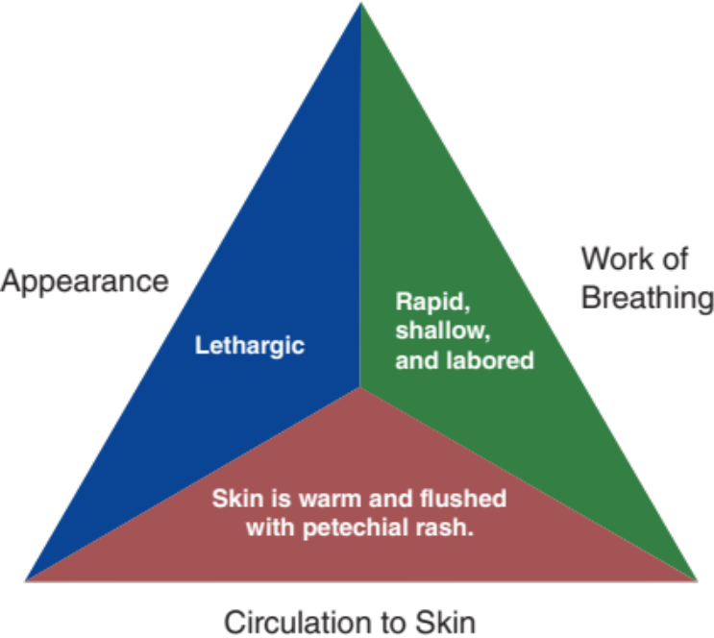
Initial Observations
© Tomsickova Tatyana/Shutterstock
Used with permission of the American Academy of Pediatrics, Pediatric Education for Prehospital Professionals, © American Academy of Pediatrics, 2000
Notes:
Instructor Notes
Discuss the initial findings at the scene and the PAT findings.
As you arrive at the front entrance of the home you are met by the father, who appears extremely anxious.
PAT
Appearance: Lethargic.
Work of breathing: Rapid, shallow, and labored.
Circulation: Skin is warm and flushed with petechial rash.
Father tells you that the previous day the child was taken to see his PCP due to fever.
He was diagnosed with a nonspecific respiratory infection.
Father advises they have recently traveled internationally.
Discuss additional precautions or concerns that may be warranted based on initial observations.
Is this patient “Quick” or “Not Quick”?
The patient is “Quick.”
Expand how this determination was made.
Have you identified any possible red flags?
Altered mental status
Recent travel
Participant engagement:
Remind participants that completing a thorough assessment and history in pediatrics is of utmost importance.

Slide 18
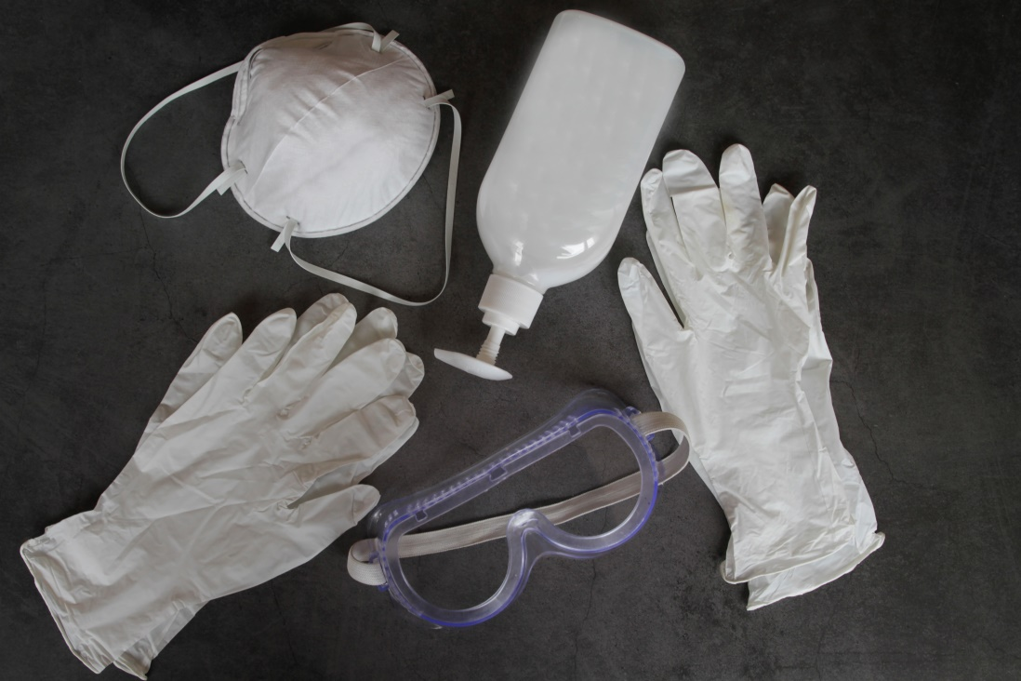
Standard Precautions
Personal Protective Equipment (PPE)
  Arriving EMS
  Patient care considerations
© Isabel Pavia/Moment/Getty Images
Notes:
Instructor Notes
Personal Protective Equipment (PPE)
Various types of PPE are available for use by healthcare providers, patients, and caregivers.
Follow your local guidelines in the use of PPE at your agency.
A single pair of gloves should be worn during all patient contact for any potential exposure to infectious agent or bodily fluids.
Goggles, face shields, and surgical masks should be worn during any aerosolizing procedures or in the presence of a patient with active cough.
An N95 mask should be worn by healthcare providers to protect themselves and others.
Healthcare provider PPE must be fit tested and properly maintained.
A facemask or respirator should be used by all healthcare workers in the ambulance when transporting a potentially infectious patient.
Impermeable/isolation gowns should be worn for situations in which splash and liquid exposures would likely occur.
PPE should be doffed with care to avoid self-contamination.
Potential exposures should be reported according to your agency’s protocols.
Arriving EMS
Assess patient upon arrival (at a distance of 6 feet when possible).
Be prepared to adjust PPE precautions as the situation dictates.
You may need to add layers of PPE as the situation changes.
• Wash your hands before and after patient care.
Hand sanitizer can be used as a substitute when hand washing is not available.
Patient care considerations
For patients with an active cough or who are immunocompromised, a surgical mask should be provided for them to wear.
Family considerations
When it is appropriate for family to accompany EMS clinicians and the patient, the same PPE should be provided to them as is provided to the patient.
If they are incapable of tolerating a surgical mask or similar PPE, a reevaluation of their accompaniment should be conducted.

Slide 19
Primary Survey
    Primary survey
      X ‒ No bleeding found.
      A ‒ Open.
      B ‒ Respirations are rapid, labored, and shallow. Lung sounds are clear bilaterally.
      C ‒ Brachial pulses are weak. Capillary refill time is slow. Skin is warm and flushed.
      D ‒ Lethargic and responsive to pain; GCS = 11 (E2, V4, M5).
      E ‒ Lying on couch. Rash on skin.
Notes:
Instructor Notes
Discuss the primary survey.
Note that the PAT is completed prior to the primary survey.
Ask participants to explain any abnormal findings of the patient, whether physically and/or developmentally.
Discuss any life threats identified in this case.
There are life threats: tachypnea with shallow breaths and weak pulses.
Primary survey
X ‒ No bleeding found.
A ‒ Open.
B ‒ Respirations are rapid, labored, and shallow. Lung sounds are clear bilaterally.
C ‒ Brachial pulses are weak. Capillary refill is time slow. Skin is warm and flushed.
D ‒ Lethargic and responsive to pain; GCS = 11 (E2, V4, M5).
E ‒Lying on couch. A rash can be seen on his skin.
What would your initial treatment be?
Discuss treatment options per local guidelines and policy.
Treatment should be focused on aggressive resuscitation.
Apply blow-by oxygen.
Are there any indications of trauma? (No, but patient appears septic.)

Slide 20
Detailed Assessment
History taking
  O – Sudden
  P – None
  Q – None
  R – None
  S – Unknown
  T – 24 hours
Notes:
Instructor Notes
Review history taking using the OPQRST mnemonic.
O – Sudden
P – None
Q – None
R – None
S – Unknown
T – 24 hours
Participant engagement:
Discuss the importance of continuously reevaluating the patient.
Discuss questions that should be asked given the patient’s physiologic presentation.

Slide 21
Detailed Assessment
History taking
    S ‒ Altered mental status, weak brachial pulse, tachypnea.
    A ‒ No known allergies.
    M ‒ None.
    P ‒ Recent nondescript respiratory infection.
    L ‒ Not eating or drinking.
    E ‒ Has gotten worse over the last 24 hours.
    R – Recent travel without recommended vaccinations.
Notes:
Instructor Notes
Review history taking using SAMPLER.
S ‒ Altered mental status, weak brachial pulse, tachypnea.
A ‒ No known allergies.
M ‒ None.
P ‒ Recent nondescript respiratory infection.
L ‒ Not eating or drinking.
E ‒ Has gotten worse over the last 24 hours.
R – Recent travel without recommended vaccinations.
In a physiologically unstable child, limit on-scene assessment.
A focused history assessment assists prehospital providers in refining their differential diagnosis.
Focused history
Known exposure to illness.
Recent travel through Guinea, returned 2 days prior.
Perinatal hx for patients <1 month of age.
Onset of symptoms and rapidity of progression.
Symptoms began 24 hours ago and have gotten worse since that time.
Presence of fever.
Associated symptoms and signs:
Rash (petechiae).
Parent reported that patient held his head and cried prior to the onset of fever the day before.
Adipsia.
Immunization hx: No immunizations.

Slide 22
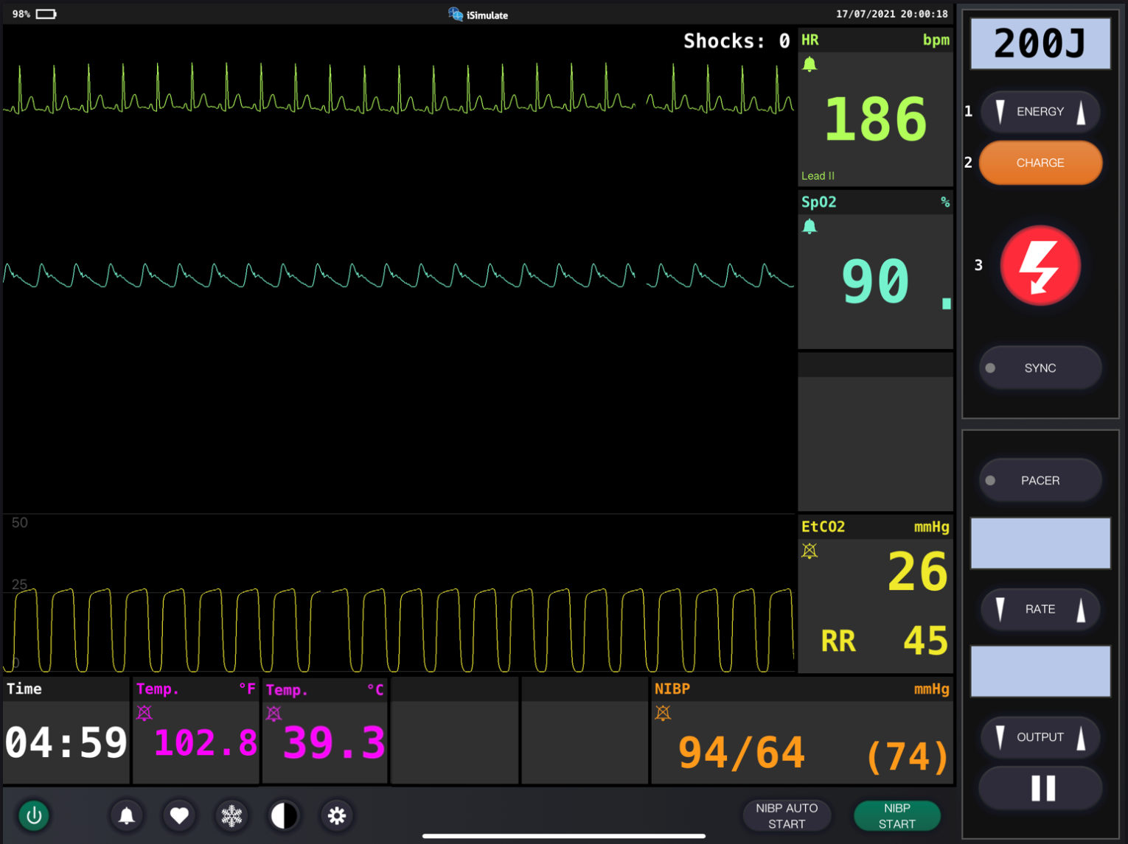
Vital Signs
Notes:
Instructor Notes
Discuss what the vital signs tell us about the patient.
SpO₂: 90% on room air.
Is oxygen needed?
Discuss treatment options in your region.
ETCO₂ is 26.
Discuss reason for low ETCO₂.
In sepsis, as lactate levels rise, carbon dioxide levels fall.
Respiratory rate is 45.
Blood pressure is 94/64.
Blood glucose is 94 mg/dL (5.2 mmol/L).
ECG indicates sinus tachycardia.
Weight is 23 kg.
Participant engagement:
Discuss expected typical vital signs for age.

Slide 23
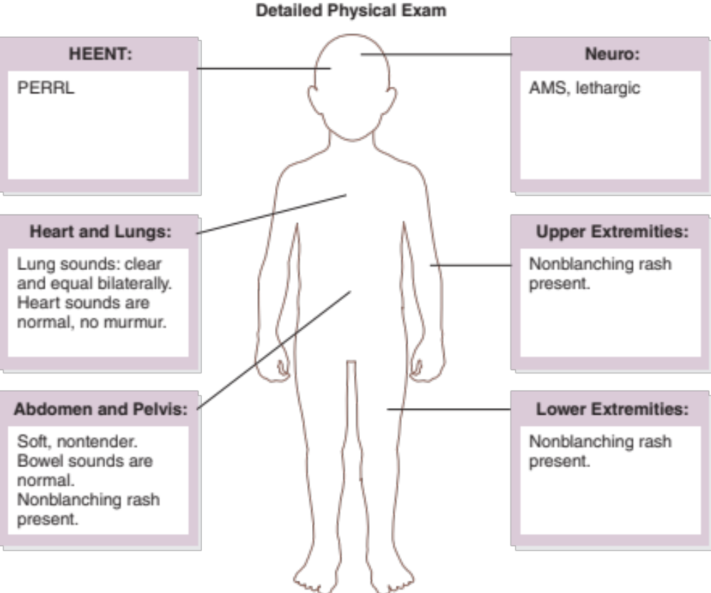
Detailed Assessment
Notes:
Instructor Notes
*Ask students: Given the age of this child, would you perform a head-to-toe or toe-to-head assessment? Or, in a critically ill child, does it matter?
HEENT
Head: Unremarkable
Eyes: PERRL
Heart and lungs
Lung sounds, clear and equal bilaterally. Heart sounds are normal, no murmur.
Respirations rapid with intercostal retractions.
Neuro
AMS, lethargic.
Abdomen and pelvis
Soft, nontender. Bowel sounds are normal.
Nonblanching rash present.
Upper extremities
Nonblanching rash present.
Capillary refill time is slow.
Lower extremities
Nonblanching rash present.
Capillary refill time is slow.

Slide 24
Treatment
BLS
  Monitor airway.
  Assist ventilation, as appropriate.
  Administer high-flow oxygen.
  Prevent disease transmission!
ALS
  BLS care.
  Fluid resuscitation and boluses as appropriate.
Critical care
  BLS/ALS care.
Notes:
Instructor Notes
Ask students how they would treat this patient according to their local protocol and scope of practice.
The patient should be treated with aggressive airway, breathing, and circulatory management and monitoring.
Be prepared for rapid deterioration.
Given the likelihood of infectious illness, be sure to take appropriate safety precautions.
Patient management:
What are your goals for this patient?
Promptly identify distributive shock and intervene for patients who require escalation of therapy.
Deliver appropriate therapy by differentiating other causes of AMS.
What conditions are part of your potential differential diagnosis?
Trauma: Epidural/subdural/subarachnoid hematoma, concussion, obstructive shock; less likely with fever, but still a possibility.
Hypoxia: Respiratory illness, shock (cardiogenic, distributive, neurogenic, hypovolemic); very high on differential.
Infection: CNS infections, UTI, pneumonia; very likely.
Neurogenic: Seizure, ICP (shunt malfunction), aneurysm; less likely because the patient does not have a shunt or a history of seizures.
Poisoning: Carbon monoxide, alcohol, fertilizers, pesticides; less likely with no known exposure.
Metabolic disorders: Hypoglycemia, DKA, hepatic encephalopathy; still a possibility.
Cardiac arrhythmias: ECG showed sinus tachycardia, so less likely, but patient should still be monitored.
Intestinal obstructions: Possibility if a rupture occurred.

Slide 25
Ongoing Management
Reassess the patient.
What is the most appropriate treatment destination and why?
Can you safely transport this child in your ambulance?
Will you allow a family member to ride in the ambulance?
Notes:
Instructor Notes
Discuss ongoing management options based on scope of practice and local protocols.
The patient is continuously monitored during transport while you prepare intubation and positive pressure ventilation equipment.
There are no further changes during transport to the emergency department.
What is the most appropriate treatment destination and why?
Discuss transportation destination options for pediatrics in your region.
Share with students when and if it would be appropriate to bypass certain facilities.
This child should be transported to the closest appropriate facility.
How would you safely transport this child in your ambulance?
Discuss policies and procedures for transporting pediatric patients in your region.
The father handed you the child’s car seat to use during transport.
Will you allow a family member to ride in the ambulance?
Family-centered care is a priority, so we recommend allowing one parent to ride in the ambulance with the EMS crew if safety allows and the appropriate PPE is available.
We encourage EMS to include this family member in the care of their child as a member of their care team.
Family members should maintain a 6-foot distance from the person who is sick when possible.
Appropriate PPE should be worn when unable to maintain a 6-foot distance.

Slide 26
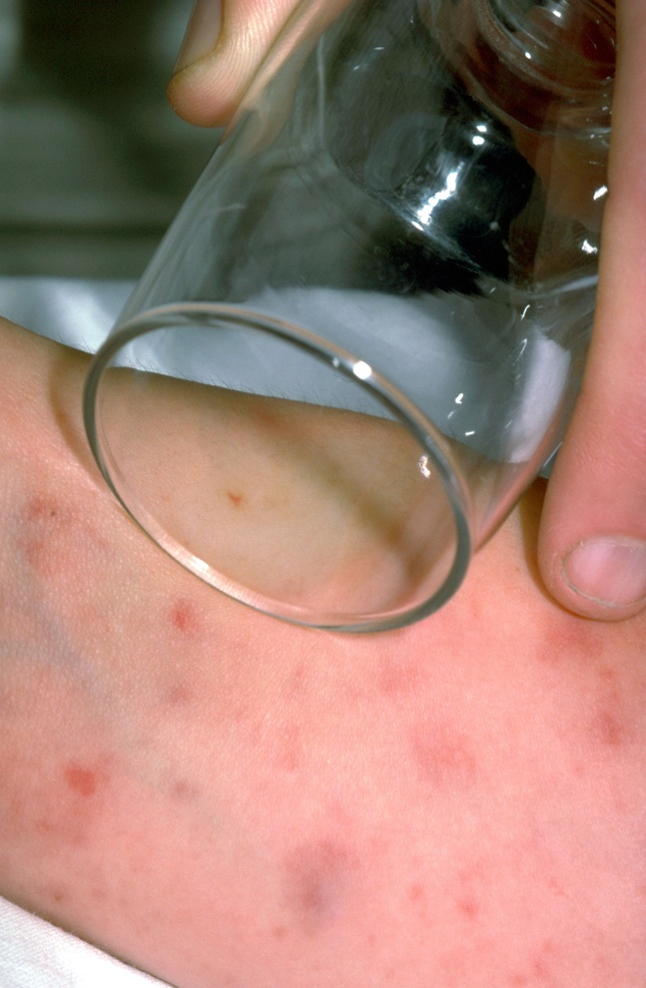
Case Wrap-Up
Diagnosis: Meningococcal septicemia
© Mediscan/Alamy Stock Photo
Notes:
Instructor Notes
Meningitis is the second-leading cause of infection-related deaths in the world.
Meningitis has several bacterial causes.
S. pneumoniae (most common in children >1 month of age)
N. meningitidis (in children >1 month of age)
Group B streptococcus (only in children under 3 months of age)
Although rare, meningitis still occurs in the U.S. In older children clinical manifestations may include:
Fever
Headache
Photophobia
Nausea/vomiting
Confusion
Lethargy
Irritability
Nonblanching rash
Determining if a petechial rash is blanching or nonblanching may aid diagnosis.
If clear glass or plastic is pressed firmly on the rash and the rash does not fade (see image on slide), the patient might have septicemia and urgent care is needed.
Clinicians should be aware of the likelihood of nuchal rigidity, characterized by an inability to place the chin on the chest.
Other signs:
Kernig's sign: The patient is unable to straighten the leg when the hip is flexed to 90 degrees in the supine position.
Brudzinski sign: Severe neck stiffness will cause a patient’s hips and knees to flex when the neck is flexed.
Case wrap-up:
The child died 30 minutes after delivery to the pediatric emergency room.
N. meningitidis was confirmed on autopsy.

Slide 27
Case 2
Dispatch
  At 7:15 p.m., you and your partner respond to a household for an 11-month-old male experiencing lethargy. It is a cool, clear autumn evening, and the outside temperature is 55°F (12.7°C).
Notes:
Instructor Notes
For students other than prehospital practitioners, dispatch information can be modified.
Present the case.
What are your initial concerns and possible differential diagnosis based on the dispatch information?
Initial impression begins when the dispatch information is received.
Initial concern: Altered mental status.
Differential diagnosis
AMS in pediatrics has a broad differential.
Trauma: Epidural/subdural/subarachnoid hematoma, concussion, obstructive shock
Hypoxia: Respiratory illness, shock (cardiogenic, distributive, neurogenic, hypovolemic)
Infection: CNS infections, UTI, pneumonia
Neurogenic: Seizure, ICP as a result of shunt malfunction, aneurysm
Poisoning: Carbon monoxide, alcohol, fertilizers, pesticides
Metabolic disorders: Hypoglycemia, DKA, hepatic encephalopathy
Cardiac arrhythmias
Intestinal obstructions
Discuss the importance of scene assessment and awareness.
Expand on how it applies to this case.
Case 2 involves a 11-month-old male with AMS.
Diagnosis: Intussusception

Slide 28

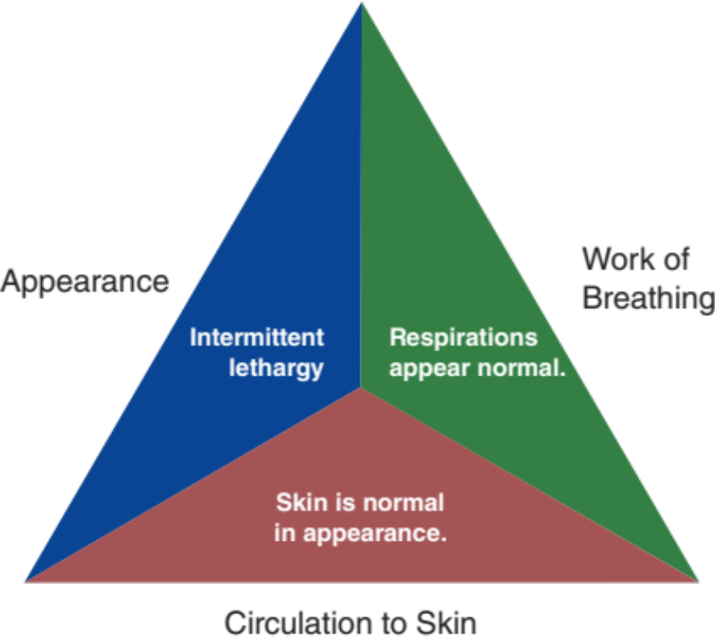
Initial Observations
© PeopleImages/iStock/Getty Images Plus/Getty Images
Used with permission of the American Academy of Pediatrics, Pediatric Education for Prehospital Professionals, © American Academy of Pediatrics, 2000
Notes:
Instructor Notes
Discuss the following initial findings at the scene.
As you arrive at the front entrance you are met by the parents, and the child is being held by the father.
PAT
Appearance: Intermittent lethargy.
Work of breathing: Respirations appear normal.
Circulation: Skin is normal in appearance.
The parents inform you that the child has had several episodes of vomiting with intermittent abdominal pain.
The child has shown decreased appetite and no bowel movements, but has produced four wet diapers.
Is this patient “Quick” or “Not Quick”?
The patient is “Quick.”
Expand how this determination was made.
Have you identified any possible red flags?
Intermittent lethargy
Discuss intermittent lethargy and its importance.
Intermittent lethargy is characterized by typically episodic periods of AMS that can recur in minutes to hours and could increase in frequency over time.
The child may appear well between episodes.

Slide 29
Primary Survey
    Primary survey
      X ‒ No bleeding found.
      A ‒ Patent.
      B ‒ Respirations are regular and normal depth. Lung sounds are clear bilaterally.
      C ‒ Radial pulses are strong and regular. Capillary refill time is brisk.
      D ‒ Intermittent lethargy; GCS = 14 (E4, V4, M6), otherwise cries inconsolably.
      E ‒ In father’s arms. Skin is normal in appearance.
Notes:
Instructor Notes
Discuss the primary survey.
Note that the PAT is completed prior to the primary survey.
Ask participants to explain any abnormal findings of the patient, whether physically and/or developmentally.
Discuss any life threats identified in this case.
There are life threats: Lethargy can indicate presence of a life threat.
Primary survey
X ‒ No bleeding found.
A ‒ Patent.
B ‒ Respirations are regular and normal depth. Lung sounds are clear bilaterally.
C ‒Radial pulses are strong and regular. Capillary refill time is brisk.
D ‒ Intermittent lethargy; GCS = 14 (E4, V4, M6), otherwise, the child cries inconsolably.
E ‒ In father’s arms. Skin is normal in appearance.
What would your initial treatment be?
Discuss treatment options per local guidelines and policy.
IV therapy with antiemetic.

Slide 30
Detailed Assessment
History taking
  O – Gradual
  P – Pain upon palpation to abdomen
  Q – Unable to obtain
  R – Unable to obtain
  S – Obvious discomfort
  T – 12 hours
Notes:
Instructor Notes
Review history taking using the OPQRST mnemonic.
O – Gradual
P – Pain upon palpation to abdomen
Q – Unable to obtain
R – Unable to obtain
S – Obvious discomfort
T – 12 hours

Slide 31
Detailed Assessment
History taking
    S ‒ Vomiting, lethargy, abdominal pain, lack of bowel movement
    A ‒ No known allergies
    M ‒ None
    P ‒ None
    L ‒ Breakfast
    E ‒ Worsened over the last 12 hours
    R – Age
Notes:
Instructor Notes
Review history taking using SAMPLER.
S ‒ Vomiting, lethargy, abdominal pain, lack of bowel movement
A ‒ No known allergies
M ‒ None
P ‒ None
L ‒ Breakfast
E ‒ Worsened over the last 12 hours
R – Age

Slide 32
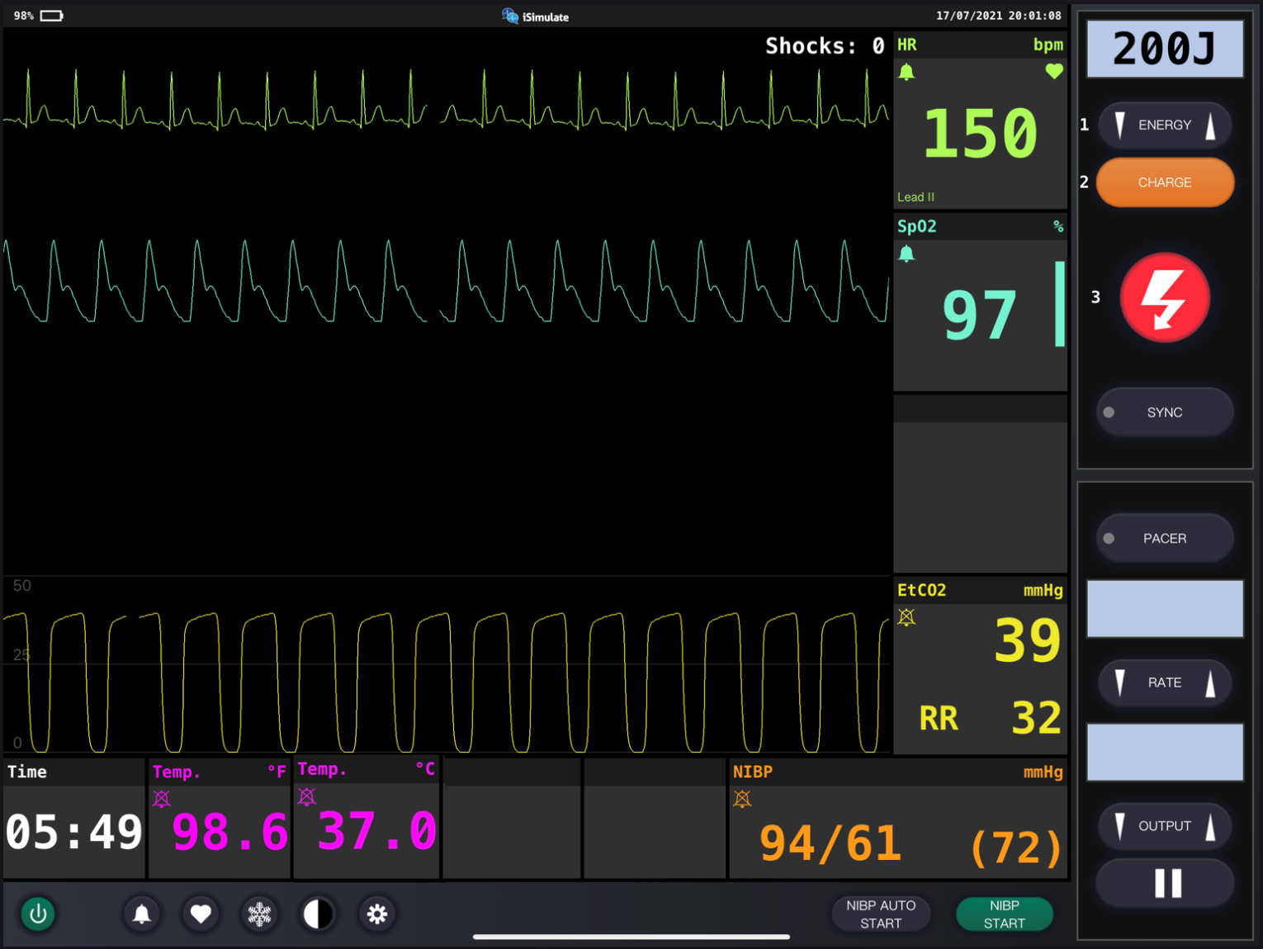
Vital Signs
Notes:
Instructor Notes
Discuss what the vital signs tell us about the patient.
SpO₂: 97% on room air.
Is oxygen needed?
No.
ETCO₂ is 39.
Respiratory rate is 32.
Blood pressure is 94/61.
Blood glucose is 106 mg/dL (5.9 mmol/L).
Weight is 10 kg per length-based tape.
ECG indicates sinus rhythm.
Participant engagement:
Discuss expected typical vital signs for age.

Slide 33
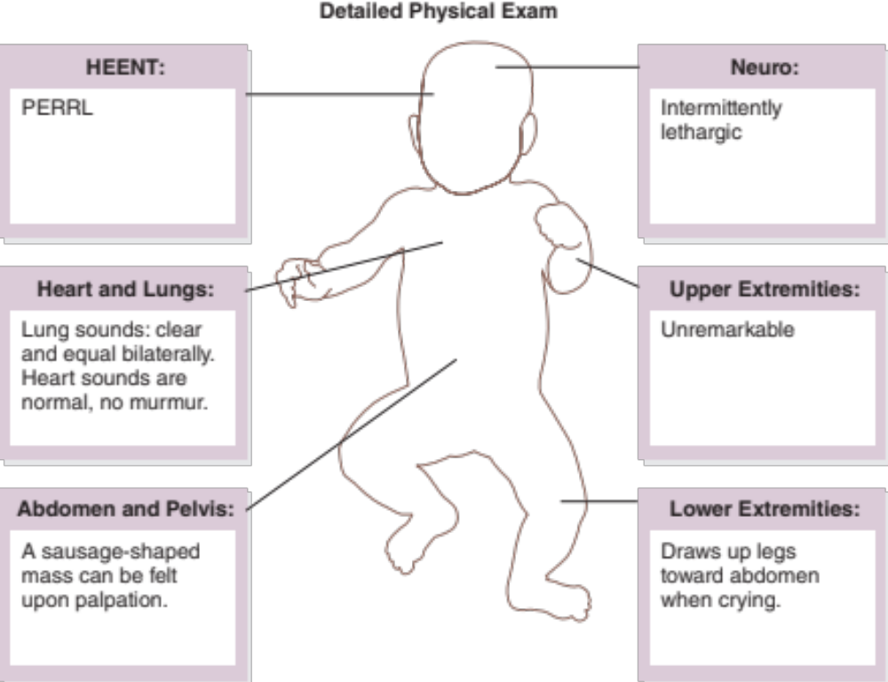
Detailed Assessment
Notes:
Instructor Notes
*Ask participants: Given the age of this child, would you perform a head-to-toe or toe-to-head assessment?
HEENT
Head: Unremarkable
Eyes: PERRL
Heart and lungs
Lung sounds, clear and equal bilaterally. Heart sounds are normal, with no murmur.
Neuro
Circulation, motor, and sensory (CMS) intact; patient is anxious and intermittently lethargic.
Abdomen and pelvis
A sausage-shaped mass can be felt upon palpation. Bowel sounds are hypoactive.
Upper extremities
Unremarkable, capillary refill time brisk.
Lower extremities:
Draws up legs toward abdomen when crying.

Slide 34

Pediatric Pain Management
Many healthcare providers are reluctant to administer pain medication in pediatrics.
Three dimensions of pain.
Real and long-term consequences exist for not treating pain in pediatric populations.
© Jens Karlsson/EyeEm/Getty Images
Notes:
Instructor Notes
Many healthcare providers are reluctant to administer pain medication to pediatric patients.
This results in pain in pediatrics often being undertreated.
Pain can be defined as any unpleasant sensory and emotional experience associated with possible or definite tissue damage.
Discuss the three dimensions of pain.
Biological pain includes many types of physiologic responses to tissue damage.
This includes inflammation, mechanical or ischemic tissue damage, or damage to the nervous system.
Psychological includes the cognitive aspects that influence pain.
This includes anxiety of how pain is experienced, previous experience with pain, and anticipation of pain.
Social includes considerations of how the pain is reported.
Is the pain level self-reported, or is that information obtained from a parent or caregiver?
It is important to know that pain reported is not pain experienced.
A verbal numeric scale (0‒10) or a visual pain scale, such as Wong-Baker Faces scale, should be used for patients old enough for self-reporting.
Real and long-term consequences exist for not treating pain in pediatric populations.
May change pain processes in infants.
Can create tendencies of avoidance in relation to medical care.
Fear increases pain during medical evaluation.

Slide 35

Treatment of Pain
Transduction
  Local antiseptic
  Splinting
  RICE
Transmission
  Pharmacological
    Mild/Moderate
    Severe
Perception
  Nonpharmacological
© LeManna/Shutterstock
Notes:
Instructor Notes
Pain can be treated by interrupting one of the mechanisms by which we experience it.
Transduction is the activation of nerve endings by a tissue-damaging stimulus.
Treatments include:
Local antiseptic
Splinting
RICE (rest, ice, compression, and elevation)
Ibuprofen 10 mg/kg q6h for mild/moderate pain
During transmission, the message is carried from the site of tissue injury to the brain.
Treatment is pharmacologic.
Mild/moderate pain: Acetaminophen 15 mg/kg q4h
Severe pain:
Fentanyl
IV 1 mcg/kg/dose every 30 to 60 minutes
IN 1‒2 mcg/kg
Morphine
Neonates: 0.05 mg/kg IM, IV, IO, SQ,
Infants and children: 0.05–0.1 mg/kg IM, IV, IO, SQ
Adolescents: 3‒4 IV or IO, repeat in 5 minutes, as needed
Ketamine
An effective analgesic agent in pediatrics.
May alter the results of the mental status exam, so discuss its use with the receiving physician.
Ketamine is best used for trauma.
Single analgesic doses: 0.1‒0.3 mg/kg IV or 05‒1.0 mg/kg IM over 1 to 2 minutes.
Perception relates to any unpleasant sensory and emotional experiences related to possible or actual damage.
Perception of pain is continuously accompanied by negative emotions.
Treatment is nonpharmacologic: Visual imagery, pacifier, bottle, music, distraction techniques, caregiver assistance, holding child, etc.

Slide 36
Treatment
BLS
  Monitor airway
  Position of comfort
ALS
  BLS care
  Consider IV
Critical care
  BLS/ALS care
Notes:
Instructor Notes
Ask students how they would treat this patient according to their local protocol and scope of practice.
Patient Management:
What are your goals for this patient?
Discuss treatment options in your region
What conditions are part of your potential differential diagnosis?
Trauma: Epidural/subdural/subarachnoid hematoma, concussion, obstructive shock—not likely based on history and physical exam
Hypoxia: Respiratory Illness, shock (cardiogenic, distributive, neurogenic, hypovolemic)—less likely, as lung sounds are clear and equal.
Infection: CNS infections, UTI, pneumonia—could be the underlying cause of shock
Neurogenic: Seizure, ICP as a result of shunt malfunction, aneurysm—no history or signs upon physical exam to suggest this
Poisoning: Carbon monoxide, alcohol, fertilizers, pesticides—no history or signs upon physical exam to suggest this
Metabolic disorders: Hypoglycemia, DKA, hepatic encephalopathy—still possibilities
Cardiac arrhythmias—unlikely based on monitor results
Intestinal obstructions—likely based on abdominal findings (sausage-shaped mass, hypoactive bowel sounds, complaint of abdominal pain)

Slide 37
Ongoing Management
Reassess the patient.
What is the most appropriate treatment destination and why?
Can you safely transport this child in your ambulance?
Notes:
Instructor Notes
Discuss ongoing management options based on scope of practice and local protocols.
Reassess the patient’s mental status throughout transport.
There are no further changes during transport to the emergency department.
What is the most appropriate treatment destination and why?
Discuss the transportation destination options for pediatrics in your region.
Share with students when and if it would be appropriate to bypass certain facilities.
This patient should be transported to the closest appropriate facility.
How would you safely transport this child in your ambulance?
This patient was transported in the car seat provided by his family.

Slide 38
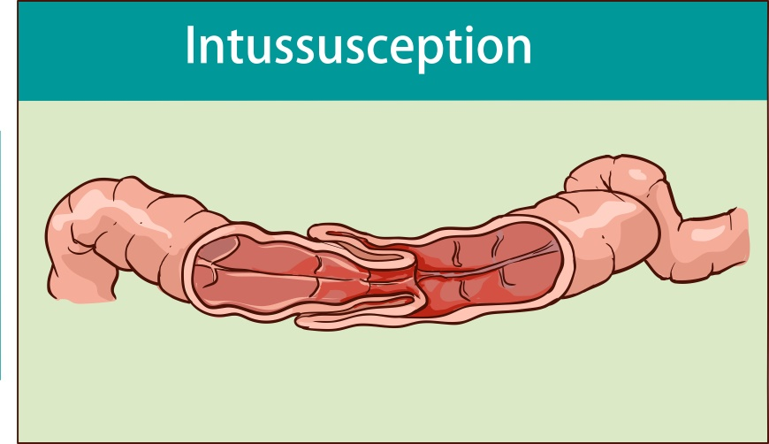
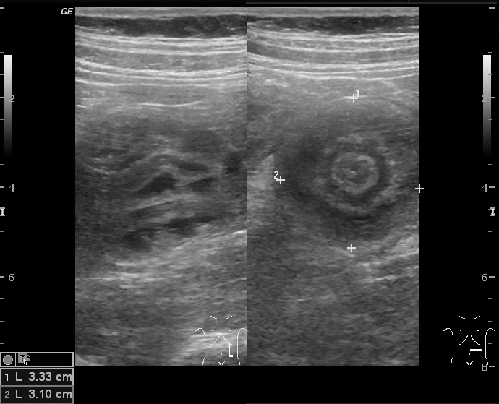
Case Wrap-Up
Diagnosis: Intussusception
© corbac40/Shutterstock
Case courtesy of Dr Maulik S Patel, Radiopaedia.org, rID: 9265
Notes:
Instructor Notes
Intussusception presents between 6 months and 3 years of age and is the most common cause of obstruction among this age group.
Most pediatric patients presenting with intussusception are younger than 2 years old.
75% of cases are idiopathic.
Case wrap-up
At the hospital, the patient was diagnosed by ultrasound.
Nonoperative reduction with pneumatic pressure was used to reduce the intussusception.
Patient was later discharged.

Slide 39
Lesson Wrap-Up
Many medical emergences in pediatric populations can present with AMS.
Patient history is often a key factor in differentiating medical emergencies in the field given limiting testing.
Pain management in pediatric populations can have profound impacts on the patients.
Notes:
Instructor Notes
Many medical emergencies in pediatric populations can present with altered mental status.
Patient history is often a key factor in differentiating medical emergencies in the field given limiting testing.
Pain management in pediatric populations can have profound impacts on the patients.
Coming Up, Lesson 6: Pediatric Cardiac Events.

Slide 40

Questions?
© Nujumuddin Mohamad Yaman/EyeEm/Getty Images
Notes:
Instructor Notes
Allow time for a question-and-answer session about the topics presented in the lesson.

