Slide 1
Fourth Edition
Lesson 4: Pediatric Shock
Notes:
Welcome to Lesson 4: Pediatric Shock.

Slide 2
Lesson Objectives
Review the pathophysiology of each category of shock.
Differentiate between compensated and uncompensated states of shock.
Discuss management of pediatric patients in shock using the Pediatric Assessment Triangle and XABCDE.
Use the most appropriate pediatric shock management intervention based on the patient’s assessment findings.
Notes:
Instructor Notes
Discuss the learning objective and the importance of thoroughly understanding each one.
Review the pathophysiology of each category of shock.
Differentiate between compensated and uncompensated states of shock.
Discuss management of pediatric patients in shock using the Pediatric Assessment Triangle and XABCDE.
Use the most appropriate pediatric shock management intervention based on the patient’s assessment findings.

Slide 3
Shock
Inadequate energy production required to sustain life.
Change from aerobic to anaerobic metabolism.
Cell and organ death.
Shock is progressive.
Notes:
Instructor Notes
Expand on the following points:
One definition of shock is a lack of tissue perfusion at the cellular level, which leads to anaerobic metabolism and a loss of energy production at the level needed to support life.
Shock is most often regarded as a state of generalized cellular function change from aerobic metabolism to anaerobic metabolism secondary to hypoperfusion of the tissue cells, in which the delivery of oxygen at the cellular level is inadequate to meet metabolic needs.
Shock leads to cell and organ death.
Simply put, shock is one of the ways a child’s body may die.
Energy powers all functions in the body.
Cells make energy from oxygen and glucose.
Energy sustains cellular and organ functions.
Energy is stored in the form of adenosine triphosphate (ATP) molecules.
ATP molecules store energy for the cells.
ATP molecules are broken down to release the stored energy when the energy is needed.
Aerobic metabolism results in 36 molecules of ATP from 1 molecule of glucose, while anaerobic metabolism produces only 2 molecules of ATP from 1 molecule of glucose.
Without energy, cellular functions cease.
Shock is progressive and not sudden. The body will attempt to maintain homeostasis through compensatory mechanisms.
The goal is to help ensure that the patient’s body maintains enough energy production to support cellular processes.

Slide 4
Causes of Shock (1 of 2)
Three general causes of shock:
  Loss of fluid volume.
  Impairment of cardiac function.
  Loss of vascular tone.
These can result from traumatic events or a medical cause.
Notes:
Instructor Notes
Expand on the following points:
Worldwide, pediatric shock is one of the most diagnosed conditions and one of the leading causes of pediatric morbidity and mortality, yet it is still poorly understood.
Generally, causes of shock can fall into one of three categories: loss of fluid volume, impairment of cardiac function, or loss of vascular tone.
These can be the result of traumatic events or from a medical cause.

Slide 5
Causes of Shock (2 of 2)
Trauma
Blood loss
Tension pneumothorax
Cardiac tamponade
Spinal cord injury
Medical
Hypovolemia
  Internal bleeding
  Emesis/diarrhea
Sepsis
Anaphylaxis
Heart failure
Dysrhythmia
Drug ingestion
Notes:
Instructor Notes
Discuss possible causes of shock.
Trauma
Loss of volume
Internal/external blood loss
Plasma loss from burns
Impairment of cardiac function
Tension pneumothorax
Cardiac tamponade
Loss of vascular tone
Spinal cord injury
Medical
Loss of volume
Emesis and diarrhea
Osmotic diuresis from diabetes
Internal bleeding
Plasma loss from sepsis or anaphylaxis
Impairment of cardiac function
Heart failure
Dysrhythmia (cardiogenic shock)
Loss of vascular tone
Drug ingestion
Stroke
Even if treated, shock can lead to renal failure, brain damage, liver failure, metabolic derangements, disseminated intravascular coagulation (DIC), multiple organ dysfunction syndrome (MODS), acute respiratory distress syndrome (ARDS), and cardiac failure.

Slide 6
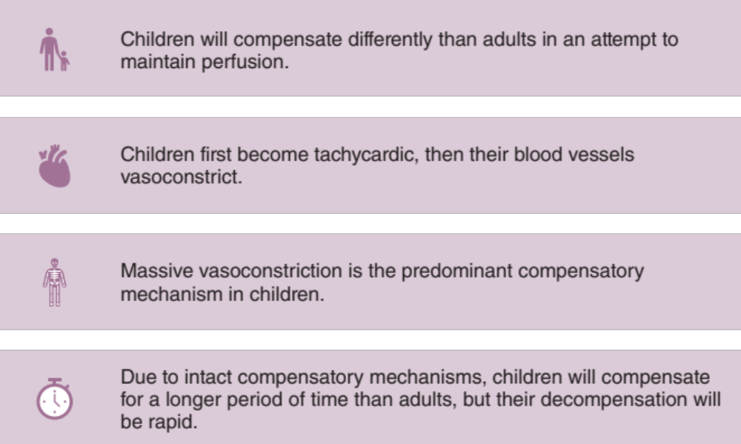
Shock Is Progressive
Notes:
Instructor Notes
Shock is progressive.
The body attempts to keep oxygen perfusion and circulation to its vital areas.
Children will compensate differently than adults in an attempt to maintain perfusion.
Children first become tachycardic, and then their blood vessels vasoconstrict.
Children primarily compensate for the need for increased cardiac output by increasing their heart rate instead of their stroke volume.
They can sustain prolonged high heart rates for hours to days because they have strong heart muscle and good coronary circulation.
Massive vasoconstriction is the predominant compensatory mechanism for children.
Due to intact compensatory mechanisms, children will compensate longer than adults, but their decompensation will be more rapid.

Slide 7
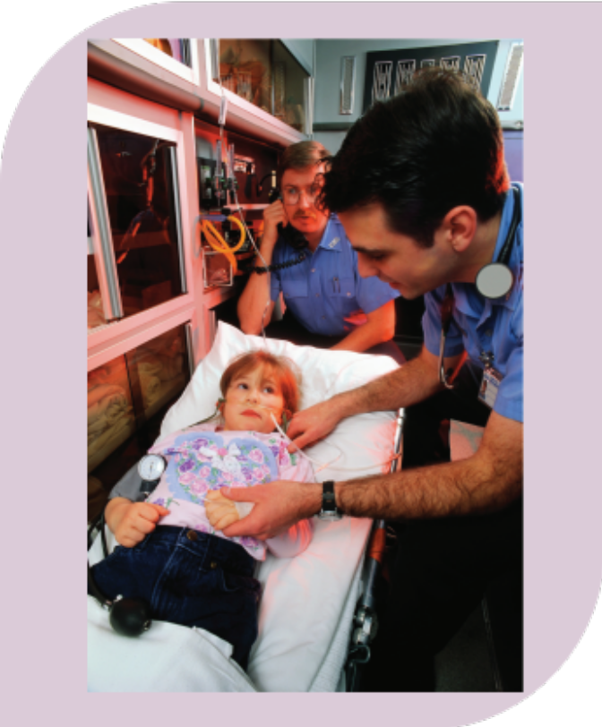
Compensated Shock (1 of 2)
Reversible with prompt recognition and appropriate intervention.
© CORBIS/age fotostock
Notes:
Instructor Notes
Compensated shock is also called early shock.
Inadequate tissue perfusion without end-organ dysfunction (i.e., no hypotension or altered mental status).
During compensated shock, the body is experiencing a state of low volume but is still able to maintain blood pressure and organ perfusion by increasing the heart rate and constricting the blood vessels.
The body’s defense mechanisms attempt to preserve perfusion of the brain, heart, kidneys, and liver at the expense of nonvital organs (e.g., skin, muscles, and gastrointestinal tract).
The last organs to shut down are the lungs and heart.
Early, compensated shock is reversible.
If uncorrected, compensated shock will progress to decompensated shock.

Slide 8
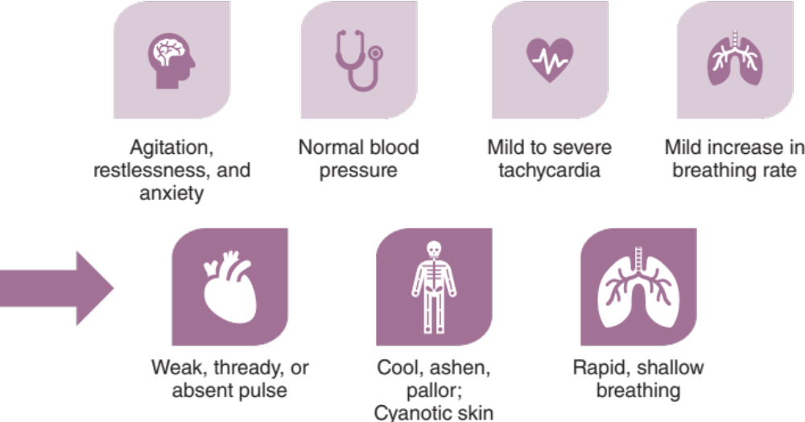
Compensated Shock (2 of 2)
Notes:
Instructor Notes
Discuss the findings of compensated shock.
Neurologic/mental status changes, such as restlessness, irritability, or confusion
Normal systolic blood pressure
Mild to severe tachycardia (unless patient is in cardiogenic shock due to a bradyarrhythmia, or neurogenic shock)
Mild increase in ventilatory rate
Strong central pulses; weak peripheral pulses
Nausea, thirst
Pale mucous membranes
Mild decrease in urine output
There may be a progressive shift toward decompensated shock that can evolve differently in each patient.
There may be some overlap of symptoms.
Peripheral vasoconstriction, a compensatory mechanism that is seen with hypovolemic, cardiogenic, and obstructive shock, is evidenced by cool, pale extremities and decreased capillary refill.
In contrast, peripheral vasodilation is usually present with early distributive shock, resulting in warm, pink extremities with bounding peripheral pulses and brisk capillary refill.

Slide 9

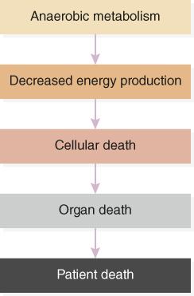
Decompensated Shock (1 of 2)
If uncorrected, compensated shock will progress to decompensated shock.
© cash14/iStock/Getty Images Plus/Getty Image
Notes:
Instructor Notes
Discuss decompensated shock.
Begins when compensatory mechanisms begin to fail.
Classic signs and symptoms of shock are evident because mechanisms previously used to maintain perfusion have become ineffective at maintaining sufficient energy supplies to all organs.
Decompensated shock is difficult to treat, but may be reversible if appropriate, aggressive treatment is begun.
As shock progresses, organs begin to fail. The longer organs remain poorly perfused, the less likely the patient is to respond to normal treatments/interventions. This is called irreversible shock.
Thus, it is critical to recognize and treat shock early.
Discuss the chain of events in decompensated shock.
Hypotension worsens cardiac perfusion, and cardiac dysrhythmias may develop as ventricular irritability increases.
Cell membranes break down and release harmful enzymes.
Acidosis occurs.
Irreversible damage to vital organs occurs because of sustained altered perfusion and metabolism, resulting in multisystem organ failure, cardiopulmonary arrest, and death.
This can progress quickly.
Discuss the cascade of death.
Decreased energy production
Cellular death
Organ death
Patient death

Slide 10
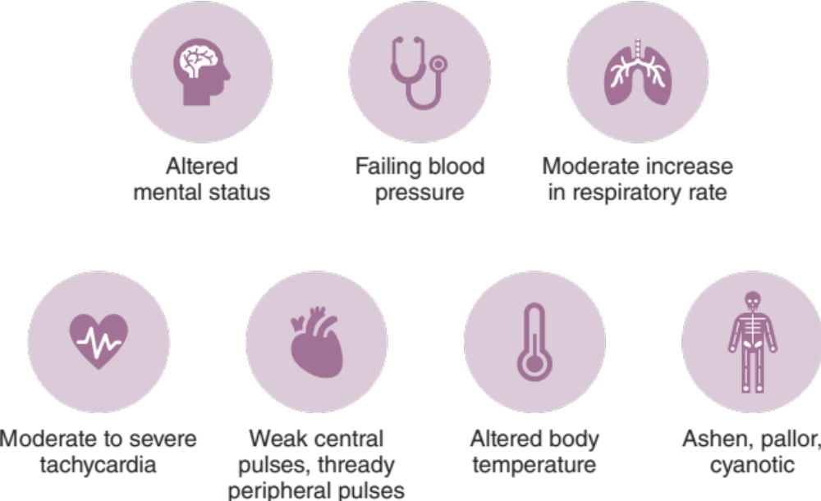
Decompensated Shock (2 of 2)
Notes:
Instructor Notes
Discuss the findings often associated with decompensated shock.
Altered mental status, such as agitation, lethargy, or unresponsiveness
Fall in systolic and diastolic blood pressures
Moderate increase in ventilatory rate; possible respiratory muscle fatigue or failure
Moderate to severe tachycardia; possible dysrhythmias
Weak central pulses; thready peripheral pulses
Delayed capillary refill
Pale, ashy, or cyanotic mucous membranes
Altered body temperature
Marked decrease in urine output

Slide 11
Types of Shock
Hypovolemic (most common)
Distributive
Cardiogenic
Obstructive
Notes:
Instructor Notes
Adequate perfusion depends on a working pump (heart), adequate fluid (blood), and an adequately sized and intact container (blood vessels).
These three have a mutual relationship with each other, and each one must be functioning adequately for the other two to work in order to produce adequate cardiac output.
Of course, failure of one will eventually lead to failure of another, and then another, until there is complete failure and eventually death.
Shock can be generally categorized as a result of loss of fluid volume, impairment of cardiac function, or loss of vascular tone.
Cardiogenic shock is be caused by a failure of the heart to function normally.
Hypovolemic shock is caused by loss of fluid volume.
Distributive shock is caused by loss of vascular integrity.
Obstructive shock is caused by obstruction of the great vessels or heart, and, ideally, is included with cardiogenic shock.
Hypovolemic shock is the most common type of shock in the pediatric population and is the leading cause of death from shock within the pediatric population worldwide.

Slide 12
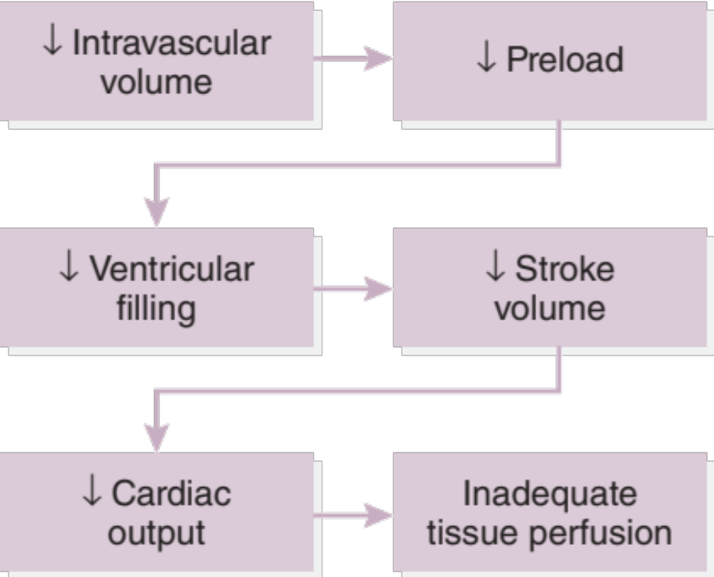
Hypovolemic Shock
Results from inadequate circulating blood volume.
Used with permission from Rnpedia
Notes:
Instructor Notes
Expand on the following points:
Hypovolemia is the most common cause of shock in infants and children worldwide.
Hypovolemic shock is the result of inadequate circulating blood volume in the vascular space.
Possible causes include hemorrhage, plasma loss, fluid and electrolyte loss, and endocrine disease.
Physiology: ↓ intravascular volume → ↓ preload → ↓ ventricular filling → ↓ stroke volume → ↓ cardiac output → inadequate tissue perfusion

Slide 13
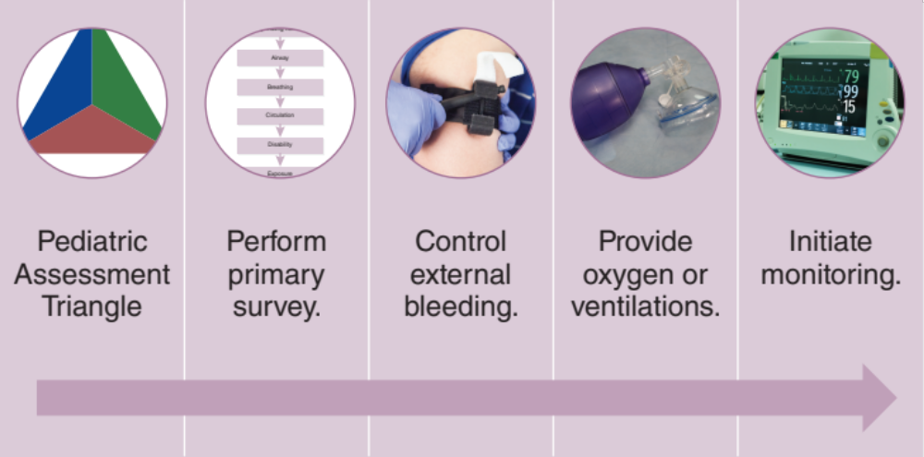
Hypovolemic Shock Treatment (1 of 2)
Used with permission of the American Academy of Pediatrics, Pediatric Education for Prehospital Professionals, © American Academy of Pediatrics, 2000
© Jones and Bartlett Publishers. Courtesy of MIEMSS.
© bymuratdeniz/E+/Getty Images
Notes:
Instructor Notes
Obtain an initial observation using the PAT.
Perform an initial assessment.
Obtain a focused history as soon as possible from the parent or caregiver to assist in identifying the type of shock.
Control external bleeding, if present.
If ventilation is adequate, give supplemental oxygen in a manner that does not agitate the child. Supplemental oxygen is important to maximize oxygen-carrying capacity in the setting of decreased hemoglobin (red blood cells).
If signs of respiratory failure or respiratory arrest are present, assist ventilation using a bag-mask device with supplemental oxygen and basic airway adjuncts.
Intubation may NOT be required.
Initiate pulse oximetry, cardiac monitoring, and blood pressure monitoring, to include ETCO2.

Slide 14
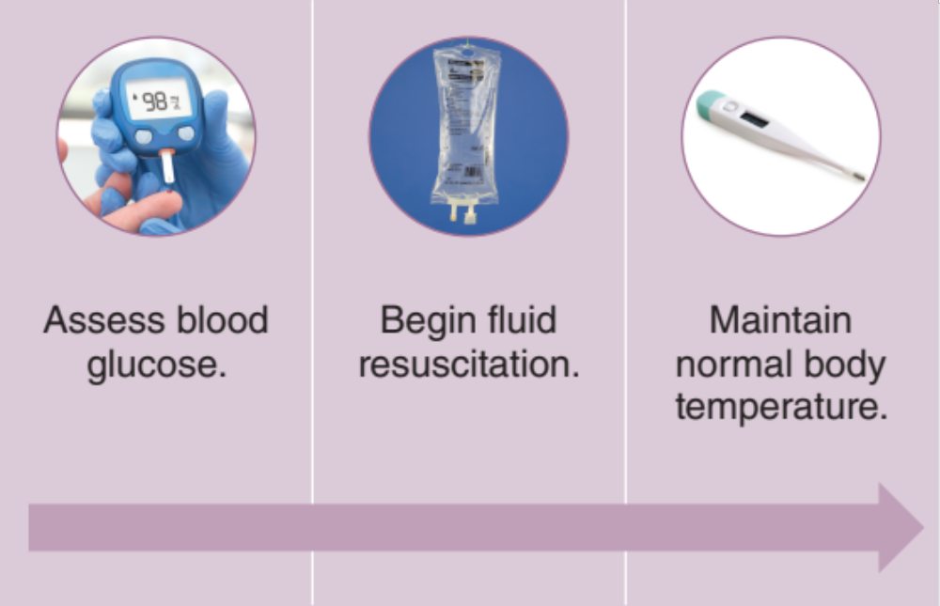
Hypovolemic Shock Treatment (2 of 2)
© simpson33/iStock/Getty Images Plus/Getty Images
© Creativeye99/iStock/Getty Images Plus/Getty Images
Notes:
Instructor Notes
Check the glucose level.
Some children in shock are hypoglycemic because of rapidly depleted carbohydrate stores.
If the serum glucose is below 60 mg/dL, administer dextrose IV or IO.
Obtain vascular access.
When shock is present, the most readily available vascular access site is preferred.
If immediate vascular access is needed and reliable IV access cannot be rapidly achieved, early IO access is appropriate.
After vascular access has been obtained, begin fluid resuscitation when indicated.
Administration of an initial 20 mL/kg fluid bolus of an isotonic crystalloid solution, such as normal saline (NS) or lactated Ringer’s (LR), is reasonable.
An IV tubing system that incorporates an in-line three-way stopcock (push-pull method) is often useful for rapid fluid administration.
After each fluid bolus, reassess the child’s mental status, HR, blood pressure, capillary refill, peripheral perfusion, and urine output.
Assess the child’s response after each bolus.
Monitor closely for increased work of breathing and signs and symptoms of volume overload.
In the setting of hemorrhagic shock in children, alternative management is preferred over fluid hydration when possible, including tourniquets, TXA, and in some systems, blood products. However, in the setting of hypotension, fluids should not be withheld if no other treatment proves effective or is available.
Maintain normal body temperature.

Slide 15
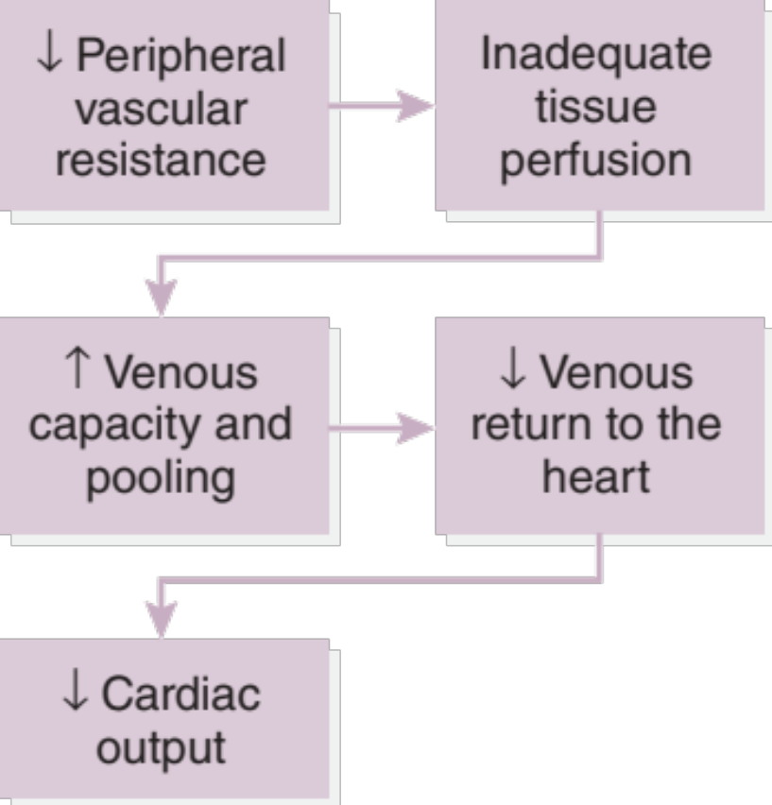
Distributive Shock
Results from an abnormality in vascular tone.
Cases of septic shock in children are on the rise.
© Jonathan ORourke/Alamy Stock Photo.
Notes:
Instructor Notes
Distributive shock results from an abnormality in vascular tone.
A relative hypovolemia occurs when vasodilation increases the size of the vascular space and the available blood volume must fill a greater space.
This results in an altered distribution of the blood volume (relative hypovolemia) rather than actual volume loss (absolute hypovolemia).
This process is true of so-called warm shock but is more common in adults than in children. Children tend to vasoconstrict early on, resulting in cold poorly perfused distal extremities (cold shock). The concern in pediatric patients is third spacing of fluids; that is, blood vessels become leaky due to increased inflammation.
Physiology: ↓ peripheral vascular resistance → inadequate tissue perfusion → ↑ venous capacity and pooling → ↓ venous return to the heart → ↓ cardiac output
Three types of distributive shock: septic shock, anaphylactic shock, and neurogenic shock.
Septic shock is caused by severe infection, specifically the severe inflammatory response to the infection.
Cases of septic shock in children are on the rise.
Incidence of septic shock ranges from 1% to 26% of hospitalized pediatric patients.
Mortality in pediatrics from septic shock ranges from 5% to 35%.
Studies attribute the high mortality rate to incorrect diagnosis, delayed treatment, and not following treatment guidelines.
Anaphylactic shock is the result of a severe allergic reaction.
Anaphylaxis is a severe allergic reaction to a chemical that has become an allergen that happens quickly after the exposure.
Anaphylaxis is defined as impacting two or more body systems (e.g., skin and gastrointestinal tract), but as many as 10% of cases can present with hypotension only.
Neurogenic shock is caused by central nervous system injury—specifically, spinal cord injury that prevents messaging from the brain (in the form of epinephrine) from reaching other organs in the body, including the heart and blood vessels.

Slide 16
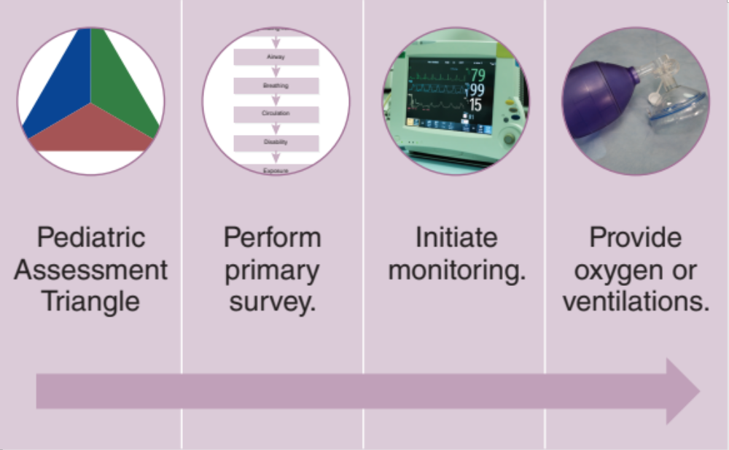
Distributive Shock Treatment (1 of 2)
Used with permission of the American Academy of Pediatrics, Pediatric Education for Prehospital Professionals, © American Academy of Pediatrics, 2000
© bymuratdeniz/E+/Getty Images
© Jones and Bartlett Publishers. Courtesy of MIEMSS.
Notes:
Instructor Notes
Obtain an initial observation using the PAT.
Perform initial and primary assessments.
Obtain a focused history as soon as possible from the parent or caregiver to assist in identifying the type of shock.
Recognize signs and symptoms of shock.
Initiate pulse oximetry, cardiac monitoring, and blood pressure monitoring, to include ETCO₂.
Low ETCO₂ in septic shock is indicative of increased lactate levels and severity of infection.
If ventilation is adequate, give supplemental oxygen in a manner that does not agitate the child.
If signs of respiratory failure or respiratory arrest are present, assist ventilation using a bag-mask device with supplemental oxygen and basic airway adjuncts.
Do not delay transport.
Intubation and mechanical ventilation may be required in rare cases.
These should be considered in cases of prolonged transport times (consult with medical director).
RSI or med-facilitated intubation should be used with caution as induction agents, especially etomidate, may precipitate cardiac arrest in pediatric patients in septic shock.
Etomidate is contraindicated in septic shock because it may suppress the stress response, making the body less capable of developing an appropriate inflammatory response. However, it does not directly cause cardiac arrest. Intubation in the setting of hypotension, hypoxia and acidosis (i.e., any uncorrected shock state) is exceptionally dangerous as during intubation attempts the body is further stressed and more likely to go into cardiopulmonary failure.

Slide 17
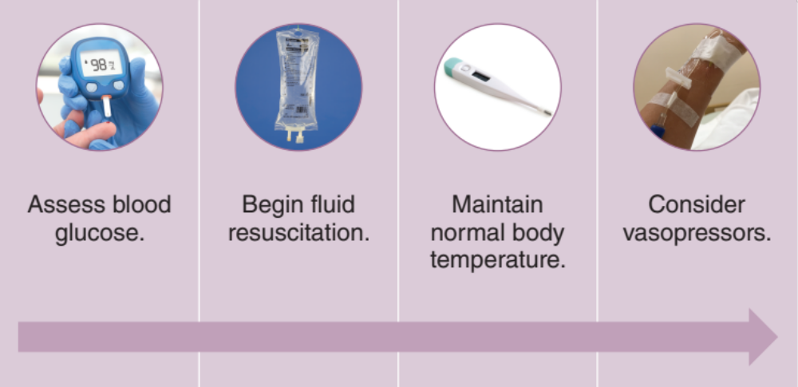
Distributive Shock Treatment (2 of 2)
© simpson33/iStock/Getty Images Plus/Getty Images
© Creativeye99/iStock/Getty Images Plus/Getty Images
© natnaree sangkaew/Shutterstock
Notes:
Instructor Notes
Check the glucose level. Some children in septic shock are hypoglycemic because of rapidly depleted carbohydrate stores.
If the serum glucose is below 60 mg/dL, administer dextrose IV or IO (prefer D10 over D25).
Obtain vascular access.
If immediate vascular access is needed and reliable IV access cannot be rapidly achieved, early IO access is appropriate.
After vascular access has been obtained, begin fluid resuscitation.
Administration of an initial 20 mL/kg fluid bolus of an isotonic crystalloid solution, such as normal saline (NS) or lactated Ringer’s (LR), is reasonable.
An IV tubing system that incorporates an in-line three-way stopcock (push-pull method) is often useful for rapid fluid administration.
After each fluid bolus, reassess the child’s mental status, HR, blood pressure, capillary refill, peripheral perfusion, and urine output.
Assess the child’s response after each bolus.
Monitor closely for increased work of breathing and signs and symptoms of volume overload.
Maintain normal body temperature.
In some agencies, vasopressors (e.g., dopamine, norepinephrine, epinephrine) may be considered only if shock remains refractory after 60 mL/kg of volume resuscitation.

Slide 18
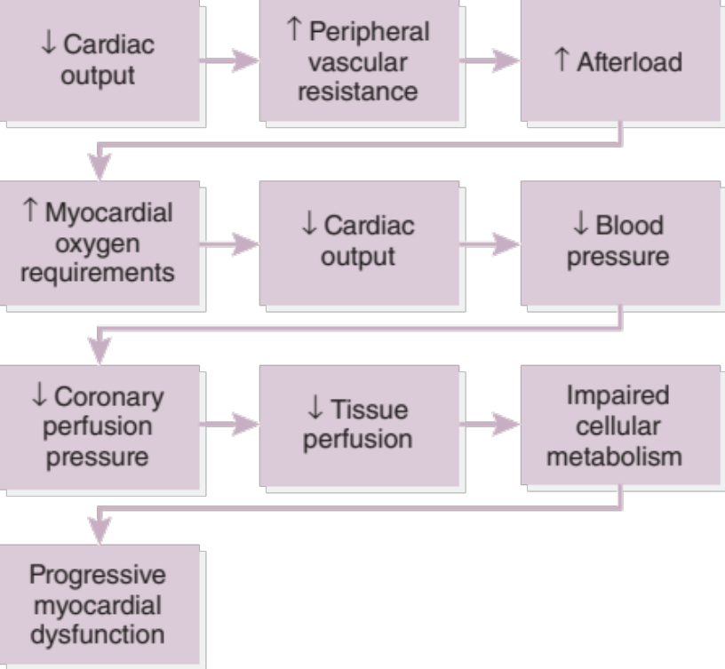
Cardiogenic Shock (1 of 2)
Results from impaired cardiac muscle function that leads to decreased cardiac output.
Many potential causes.
Notes:
Instructor Notes
Cardiogenic shock results from heart failure due to poor contraction, inadequate rate, or rhythm, leading to decreased cardiac output and inadequate tissue perfusion.
May resemble hypovolemic shock.
Physiology: ↓ cardiac output → ↑ peripheral vascular resistance → ↑ afterload → ↑ myocardial oxygen requirements → ↓ cardiac output → ↓ blood pressure → ↓ coronary perfusion pressure → ↓ tissue perfusion → impaired cellular metabolism → progressive myocardial dysfunction
Potential causes:
Cardiogenic shock may result from redirected blood flow caused by dysrhythmias that cause insufficient cardiac output.
Corrected congenital heart diseases may cause arrhythmias due to the surgery disrupting conduction.
Decreased myocardial contractility might be caused by anomalous coronary arteries, leading to myocardial infarctions. Further, genetic syndromes such as Duchenne muscular dystrophy could cause poor myocardial contractility.
Inflammatory disorders.
Obstructive shock: Valve obstruction (e.g., aortic stenosis) or other obstruction such as hypertrophic obstructive cardiomyopathy.
Other conditions (e.g., acute and chronic drug toxicity, acute valvular regurgitation, ischemic heart disease, myocardial injury, pheochromocytoma, and thyrotoxicosis).

Slide 19
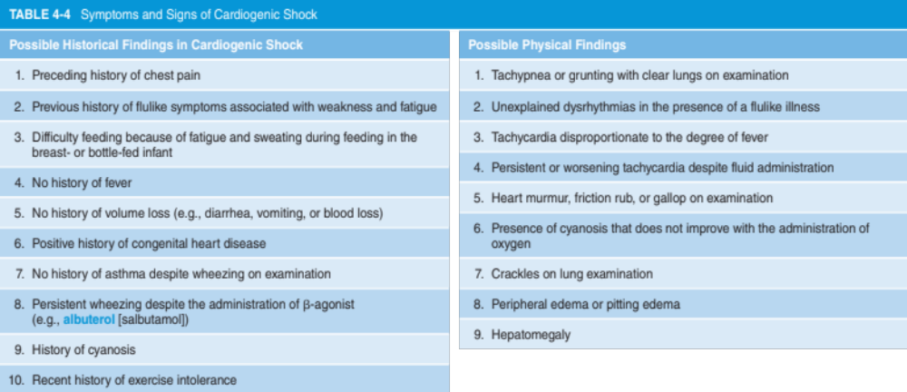
Cardiogenic Shock (2 of 2)
Used with permission of the American Academy of Pediatrics, Pediatric Education for Prehospital Professionals, © American Academy of Pediatrics, 2000
Notes:
Instructor Notes
Cardiogenic shock is not as rare as providers may think it is.
It may be a complication of viral illness (e.g., viral myocarditis) or ingested medications.
It could also result from anatomic causes (aberrant coronary arteries or other structural anomalies).
Dysrhythmias can be a cause, including SVT.
Clinical signs of decompensation may be similar across all types of shock, which speaks to the emphasis on patient history to understand the type of shock the patient may be experiencing.
Discuss historical findings found in the chart.
Discuss physical findings found in the chart.
The older child may begin to report cardiac-specific symptoms such as chest pain.
Caregivers may also report that the child may have ingested some medications.
It is vitally important to determine what type of medication was ingested and how much, as certain cardiac medications, like calcium channel blockers or beta blockers, could result in cardiogenic shock even in low doses.

Slide 20
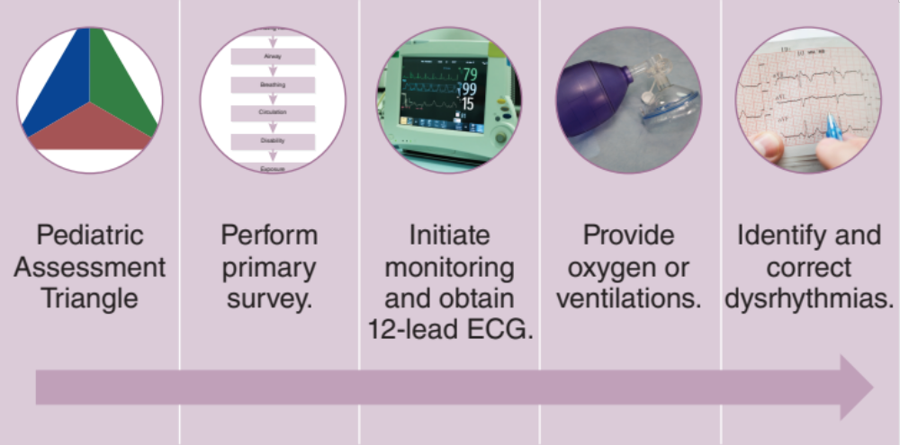
Cardiogenic Shock Treatment (1 of 2)
Used with permission of the American Academy of Pediatrics, Pediatric Education for Prehospital Professionals, © American Academy of Pediatrics, 2000
© bymuratdeniz/E+/Getty Images
© Jones and Bartlett Publishers. Courtesy of MIEMSS.
© diy13/Shutterstock
Notes:
Instructor Notes
Obtain an initial observation using the PAT.
Perform an initial assessment.
Obtain a focused history as soon as possible from the parent or caregiver to assist in identifying the type of shock.
Focus on reducing myocardial oxygen demand, improving preload, reducing afterload, improving contractility, and correcting dysrhythmias.
It is important to obtain a 12-lead ECG.
If ventilation is adequate, give supplemental oxygen in a manner that does not agitate the child.
If breathing is inadequate, ventilate using a bag-mask device with supplemental oxygen.
Use basic airways in cases of respiratory arrest.
Identify and correct any dysrhythmias.

Slide 21
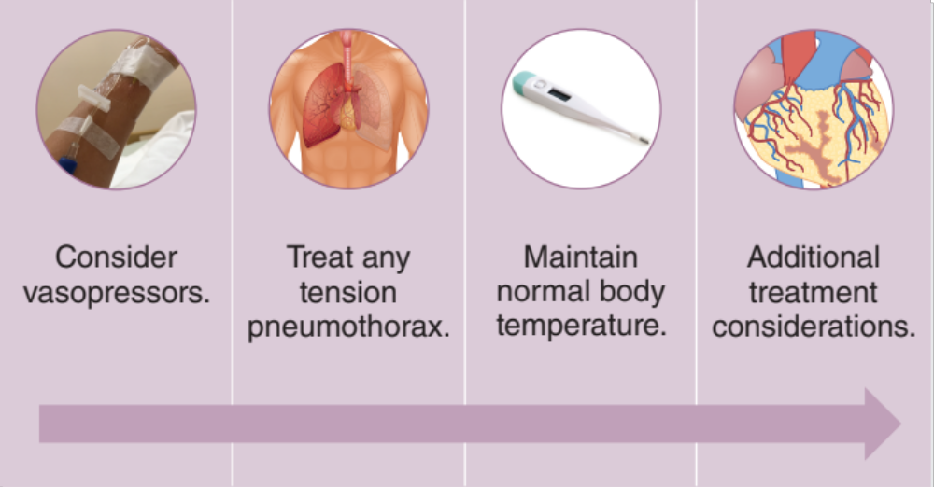
Cardiogenic Shock Treatment (2 of 2)
© natnaree sangkaew/Shutterstock
© BlueRingMedia/Shutterstock
© Creativeye99/iStock/Getty Images Plus/Getty Images
Notes:
Instructor Notes
Obtain vascular access.
If indicated, preload may be optimized with administration of a small fluid bolus (5 to 10 mL/kg) given over 10 to 20 minutes accompanied by careful monitoring of mental status, lung sounds, work of breathing, and signs of volume overload.
Consider tension pneumothorax if trauma is suspected.
In some instances, spontaneous pneumothorax may be a nontraumatic cause.
Maintain normal body temperature.
Additional treatment considerations:
Consider PEEP if or when tolerated to decrease afterload by facilitating myocardial contraction.
The patient who has significant hypotension and is unresponsive to fluid resuscitation or who becomes volume overloaded may require vasopressors to increase blood pressure.
Consider norepinephrine as a vasopressor as it increases SVR and BP, increases HR and cardiac output, and protects blood flow to organs.
Obtain a focused assessment with sonography for trauma (FAST) examination (i.e., point-of-care-ultrasound [POCUS]), if the equipment is available and bleeding is suspected in the chest, abdomen, or pelvis.
Do not delay transport to perform POCUS.
Refractory cardiogenic shock may require mechanical support with extracorporeal membrane oxygenation (ECMO) or a ventricular assist device (VAD).
Participant engagement:
Discuss the similarities and differences in treatment among all types of shock.

Slide 22
Case Study
Dispatch
  It is 0900 hours on a fall morning. You are responding to a 5-year-old male for a "sick child" at an apartment complex. Outside temperature is 52°F (11°C).
Notes:
Instructor Notes
For students other than prehospital practitioners, dispatch information can be modified.
Present the following scenario:
Case 1 involves a 5-year-old male with flulike symptoms.
What are your initial concerns and possible differential diagnosis from the dispatch information?
Discuss the importance of scene assessment and awareness.
Expand on how it applies to this case.
Diagnosis: influenza-B, strep throat, sepsis.

Slide 23
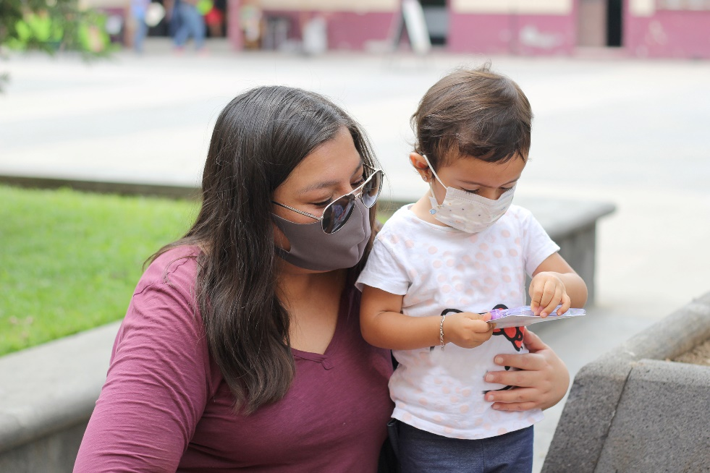
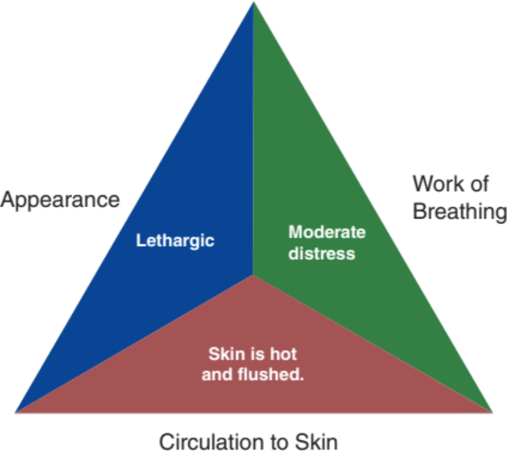
Initial Observations
© Arlette Lopez/Shutterstock
Used with permission of the American Academy of Pediatrics, Pediatric Education for Prehospital Professionals, © American Academy of Pediatrics, 2000
Notes:
Instructor Notes
Discuss the following initial findings at the scene and PAT findings.
The parent is waiting for you outside the door in the stairwell, holding the child in her arms. The child is wearing a face mask.
PAT
Appearance: Lethargic.
Work of breathing: Moderate distress.
Circulation: Skin is hot and flushed.
Parent states that the child has “not been feeling well” for the last 3 days.
Began with diarrhea, then vomiting. Child has felt “hot.”
Child would not get out of bed this morning.
Discuss additional precautions or concerns that may be warranted based on initial observations.
Discuss PPE options and availability at your agency, as well as the importance of precautions.
Appropriate PPE should be worn until the need is ruled out.
Initial impression begins when the dispatch information is received. However, in this case, you are provided with limited dispatch information and must delay your initial impression until further information is obtained.
Initial concerns
Child with fever, COVID-19 symptoms, flulike symptoms?
Differential diagnosis:
COVID-19
Influenza
Dehydration
Sepsis
Viral myocarditis (although less likely as patient is vasodilated)

Slide 24
Discussion
Is this patient “Quick” or “Not Quick”?
Have you identified possible red flags?
Have you identified possible shock?
Notes:
Instructor Notes
Is this patient “Quick” or “Not Quick”?
The patient is “Quick.”
Expand on how and why this determination was made.
Have you identified any possible red flags?
Lethargy
Hot, flushed skin
Have you identified possible shock?
Is it compensated or decompensated shock?
This patient is in late compensated shock.
Expand on how and why this determination was made.

Slide 25
Septic Shock
Warm Shock
Warm extremities
Bounding pulses
Tachycardia
Cold Shock
Cold, clammy skin
Rapid breathing, hypoxia
Rapid, weak pulse
Notes:
Instructor Notes
For the purpose of this presentation, the focus will be on septic shock.
Septic shock can be quite deceiving, especially in the early stages.
Septic shock occurs in two clinical stages:
The early phase (warm shock) is characterized by peripheral vasodilation and increased cardiac output.
In the next phase (cold shock), the inflammatory response causes cardiac output to fall, increased peripheral vascular constriction, and decreased cardiac output.
Late septic shock is usually indistinguishable from other types of shock.
Because of these two stages, providers should not use the presence or absence of fever to diagnose septic shock.

Slide 26
Septic Shock: Signs and Symptoms
Confusion/altered mental status
Difficulty breathing
Difficulty waking from sleep
Fever
Irritability
Restlessness
Lethargy
Tachycardia
Skin color changes
Notes:
Instructor Notes
There are numerous mnemonics that exist for remembering the signs/symptoms of septic shock.
Consider using any resource that can assist you as a provider.
Signs/symptoms can include:
Confusion/altered mental status
Difficulty breathing
Difficulty waking from sleep
Fever
Irritability
Restlessness
Lethargy
Tachycardia
Skin color changes

Slide 27
Septic Shock: Treatment
Stabilize.
Obtain ETCO₂.
Establish immediate vascular access.
Provide fluid resuscitation.
Consider vasopressors.
Notes:
Instructor Notes
Treatment of the child in septic shock is more about stabilization than treatment.
ETCO₂ is a reliable indicator of progression of sepsis.
The lower the number, the higher the lactate level.
An IV or IO line should be established immediately, followed by fluid resuscitation and reassessment.
Two additional fluid boluses should be given if there are no signs of improvement, for a total of 60 mL/kg.
If the child is hypoglycemic, then 10% dextrose should be given.
Vasopressors, such as dopamine, epinephrine, or norepinephrine may be indicated for fluid-refractory shock.
Discuss pressor options.
Norepinephrine is recommended for warm shock with a low blood pressure.
Dopamine is not recommended for children in septic shock, because it was associated with increased risk of death and infection. (Source: Ventura, A. M. C. et al. double-blind prospective randomized controlled trial of dopamine versus epinephrine as first-line vasoactive drugs in pediatric septic shock. Critical Care Medicine. 2015;43(11):2292–2302)
Epinephrine is recommended for cold shock with a low blood pressure.

Slide 28
Primary Survey
    Primary survey
  X ‒ No bleeding found.
  A ‒ Open, upper congestion heard.
  B – Moderate distress with rapid rise and fall of chest. Lung sounds reveal congestion bilaterally.
  C ‒ Brachial pulses are rapid, weak, and regular. Capillary refill time is delayed. Skin is hot and flushed.
  D – Lethargic; GCS = 13 (E3, V4, M6).
  E – Sitting in parent’s arms.
Notes:
Instructor Notes
Discuss the primary survey.
Note that the PAT is completed prior to the primary survey (XABCDE approach).
Ask participants to explain any abnormal findings of the patient, whether physically and/or developmentally, and why.
Discuss any life threats identified in this case.
There are life threats: Weak peripheral pulses and decreased mental status.
Primary survey
X - No bleeding found.
A - Open, upper congestion heard.
B – Moderate distress with rapid rise and fall of chest. Lung sounds reveal congestion bilaterally.
C - Brachial pulses are rapid, weak, and regular. Capillary refill time is delayed. Skin is hot and flushed.
D – Lethargic; GCS = 13 (E3, V4, M6).
E – Sitting in parent’s arms.
What would your initial treatment be?
Discuss treatment options per local guidelines and policy.
Treatment should be focused on improving cardiac output and reducing possible fever.
Participant engagement:
Remind participants that recognizing and managing hypovolemic shock in pediatrics is of upmost importance.
Remind participants that aggressive IV/IO fluid therapy might not be required if the patient can drink fluids.

Slide 29
Detailed Assessment
History taking
  O – Gradual
  P – None
  Q – None
  R – None
  S – Unknown
  T – 3 days
Notes:
Instructor Notes
Review history taking using the OPQRST mnemonic.
O – Gradual
P – None
Q – None
R – None
S – Unknown
T – 3 days
Participant engagement:
Discuss the importance of continuously reevaluating pediatric mental status.
Expand on additional measures that may be used to maintain normal body temperature.
Warm clothing, warm patient compartment, warm fluids.
Expand on measures to improve cardiac output.
Provide fluids.
Consider vasopressors if needed.

Slide 30
Detailed Assessment
History taking
  S ‒ Loss of appetite, diarrhea, vomiting, subjective fever, congestion.
  A ‒ No known allergies.
  M ‒ Tylenol last night.
  P ‒ RSV, strep throat.
  L ‒ Has not eaten or drank today; had a popsicle last night.
  E ‒ Has gotten worse over the last 3 days. Physician advised to call EMS.
  R ‒ History of RSV, strep throat, age, delayed capillary refill.
Notes:
Instructor Notes
Review history taking using SAMPLER.
S – Loss of appetite, diarrhea, vomiting, subjective fever, congestion.
A – No known allergies.
M – Tylenol last night.
P – RSV, strep throat.
L – Has not eaten or drank today; had a popsicle last night.
E – Has gotten worse over the last 3 days. Physician advised to call EMS if breathing got worse.
R –History of RSV, age, delayed capillary refill.

Slide 31
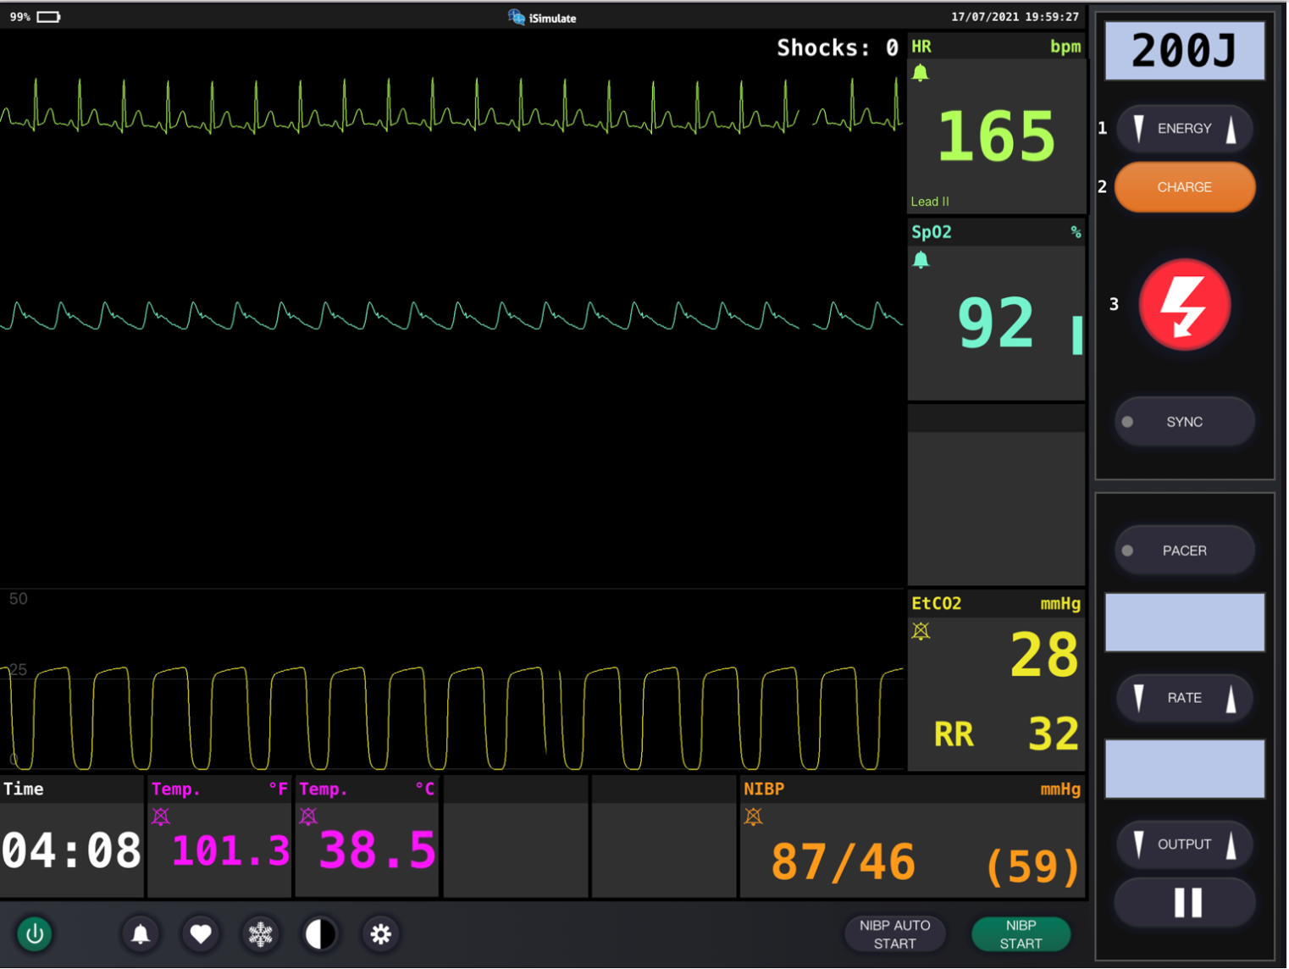
Vital Signs
Notes:
Instructor Notes
Discuss what the vital signs tell us about the patient.
SpO₂: 92% on room air.
Is oxygen needed?
Yes. Oxygen is needed to maximize delivery of oxygen to tissues at the cellular level (i.e., energy).
ETCO₂ is 28.
Discuss the reason for low ETCO₂.
In sepsis, as lactate levels rise, carbon dioxide levels fall.
Respiratory rate is 32.
Discuss the reason for increased rate.
Blood pressure is 87/46 mm Hg.
Blood glucose is 167 mg/dL (9.3 mmol/L)
Weight is 18 kg.
ECG shows sinus tachycardia.
Diagnostics indicate sepsis, hypovolemia, and fever.
Participant engagement:
Discuss the expected typical vital signs for age.
Expand on initial measures that may be used to cool the patient.
Removing clothing or no skin-to-skin contact.

Slide 32
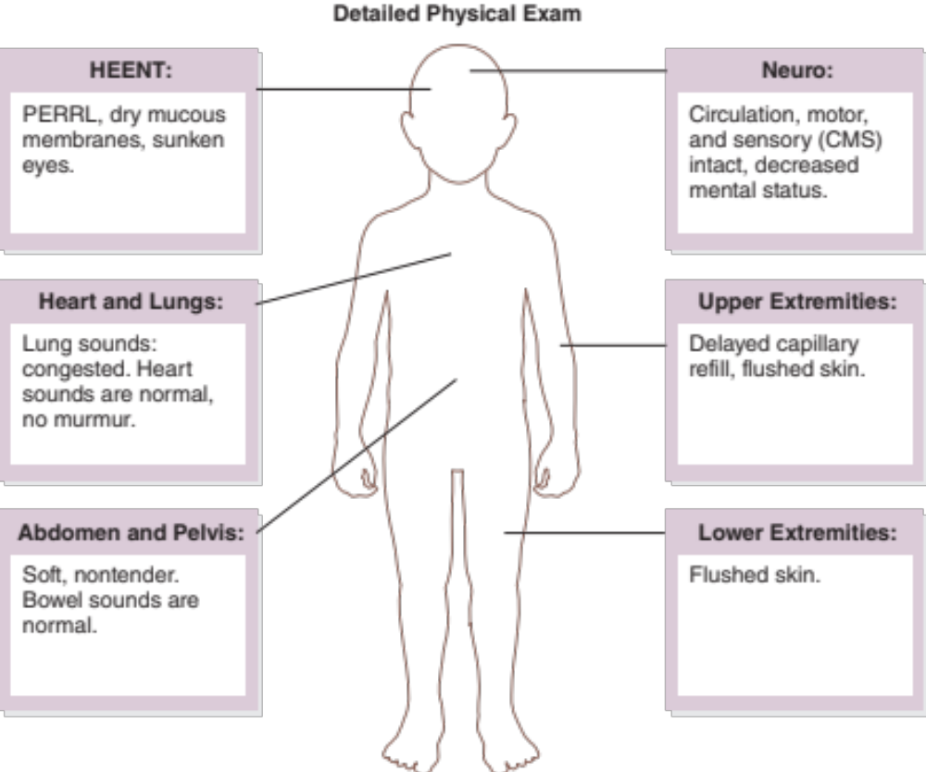
Detailed Assessment
Notes:
Instructor Notes
*Ask participants: Given the age of this child, would you perform a head-to-toe or toe-to-head assessment?
HEENT
Head: Dry mucous membranes
Eyes: PERRL, sunken eyes
Ears: Unremarkable
Nose: Dried mucus
Throat: Unremarkable
Heart and lungs
Lung sounds, Congested bilaterally. Heart sounds are normal, no murmur. Respirations rapid with good rise and fall.
Neuro
Circulation, motor, and sensory (CMS) intact, decreased mental status.
Abdomen and pelvis
Soft, nontender. Bowel sounds are normal.
Upper extremities
Delayed capillary refill, flushed skin
Lower extremities
Flushed skin

Slide 33
Treatment
BLS
  Monitor airway
  Consider oxygen
  Antipyretics
  Obtain glucose level
  Position of comfort
ALS
  BLS care
  Antipyretics
  Fluid bolus(es) via IV/IO
Critical care
  BLS/ALS care
  Initiate vasopressors
Notes:
Instructor Notes
Ask students how they would treat this patient according to their local protocol and scope of practice.
Patient management: (STRESS that less is more!)
What are your goals for this patient?
The patient should be treated with supportive care.
Be prepared for rapid deterioration.
Promptly identify decompensated shock in patients who require escalation of therapy.
Deliver appropriate therapy by differentiating other causes of pediatric altered mental status.
What conditions are part of your potential differential diagnosis?
Juvenile onset diabetes
Influenza
Strep throat
COVID-19
Hydrocarbon aspiration
Sepsis
Status asthmaticus

Slide 34
Ongoing Management
Reassess the patient.
What is the most appropriate treatment destination and why?
Should the facility be alerted to possible sepsis?
Can you safely transport this child in your ambulance?
Will you allow the parent to ride in the ambulance?
What PPE would be appropriate?
Notes:
Instructor Notes
Discuss ongoing management options based on scope of practice and local protocols.
Present the following additional points:
Fluid administration of 20 mL/kg. (17.5 kg based on age = 350 mL)
The patient is reassessed for volume overload.
The patient is continuously monitored during transport.
Blood pressure rises to 96/67 with decreasing heart rate to 134. Respiratory rate decreases to 28 with ETCO₂ of 30.
There are no further changes during transport to the emergency department.
Patient should be reassessed every 5 minutes if critical, every 15 minutes if not.
What is the most appropriate treatment destination and why?
Discuss the destination options for pediatrics in your region that would be suitable for this patient.
Share with students when and if it would be appropriate to bypass certain facilities for this patient.
Important participant discussion: Not all emergency departments maintain a foundational infrastructure to meet the needs of children (i.e., "pediatric readiness“), but all can and should. Efforts should be taken to understand the pediatric capabilities of possible destination facilities to ensure the ED is ready to meet the needs of pediatric patients. This may not be the closest facility.
A children's hospital may not be required for this patient, although he is quite sick.
How would you safely transport this child in your ambulance?
Discuss policies and procedures for transporting pediatrics in your region.
Will you allow parent to ride in the ambulance?
Family-centered care is a priority, so we recommend allowing one parent to ride in the ambulance with the EMS crew if safety allows.
We encourage EMS to include this family member in the care of their child as a member of the care team.
The parent rode with EMS crew and was restrained to the bench seat.
What PPE would be appropriate for flulike Illness? Possible COVID-19?
Appropriate PPE of surgical mask, eye shields, and gloves for flulike illness.
Appropriate PPE of N95 mask, eye shields, gloves, and gown for COVID-19.

Slide 35

Case Wrap-Up
Diagnosis: Influenza B with associated compensated shock and early sepsis.
© nekoztudio/Shutterstock
Notes:
Instructor Notes
An estimated 10% to 20% of the U.S. population contracts influenza each year.
Influenza is a viral infection of the upper respiratory system, which includes the nose, bronchial tubes, and lungs.
Influenza types A and B are responsible for epidemics of respiratory illness that occur almost every winter and are often associated with increased rates of hospitalization and death.
Efforts to control the impact of influenza are focused on types A and B.
One of the reasons the flu remains a problem is because the viruses alter their structure, exposing adults and children to new types of the virus each time.
CDC estimates that since 2010, flu-related hospitalizations among children younger than 5 years old have ranged from 7,000 to 26,000 in the U.S.
CDC reported 170 pediatric deaths during the 2019-2020 flu season.
Case Wrap-Up:
At the hospital, a swab indicated influenza B, with strep throat.
Fluid boluses were continued.
The child had not received a flu vaccine this season.
He was discharged with a full recovery after spending 1 week in the hospital.

Slide 36
Lesson Wrap-Up
Differentiating compensated from decompensated shock is critical.
Perfusion status and pulse quality are key indicators of shock.
Assessment is crucial in determining the type of shock, because the different types require different treatment.
Notes:
Instructor Notes
Prehospital providers need to have a high index of suspicion of shock due to history and mechanism of injury.
Early recognition and rapid intervention are the key in treating shock and preventing the patient from becoming decompensated.
Assessment of pulse quality and perfusion status are key indicators of shock.
Compensated shock is characterized by poor perfusion with a normal BP.
Decompensated shock is characterized by low BP.
Treat any airway and breathing issues immediately.
They should always be the first step in sepsis.
Obtain vascular access if shock treatment is needed.
Deliver crystalloid fluids for fluid resuscitation at a rate of 20 mL/kg. SOMETIMES THAT’S ALL THEY NEED!
The medication route is dependent on the child’s condition and medication to be used.
Coming Up, Lesson 5: Pediatric Medical Emergencies.

Slide 37

Questions?
© Nujumuddin Mohamad Yaman/EyeEm/Getty Images
Notes:
Instructor Notes
Allow time for a question-and-answer session about the topics presented in the lesson.

